Slide 1
Devon Primary Care
Digital Innovation Conference
2025

Slide 2
Workshop A
Making the Most of SystmOne Reporting and Data Visualisation Tools

Slide 3
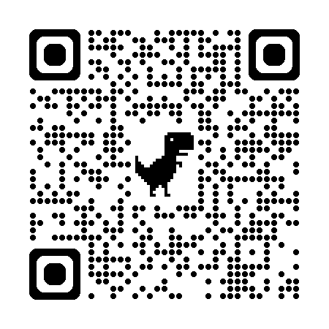
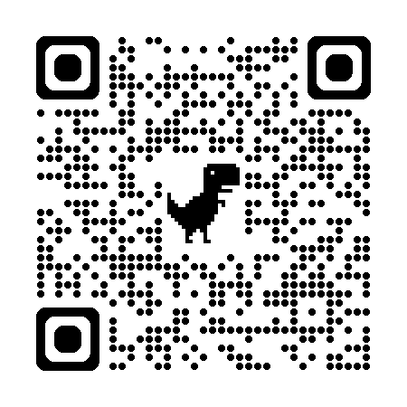
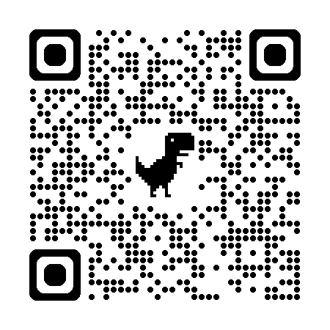
Find out more (LMS)
Clinical Reporting
Dashboards
Batch Reporting
Creating Visualisations - Interactive
Report Outputs –
Interactive

Slide 4
Workshop B
Top Tips from Experienced Users

Slide 5
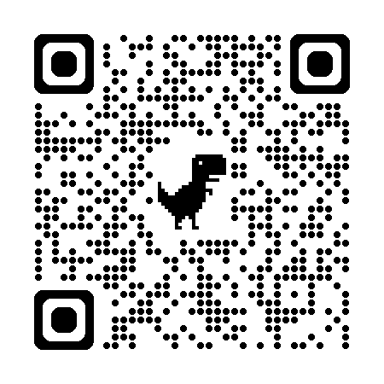
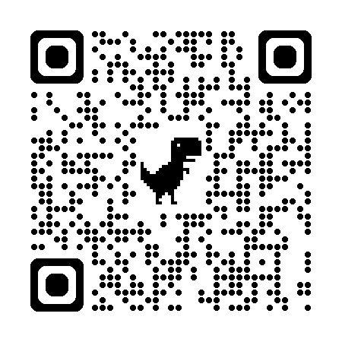
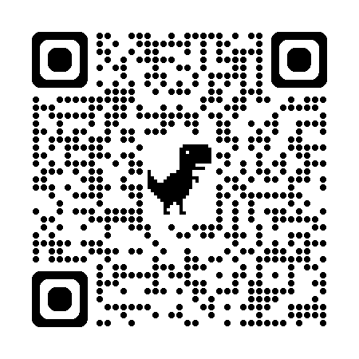
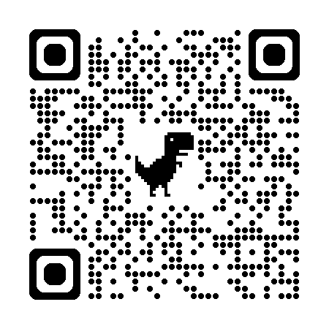
Find out more (LMS)
EPS Signing - Interactive
Communications Annexe
Scanning Rules
Customise Quick Actions
Consultation split

Slide 6
Workshop C
Driving efficiency with Protocols,
Auto-filing and
the Auto-Review Rules Tool

Slide 7
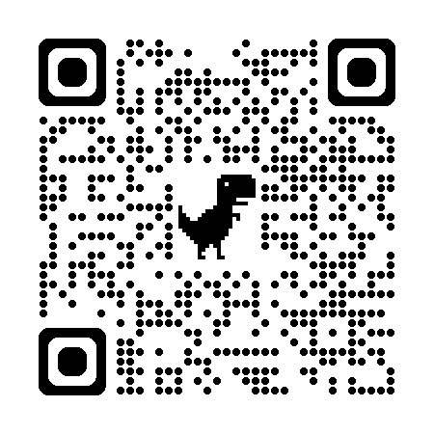
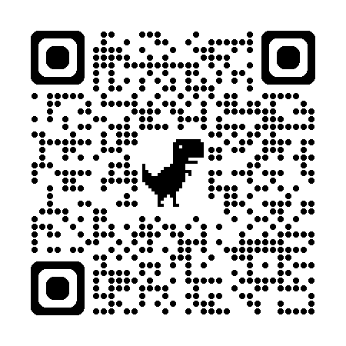
Find out more (LMS)
Creating Protocols
Auto Review Rules
Auto Filing - Protocols
Mailing link
Doc Support – Auto Review

Slide 8
Workshop D
AI: Transforming Workflows & Saving Time

Slide 9
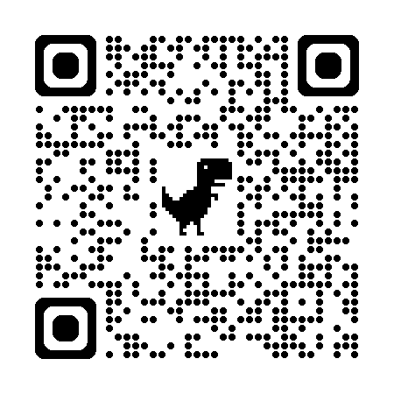
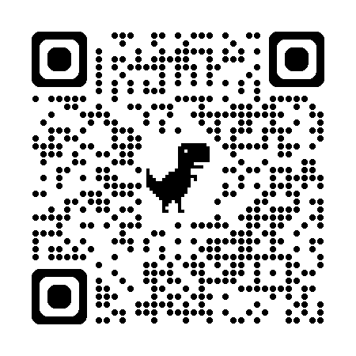
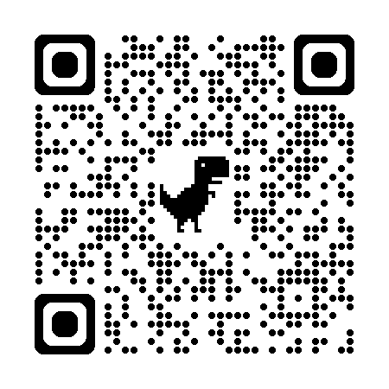
Find out more (LMS)
SystmConnect
Brigid
Airmid
Patient Insights
DNA Probability

