Slide 1
Does proactive, community-based care in care homes improve survival? Results of a quality improvement project
Open access
Quality improvement report
BMJ Open Quality
To cite: Attwood D, Hope SV,
Spicer SG, et al. Does proactive
care in care homes improve
survival? A quality improvement
project. BMJ Open Quality
2024;13:e002771. doi:10.1136/
bmjoq-2024-002771
BMJ Open Qual: first published as 10.1136/b24.
David Attwood, Suzy V Hope, Stuart G Spicer, Adam L Gordon, James Boorer, Wendy Ellis, Michelle Earley, Jillian Denovan, Gerard Hart, Maria Williams, Nicholas Burdett, Melissa Lemon
by Dr David Attwood
GP Partner and GPwSI Older People Pathfields Medical Group
Associate Medical Director, Livewell
Chair, Healthy Ageing Programme Board
Declaration of Interest: I built the i-CGA software mentioned in this QIP and work for a private company (Target Health Solutions) that owns it.
Notes:
Hi everyone, my name is David Attwood and my job roles and DOI are on the slide. Today I’ll present survival data from our QI project involving 429 care home residents, analyzed using a non-randomised cohort crossover design and time-dependent Cox regression.

Slide 2
Introduction: Enhanced Health in Care Home National Service Specification
Started in April 2020
Align care homes to primary care networks (PCNs)
Proactive care for older people in care homes (CGA delivered by an MDT)
Notes:
But first, we need to tour the last six years. In April 2020, NHSE introduced the Enhanced Health in Care Homes national service specification, which aimed to align care homes with PCNs, conduct weekly home rounds in each care home, and deliver a comprehensive geriatric assessment (CGA) for every resident.
To contextualise: we had 250 patients across 13 care homes, a workforce untrained in CGA, and a shortage of professionals skilled in older people's medicine. Identifying which patients were in care homes was also a challenge.
We had to implement a radical approach to meet these objectives while ensuring continuity of care. This is the story of what we did and the unexpected discovery we made: potential for improved survival.

Slide 3
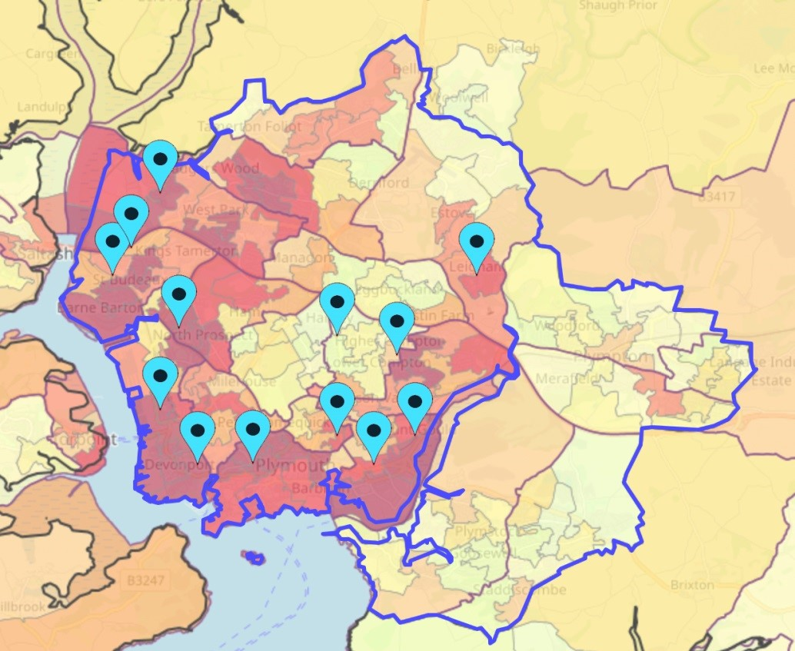
Making This Fit In Primary Care: Introduction & Methodology
Older peoples Team
Paramedic x2 with GP support
Access to Pharmacy team
Urgent care only
2018 Q4
Map of Plymouth:
Blue pins indicate contract hand-backs.
Darker red areas are the most deprived
Notes:
The methodology for this initiative originated in late 2018, a challenging period for primary care in Plymouth. At that time, contract handbacks were common, the demand for GPs was immense, and recruitment was difficult. To maintain urgent care access for the housebound and care home population, we established an older people's duty team. This team was composed of two paramedics, supported by the duty GP and the pharmacy team, and was dedicated solely to providing urgent care.

Slide 4
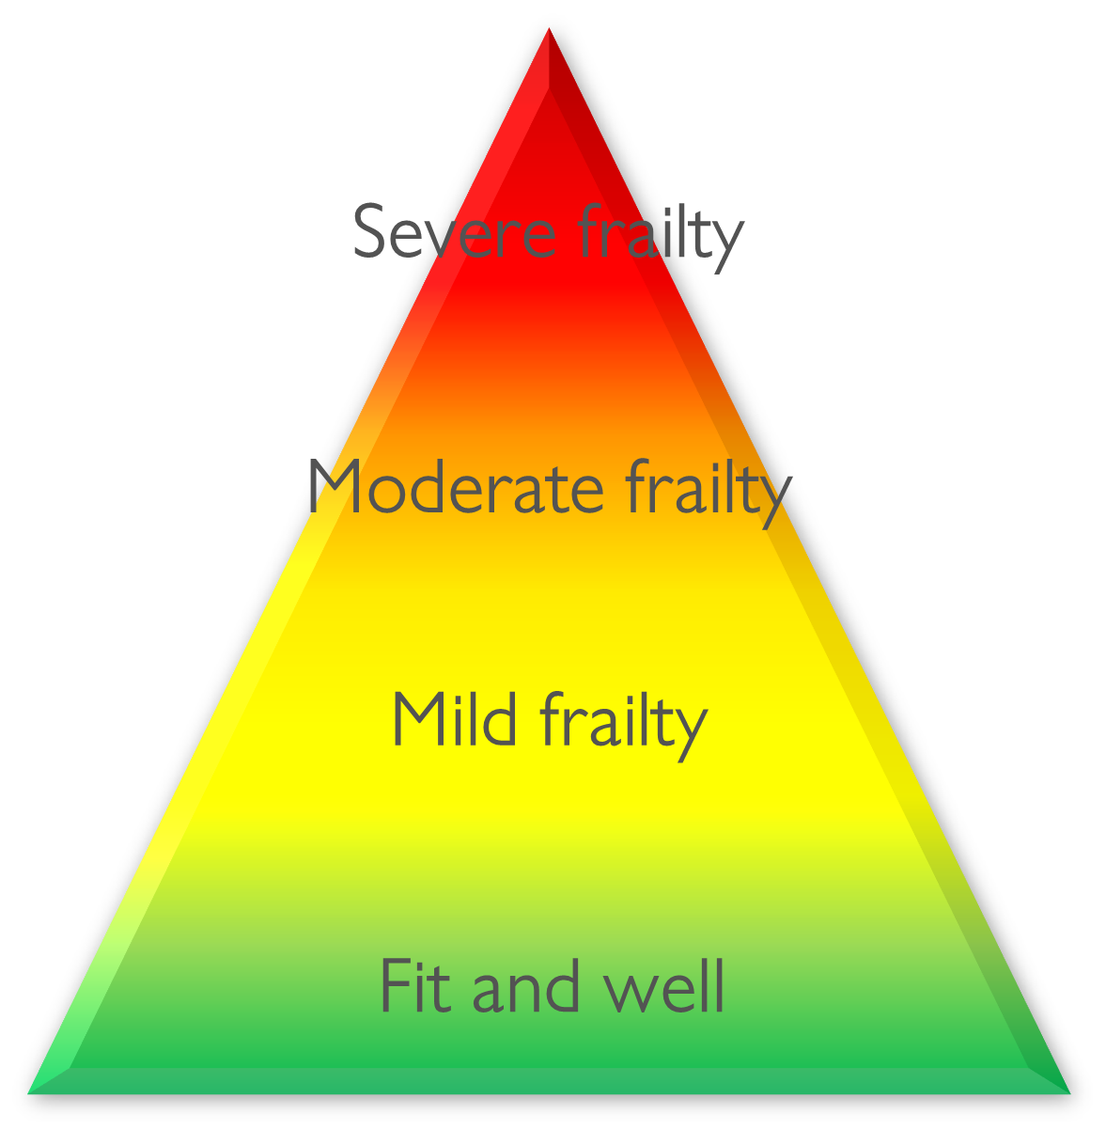
Making This Fit In Primary Care: Introduction & Methodology
Older peoples Team (urgent care only)
2018 Q4
The Pathfields Tool
2019 Q1
Notes:
In March 2019 we started actively case-finding frailty in our over 65s and developed the Pathfields Tool. It identified patients at high risk of having undiagnosed frailty and on saving the patient record invited clinicians to diagnose frailty by severity (not frail, mild, moderate, and severe frailty). This started stratifying our population by frailty severity but it also did one other thing. It sub-segmented the population by whether they were in a care home or their own dwelling. We could now start to build a dynamic and systematic frailty and care home register.

Slide 5
Making This Fit In Primary Care: Introduction & Methodology
Older peoples Team (urgent care only)
2018 Q4
The Pathfields Tool
2019 Q1
Older peoples Team (urgent & proactive care)
2019 Q2
iCGA
Notes:
In May 2019, two GPs joined the older people's team, allowing proactive care to begin for two sessions a week. We could now offer CGA in care homes. However, as BGS guidance says, it can take about 1.5 hours for the initial assessment and an hour for documentation and care plan sharing. That time frame was simply not compatible with the numbers of residents we were talking about. It needed condensing, whilst maintaining the quality.
The solution? An IT assisted CGA or iCGA

Slide 6
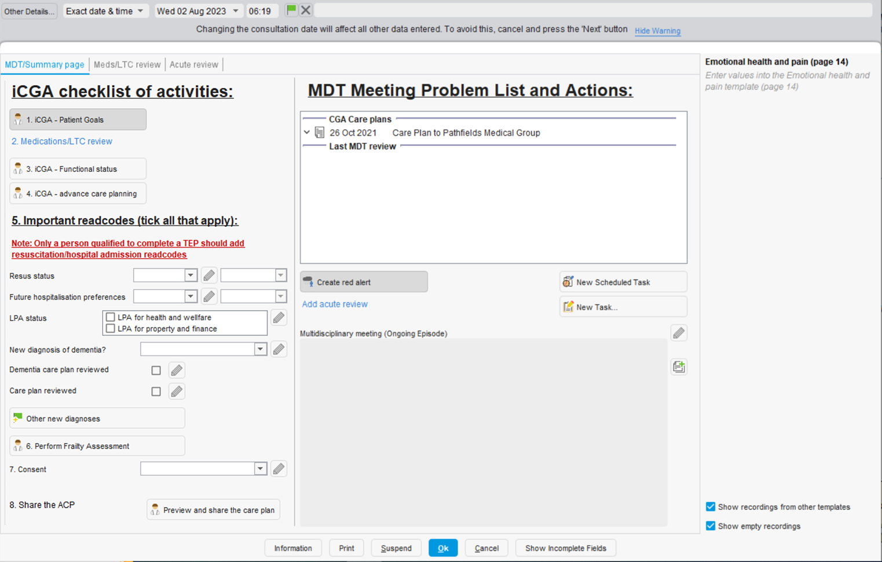
1
Tip: right click here to view the previous care and support plan
2
3
4
5
6
7
8
Notes:
This is the first page of iCGA, designed with three key principles: no duplication (data entered once), a minimum standard of quality, and easy access to all the information you need.
You can view previous CSPs here, helping kickstart new CGA cycles. The checklist of activities guides you through the iCGA, with each button linking to the relevant domain. MDT meetings and problem lists are entered here.

Slide 7
Making This Fit In Primary Care: Introduction & Methodology
Older peoples Team (urgent care only)
2018 Q4
The Pathfields Tool
2019 Q1
Older peoples Team (urgent & proactive care)
2019 Q2
iCGA
Notes:
Once you have filled in the domains on the previous slide you can then create a problem list. We then leave the information gathering stage of iCGA and enter the intervention stage where we are optimising medications and long term conditions and assessing response, pulling in a wider MDT as needed.
Once the patient is optimised and has achieved their goals, we enter the summative stage and need to share the care plan with the patient, out of hours GP, ambulance service and community services. BGS says this documentation takes an hour.

Slide 8
Notes:
iCGA makes this happen in 5-10 mins.
With a single press, you can generate a care and support plan, pre-populated with vital details—patient information, complete medical history, current medications, known allergies, personalised goals, functional baselines, and advance care preferences—seamlessly extracted from the most recent iCGA checklist entry.

Slide 9
Notes:
Creating the advance care plan (ACP) or TEP is just as quick. Key details are auto-filled from the latest ACP entry, allowing you to review, adjust, and save quickly. A pre-populated task box then prompts your admin team to share the TEP and care plan with the patient, OOH GP, and ambulance services, giving all services the information they need if the patient presents in crisis.

Slide 10
Notes:
To enable future cohort crossover analysis, key read codes were automatically inserted into the record on completion of a CGA cycle.
Following completion of a CGA, the IT automatically checks that key domains have been completed and prompt if not done as the examples on the screen show. This guarantees consistency and quality of each iCGA.

Slide 11
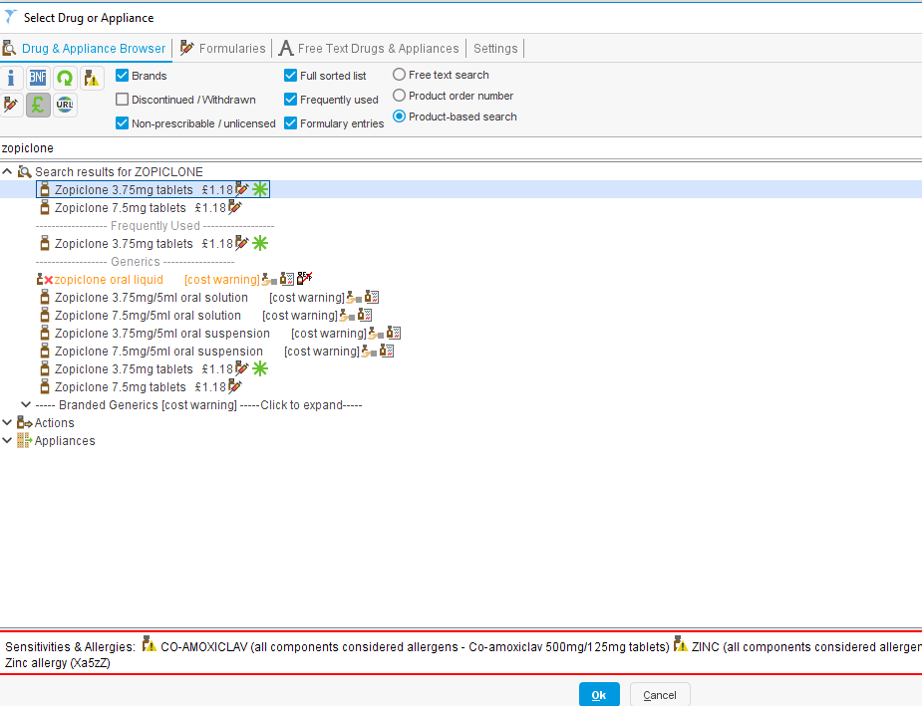
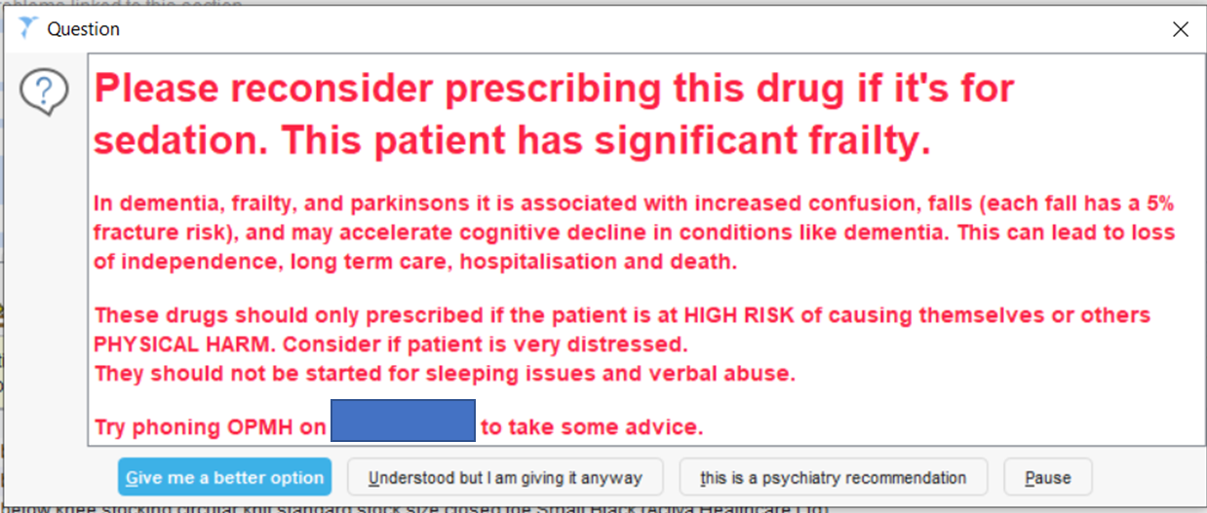
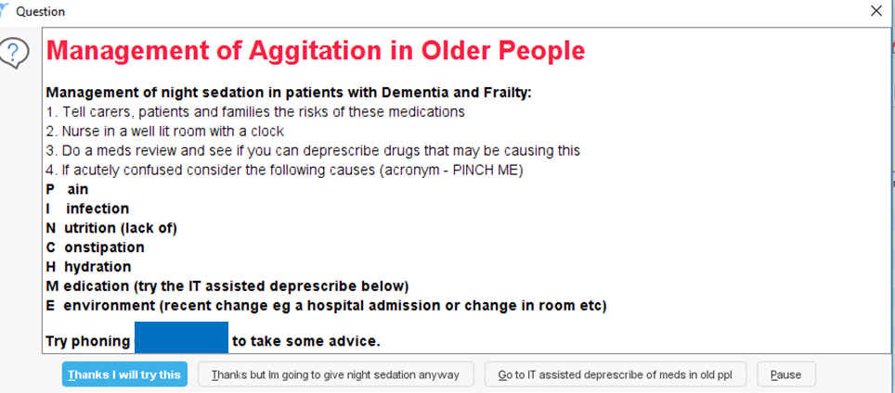
Older peoples Team (urgent care only)
2018 Q4
The Pathfields Tool
2019 Q1
Older peoples Team (urgent & proactive care)
2019 Q2
iCGA
2019 Q4
Safe prescribing
Notes:
An audit in Autumn 2019 revealed that each iCGA saved approximately £75 per patient annually through medication optimisation. However, many medications were later restarted by other clinicians. To address this, we implemented alerts for high-risk drug prescriptions, an example here being zopiclone, offering safer alternatives and enhancing workforce knowledge.

Slide 12
Older peoples Team (urgent care only)
2018 Q4
The Pathfields Tool
2019 Q1
Older peoples Team (urgent & proactive care)
2019 Q2
iCGA
2019 Q4
Safe prescribing
Pandemic begins
All residents in care homes offered iCGA.
EHCH: Care homes aligned to Pathfields
2020
Notes:
In March 2020 the pandemic begun. During the initial lockdown, primary care was unusually quiet. We were worried about what might happen if COVID were to spread in a care home, we used this time to offer all our residents an iCGA. We also aligned care homes to PCNs

Slide 13
Older peoples Team (urgent care only)
2018 Q4
The Pathfields Tool
2019 Q1
Older peoples Team (urgent & proactive care)
2019 Q2
iCGA
2019 Q4
Safe prescribing
Pandemic begins
All residents in care homes offered iCGA.
EHCH: Care homes aligned to Pathfields
2020
2021
All residents and staff vaccinated for COVID
Care home ageing well dashboard
Notes:
By early February 2021 nearly all residents and staff had been vaccinated for COVID. In April-May we launched our care home dashboard, which contained a feast of data that we could use to monitor and improve our performance.

Slide 14
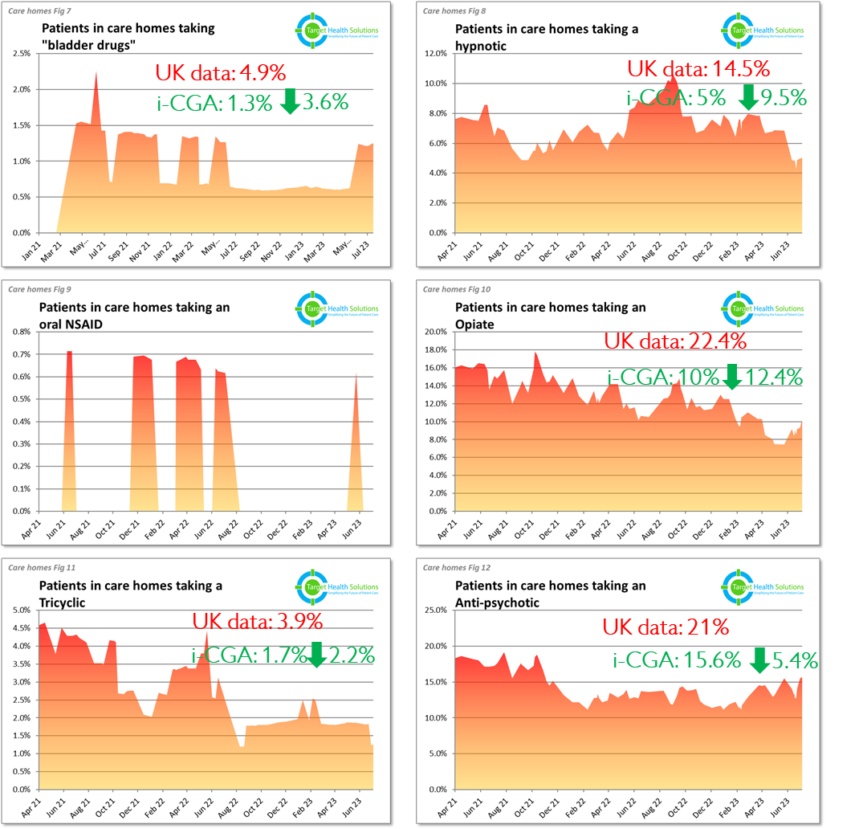
Our prescribing data
doi:10.3399/bjgp12X641447
doi:10.1093/ageing/afaa122
Notes:
This dashboard shows that prescribing of harmful drugs in our aligned care homes is consistently below the published UK literature, indicating that the safe prescribing popups are having an effect.

Slide 15
Our CGA and advance care planning data
Notes:
We could also track proactive care metrics like shared care plans, resus, and hospitalization preferences. Combined with prescribing data, this would not only measure performance but also help identify individual patients within our care home population who need attention and prioritise them for review.

Slide 16
Older peoples Team (urgent care only)
2018 Q4
The Pathfields Tool
2019 Q1
Older peoples Team (urgent & proactive care)
2019 Q2
iCGA
2019 Q4
Safe prescribing
Pandemic begins
All residents in care homes offered iCGA.
EHCH: Care homes aligned to Pathfields
2020
2021
All residents and staff vaccinated for COVID
Care home ageing well dashboard
Care coordinators recruited
Improved SOPs to detect new admissions to care homes
Carers in care homes started filling initial assessment
Yearly CGA
Paramedics trained to do CGA
2022
Notes:
In 2022 we recruited care coordinators. They helped gather key information ahead of the first clinician encounter which made the initial assessment more efficient.
We also started yearly CGA cycles and trained paramedics to do CGA.

Slide 17
Proactive care: Evaluation
Notes:
Evaluation of proactive care commenced in 2021, and by March 2024, we published evidence confirming our model of care improved the quality of advanced care planning (ACP), compared with routine NHS care. It may also improve unplanned admissions although it was underpowered for the latter.
In our data analysis, we uncovered a surprising finding: patients receiving our proactive care interventions appeared to be living longer. However, this study focused on care quality.
It’s methodology wasn't optimised to explore this outcome.
But this discovery needed exploring.

Slide 18
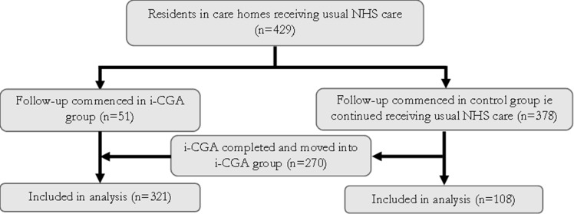
Evaluation October 2022
429 residents (intervention 321; control 108), using non-randomised cohort crossover study design and time dependent cox regression analysis:
Control group (most patients started here): routine NHS care (variable inclusion of some of the components of proactive care). Follow-up commenced on date first coded as living in a care home
Intervention group: proactive care with iCGA prioritised based on clinical need. Follow-up commenced on completion of iCGA
13% commenced follow-up 17/03/19-31/12/20
53% commenced follow-up 17/03/19-31/12/20
Notes:
So we expanded the study, recruiting 429 subjects from 1st March 2019 to 30th September 2022, including all residents in care homes registered with our PCN. Residents who left the PCN or returned home were excluded.
A control group was formed with residents receiving routine NHS care. Followup started when they were first coded as living in a care home
The intervention arm received proactive care and iCGA. Patients were prioritised based on clinical need and included advanced frailty, dementia, complex needs, or nearing end of life.
A flow diagram below illustrates the process. You will recall that in March 2020, at the onset of the pandemic, many patients were moved to the intervention arm, resulting in 53% of patients beginning follow-up during the pre-vaccination period, compared to just 13% in the control group.

Slide 19
Notes:
This transfer is reflected in the intervention arm having a higher all cause mortality in the prevaccination period. The intervention group also had a higher median age and dementia prevalence. This further reinforces that patients were prioritised for proactive care based on clinical need, as dementia is a leading cause of death and complex behaviours in care homes. Both situations benefit from proactive care.
Cancer diagnosis was the same in both groups.
To control for differences in baseline characteristics, we ran single predictor models for health conditions that had higher prevalence in the control group, which might increase mortality.
Diabetes, COPD, IHD and cancer showed no significant differences. Female sex lowered mortality at two years, whereas heart failure, and being in a nursing home or dual registered home increased it. Moderate frailty was associated with a lower mortality than severe frailty. All had p values of <0.05. We then ran multiple predictor models for each group controlling for these four variables.
To control for survival bias we used time dependent cox regression analysis (based on time each resident spent in control and intervention arms).

Slide 20
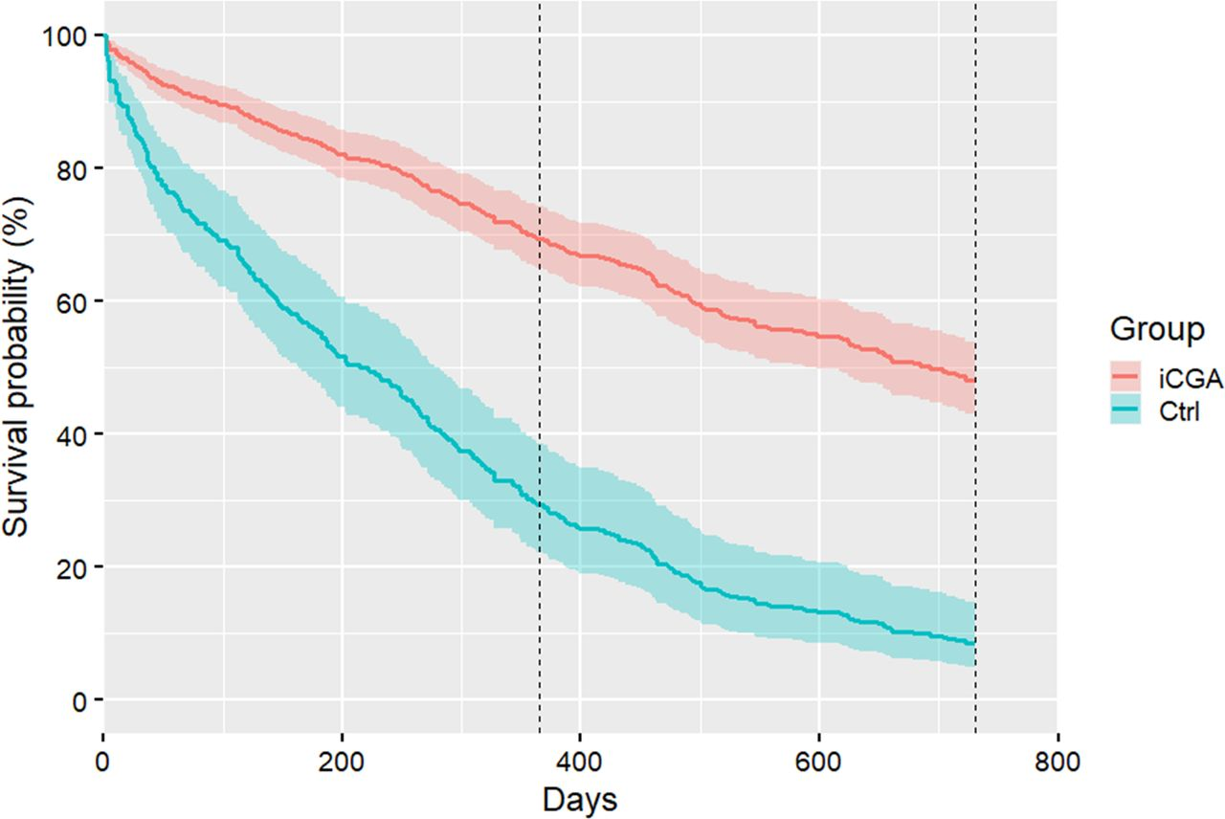
At two years:
39.6% ARR (NNT 2.5)
p value <0.001
Notes:
The results show that at two years control group survival was 8.6% vs 48.1% in the intervention arm, equating to a 39.6% absolute risk reduction in mortality and an NNT of 2.5.

Slide 21
Discussion
Four putative mechanisms:
Optimisation of care: LTC’s, meds opt, personalising care
IT-assisted CGA: reduced high-risk medication useage, info sharing, prioritising high risk patients for review
Continuity: dedicated teams (relational); iCGA (informational)
Reduced hospitalisation?
Evidence | Reference
Continuity: improves survival | Pereira-Gray et al 2018 doi: 10.1136/bmjopen-2017-021161.
CGA (reactive): In hospital CGA improves survival (alive and in own home at 12 months) | Ellis et al 2017 doi/10.1002/14651858.CD006211.pub3
CGA (proactive): Proactive CGA in own homes improves survival | Frese et al 2012 https://www.sciencedirect.com/science/article/abs/pii/S0167494312001367?via%3Dihub
Medication optimisation: improved survival | Sluggett et al 2022 doi https://doi.org/10.1093/ageing/afac149
Urgent care + Proactive care + CGA + community-based MDT: improves survival | Bernsten et al 2019 https://doi.org/10.1186/s12913-019-4397-2
Notes:
We offer four mechanism:
1. Optimisation of care: Managing long-term conditions, optimising medications, and personalising care (e.g., setting tailored hypertension targets) improve health and reduce risks of conditions such as delirium and falls, which are linked to higher mortality.
2. Efficiency and effectiveness of i-CGA: it’s faster, drives up the quality of care, and locks in the benefit of proactive care as we have seen with prescribing data.
3. Heavy focus on continuity: Dedicated teams for older patients promote relational continuity and informational continuity with care plans shared with the patient and other providers.
4. Possible reduced hospitalisation: we are seeing growing data for reduced hospitalisation in our locality with proactive care. Further analysis is underway. Fewer admissions decrease the risk of hospital associated complications, such as delirium and falls, which could improve survival.
These mechanisms have an evidence base:
Continuity improves survival.
For CGA we have evidence of survival advantages in a reactive and proactive setting. The proactive setting has less evidence but the effect on survival is greater.
There is newer evidence for meds opt and survival
And lastly there is a 2019 Norwegian study, featuring an older peoples MDT with proactive care, urgent care, person-centred care, and CGA improving survival

Slide 22
Hypothesis: is it possible that these four effects are cumulative and synergistic, resulting in outcomes that far exceed the impact of each individual component alone?
“Studies in this field have generally followed the “rational-linear” approach…. “there is a tendency to reduce messy real-world situations into the individual component parts in an attempt to determine the relationships between them.”
“However, to achieve better outcomes [for older people with frailty and multimorbidity], the whole chain of care needs to change. We propose that all components [proactive care, person-centred care, integrated care] are inter-dependent, and will only produce the expected effects if they are all in place. The effect of an intervention where [these elements] work synergistically together is mostly unexplored.”
Notes:
Is it possible that these four effects are cumulative and synergistic resulting in outcomes that exceed the impact of each individual component alone?
The Norwegian study had this to say.

Slide 23
Strengths and limitations
Strengths:
Controlled for confounding variables
Controlled for survival bias
Controlled for pandemic confounding
Weaknesses
Non-randomised (selection bias)
Not multi-centre
Not blinded
Notes:
We controlled for confounding variables, survival bias, and pandemic confounding the control and intervention arm.
However, this study was not randomised. There is still the possibility of selection bias.
It is also not multicentre and it was not blinded.

Slide 24
Next steps
Hospitalisation data
Multicentred trial conducted outside of the pandemic
Other outcomes – patient reported outcome measures, healthcare outcomes, e.g. delirium and falls/fractures
Health economic analysis
More clinical guidelines of medical management of long-term conditions in older adults with frailty e.g. heart failure, COPD, IHD
Notes:
Hospitalisation
Multicentred trial conducted outside of the pandemic to see if there is a shift in mortality
Patient reported outcome measures delirium, falls/fractures and a health economic analysis
More systematic reviews and clinical guidance of the medical management of key long term conditions in older adults with frailty. We have some targets for diabetes but what about other LTCs?

Slide 25
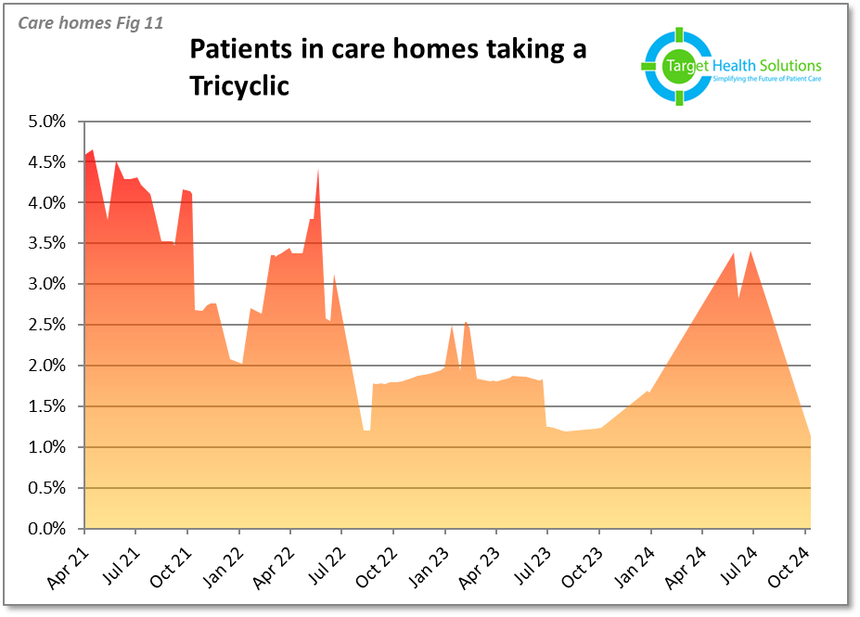
The future: taking EHCH one step further
UK data: 3.9%
Audit commences
Notes:
Let’s shift focus from survival to future opportunities with proactive care.
This summer, we began preparing our care homes for winter by conducting high-risk drug reviews on opiates, loop diuretics, NSAIDs, bladder drugs, and tricyclics. Using our dashboard searches, we booked all residents on these medications into weekly ward rounds for targeted reviews.
The result? Our lowest tricyclic prescribing since the Ageing Well dashboard launched.

Slide 26
The future: taking EHCH one step further
An audit of 191 residents in care homes showed the hospitalisation box on the TEP strongly predicts where residents die:
40% died in hospital.
94.3% died in their care home.
82% of residents with severe frailty in care homes, when asked “What matters to you?” prefer not to be hospitalised.
Notes:
We also focused on advance care planning.
An audit of 191 care home residents revealed that the "hospitalisation" box on the TEP strongly predicts end-of-life outcomes:
For patients who expressed a preference for hospital admission if they became more unwell, 40% died in hospital,
For patients who did not want to be hospitalised, 94.3% achieved their end of life preferences of dying in their care home.
82% of residents with severe frailty in care homes, when asked “What matters to you?” prefer not to be hospitalised.

Slide 27
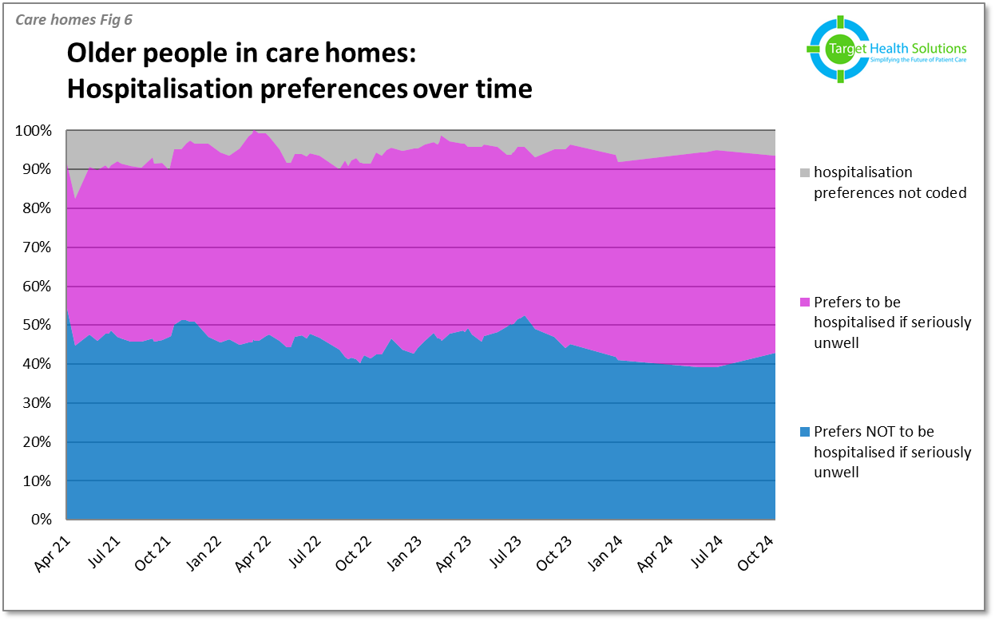
ACP work commences
Notes:
So we ran a target search of older residents with severe frailty in care homes who were still for hospital admission on their most recent advance care plan, the premise being that their frailty had progresses and their ACP may be out of date. We offered them and their families, the opportunity to update their ACP preferences.
It’s not well shown on this graph and one day I will get around to subcategorising hospitalisation preferences in care homes by frailty severity but you can see the outcomes of this work.
The hope is that our care home population come into this winter, they as ready as they can be.
Moving forwards, we will do both these audits on a yearly basis.

Slide 28
Summary:
An older peoples MDT within a PCN implementing proactive and urgent person-centred care with CGA may improve survival
Suggested enablers are:
Continuity (informational and relational)
Proactive care
CGA with LTC and meds optimisation
Tech
All are interdependent and synergistic
Implications for research
Implications for policy
Notes:
An older peoples MDT within a PCN implementing proactive and urgent person-centred care with CGA may improve survival
Suggested enablers are:
Continuity (informational and relational)
Proactive care
CGA with LTC and meds optimisation
Tech
All are interdependent and synergistic
Implications for research
Implications for policy
Thanks for listening.

Slide 29
Thanks for listening.
iCGA demonstrations available outside.
Notes:
Thanks for listening.

