Slide 1
Unexplained(?)
Variations in Care
Dr James Boorer

Slide 2
Who am I?
Dr James Boorer
CD Pathfields Medical Group
CD Sentinel CiC
Part time pain doc
Part time private skin surgeon
Amateur vasectomist
Full time geek
MSc in IT
Software Company (Target Health Solutions)
One day I’ll be diabetic & hypertensive

Slide 3

Notes:
The primary purpose of this presentation is to light a fire in you all
I’m going to highlight the issues facing our patients and health system
I want to inspire you that we can ALL do better
When you leave this conference I want you, ready to transform processes and put digital tools in to practice that are going to save lives.
I know that most of you here are non-clinical, and one of my key messages is that its not just surgeons, doctors and nurses who save lives: Managers and administrators do to.
You won’t see the lives YOU save, nor the people who YOU have prevented from getting disabling strokes and heart attacks but YOU will indeed have the power to save lives and transform care
So where do we start?

Slide 4
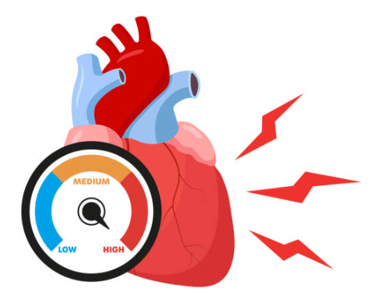
Hypertension
Affects nearly 1 in 3 adults although almost 30% of cases are undiagnosed
The most important population level driver of CVD
National drive to improve hypertension care and achieve > 80% of people treated to target
Notes:
High blood pressure is not “sexy medicine”
It is common and “dull”
It affects 1 in 3 of us by age 60
BUT it is the single most important driver of strokes and heart attacks in the UK
Because its not sexy it often gets overlooked and we don’t treat it with the respect it deserves
There is a national drive to achieve over 80% treatment to target…

Slide 5

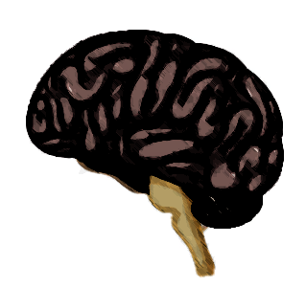

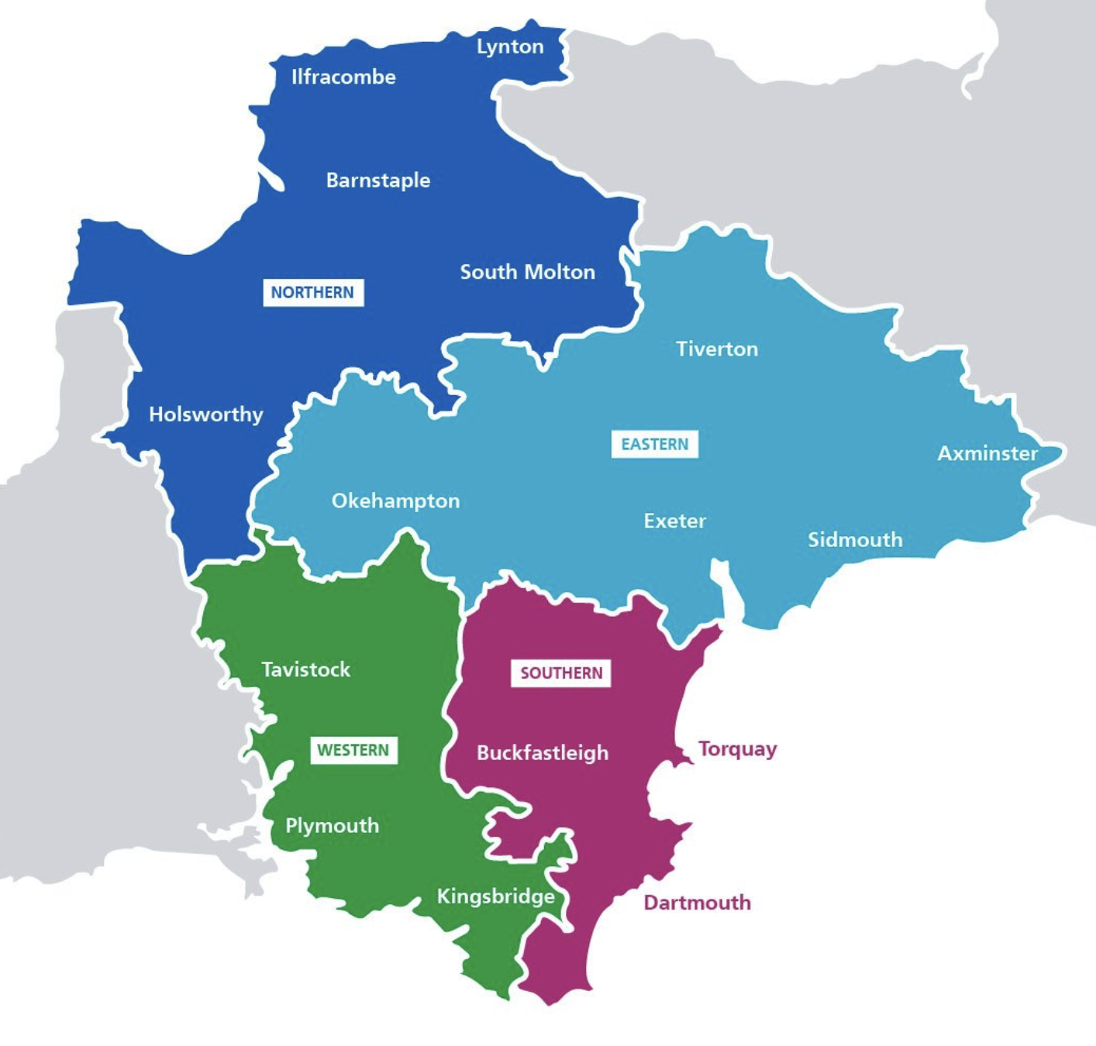
Devon
Hypertension size of the prize, if we achieved 80% TTT
134 Deaths Prevented
249 Strokes Prevented
167 Heart Attacks Prevented
Data: UCL partners: Size of the Prize
Notes:
…. And this is why
Each tomb stone you see appearing on screen represents the death of one person in Devon, that is going to occur over the next 3 years, unless we step up and take action to prevent these deaths.
That is 134 deaths that we are going to collectively prevent
We’re now seeing the strokes that are going to occur unless we step up to save the day. Each brain icon represents a stroke, some might be mild but many will result in life changing brain injury and disability requiring a prolonged hospital stay and ongoing care needs.
This slide takes a while to play out, but I think its important that we just watch, and reflect for a moment about the task ahead of us – it’s a huge task but we have a room full of heroes and life savers. We can prevent 249 strokes in Devon.
But that is not all – we are also going to prevent multiple heart attacks. 167 in all. And just think each person affected by a stroke or heart attack has a family and friends who will also be affected – we can stop this burden of disease in its tracks.
And its not going to be clinicians who lead this work – its going to be our managers and administrators who use IT and systems effectively to identify and manage hypertension.

Slide 6
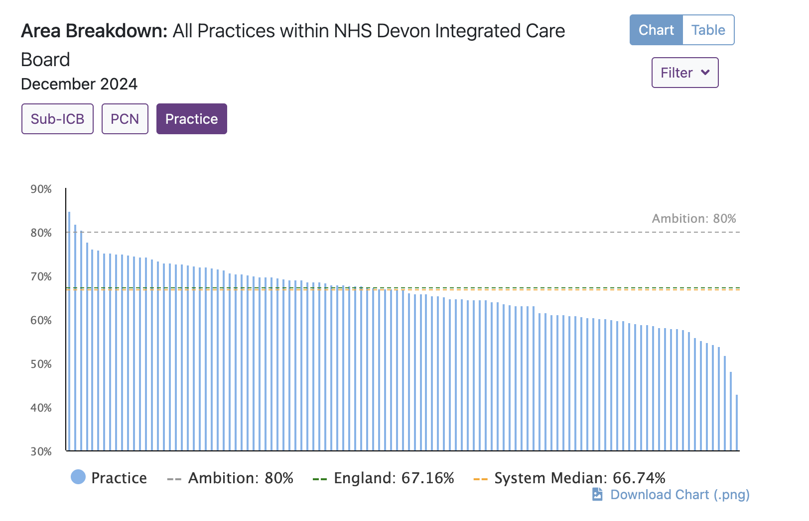
https://www.cvdprevent.nhs.uk/
Notes:
Chart shows huge variation in hypertension performance across Devon
Kudos goes to Matt Waterman and his team at Wembury for consistently achieving the top spot with 85% TTT
At the other end of the spectrum we see 42% TTT for inclusion health but we all know this is a practice that serves a very specific and highly complex patient cohort so we have to exclude them from our analysis. We mention their name only, because we know they are truly unique and that we must exclude them.
Our next lowest performing practice achieves only 48% TTT -Now don’t worry, we’re not going to mention any names of other low performers
But must take a moment to reflect that the lowest performing “normal practice” treats
37% less patients to target than those served by Matt.
Now we must acknowledge that this lowest performing normal practice has an average deprivation decile of 2 so it is going to be harder to achieve highly
But now lets look at the top of the table

Slide 7

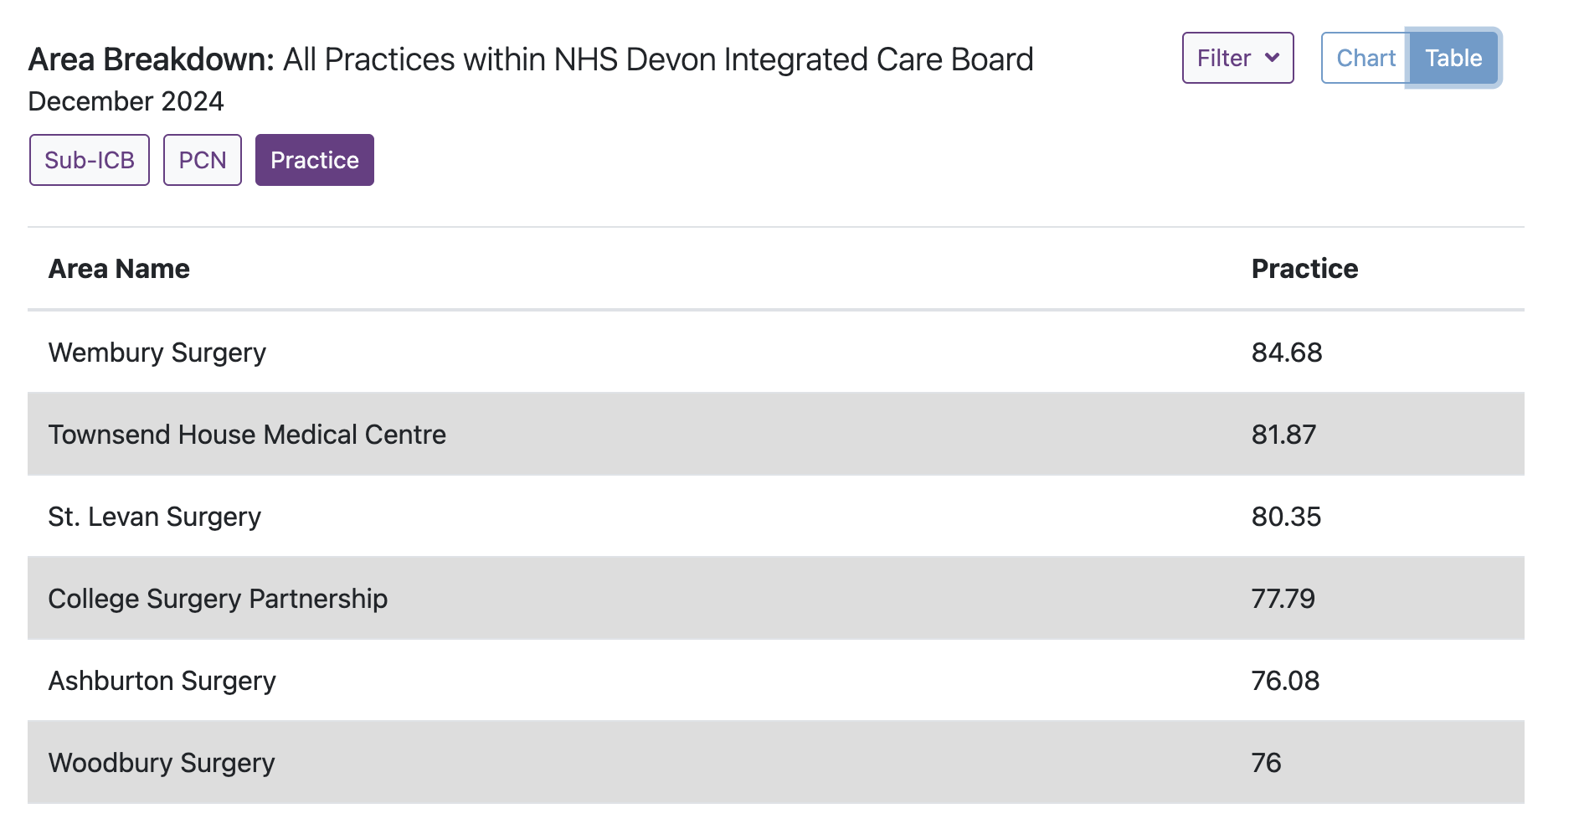
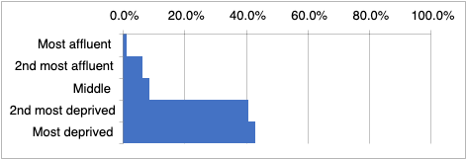
Notes:
Lets look at our league winners
The top 2 spots are taken by practices serving more affluent practices with older patients
But the third spot goes to St Levan
St Levan is an inner city GP practice serving a deprived population with a lot of additional psychosocial needs
St Levan serves a more deprived population than the worst performing normal practice on our ski slope chart

Slide 8
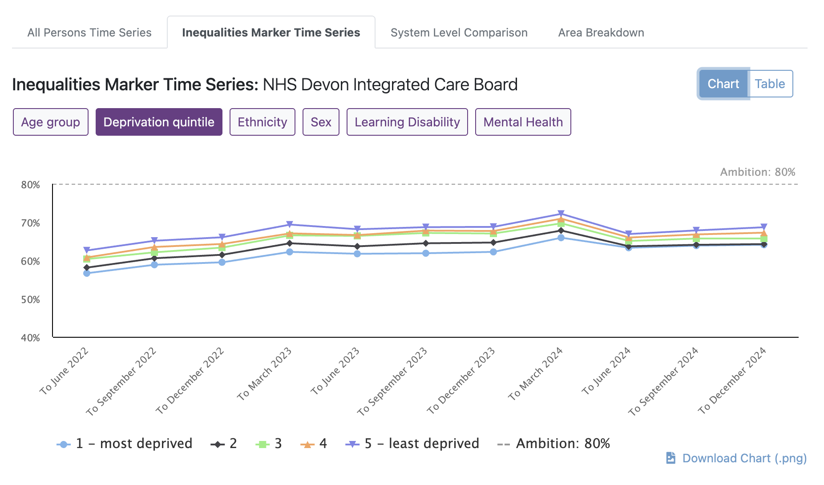
Notes:
So how impactful is deprivation on performance?
This chart maps performance at each deprivation quintile across Devon ICB - It shows that deprivation does have an impact but it is relatively modest
Practices serving deprived populations are achieving 64% treatment to target
With practices serving the most affluent patients achieving just 4% better at 68%

Slide 9
https://www.cvdprevent.nhs.uk/
Notes:
So lets go back to this chart showing HUGE variance across Devon
What causes it?
Before we search for answers lets look at another long term condition: diabetes

Slide 10
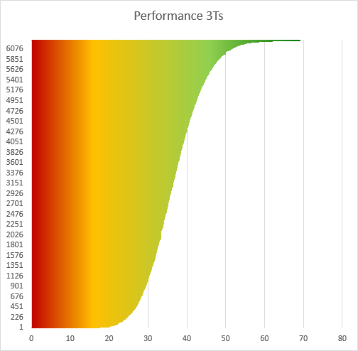
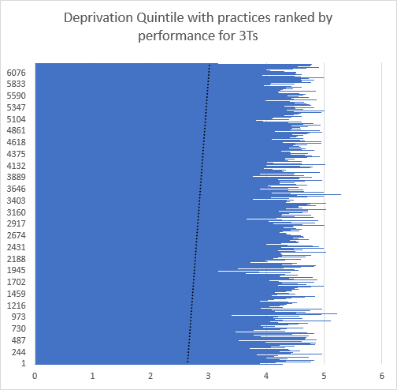
Diabetes 3 treatment targets: HbA1C + BP + Lipids
Notes:
Here we are looking at National Diabetes Audit data on achievement of all three of the key diabetes targets
This chart shows practices ranked by performance with the best achieving practices at the top of the chart and the worst at the bottom
The x axis demonstrates % achievement or performance
We can see variance in achievement of targets with the worst achieving practices sitting at 12.5% and the best at 69.6%
The best performers are treating 57.1% more of their population to target than the worst performers
So could it be deprivation? [click]
This chart plots deprivation data for the same practices ranked in the same order
There is certainly a correlation with deprivation - the best performing practices are slightly more likely to be serving an affluent population but this association is relatively modest and most variation has to be explained by other factors.
Lets look at E12 medical centre – the best performing practice in the UK [click]

Slide 11
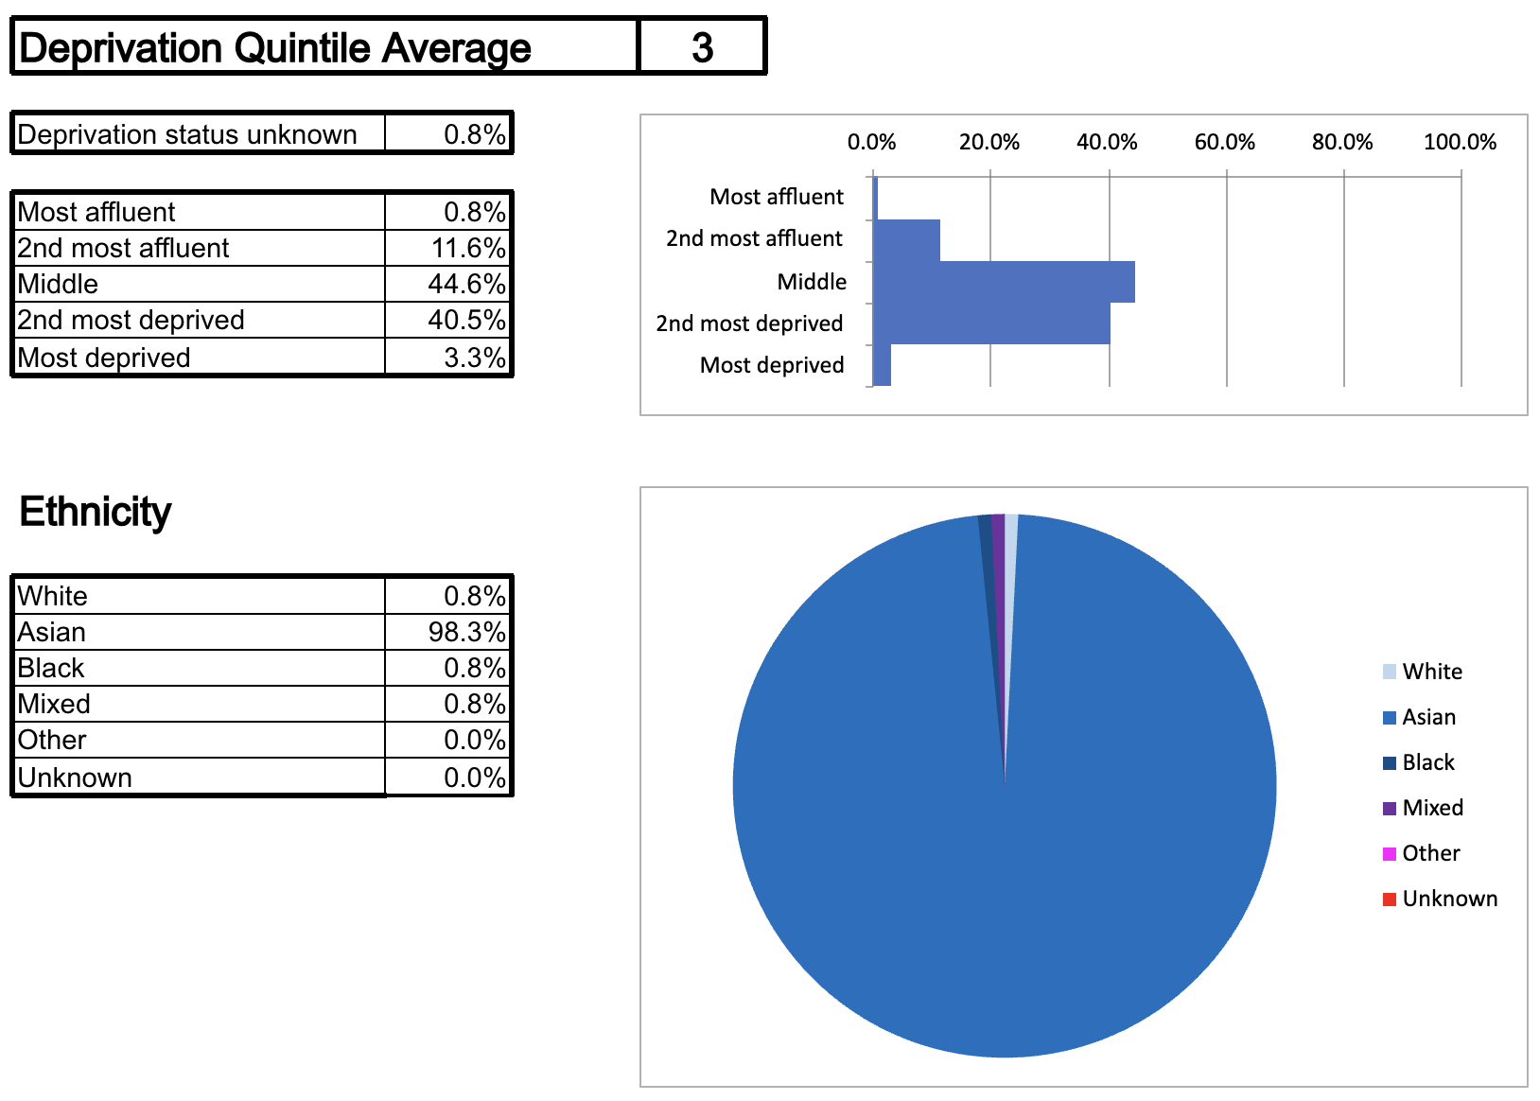
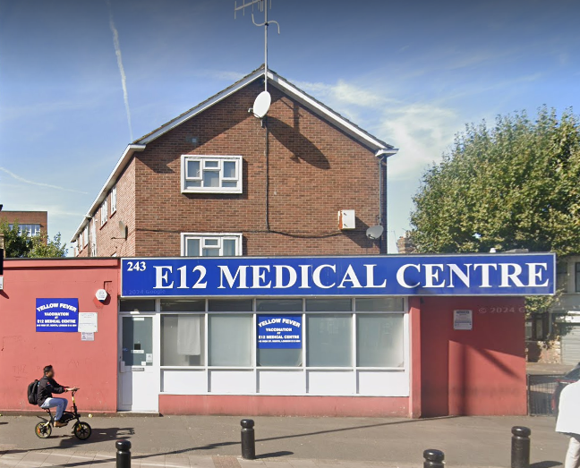
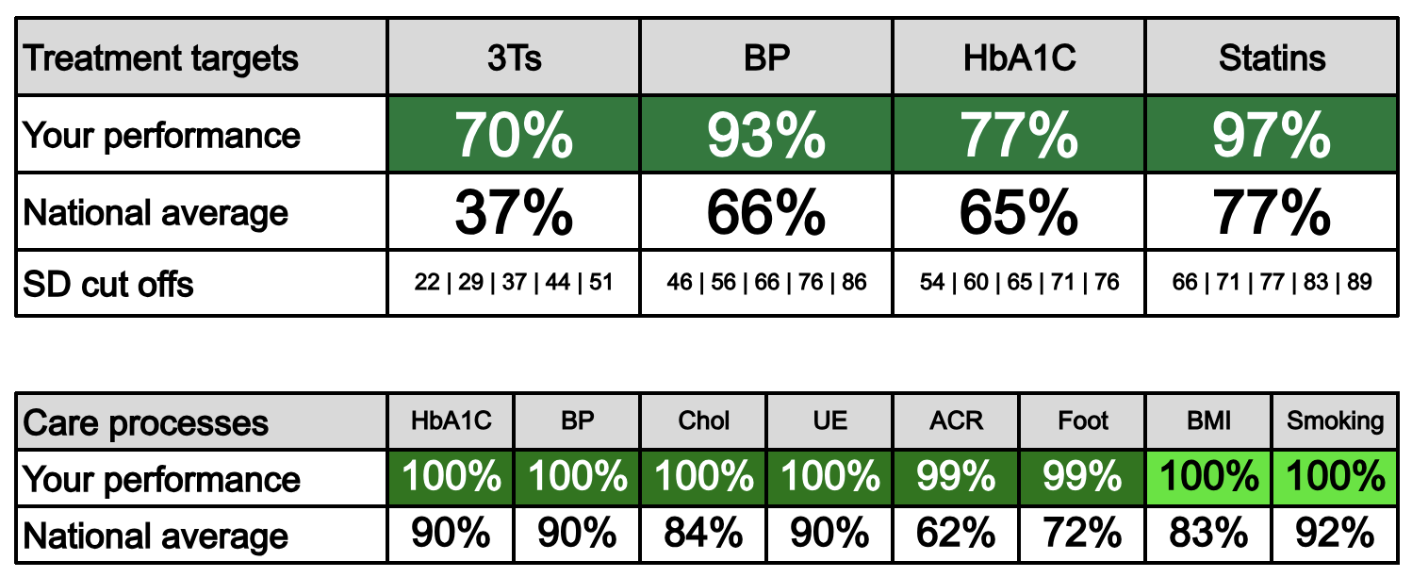
Notes:
E12 serves a moderately deprived to average community in London with a very high proportion of asian patients, an ethnic group traditionally associated with less good diabetes control.
[click]
However. Their performance across all diabetes related activity is truly spectacular with everyone / almost everyone getting all 8 GP care elements and achieving very highly in terms of treatment to target.

Slide 12
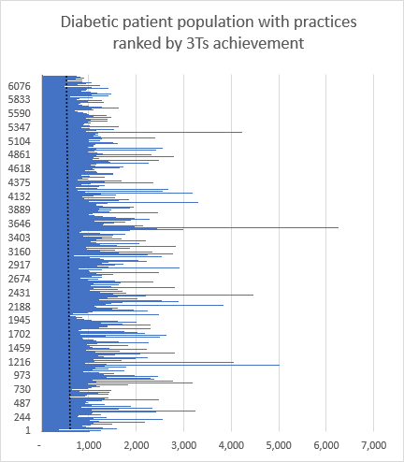
Diabetes 3 treatment targets: HbA1C + BP + Lipids
Notes:
So lets go back to our overall performance charts… if its not deprivation, could it be practice size that is a factor?
[click]
There is a very slight correlation between practice size and performance with smaller practices doing slightly better than bigger practices but again this effect is modest and cannot account for the wide variation in performance.
So now let’s consider a interesting example of variation

Slide 13
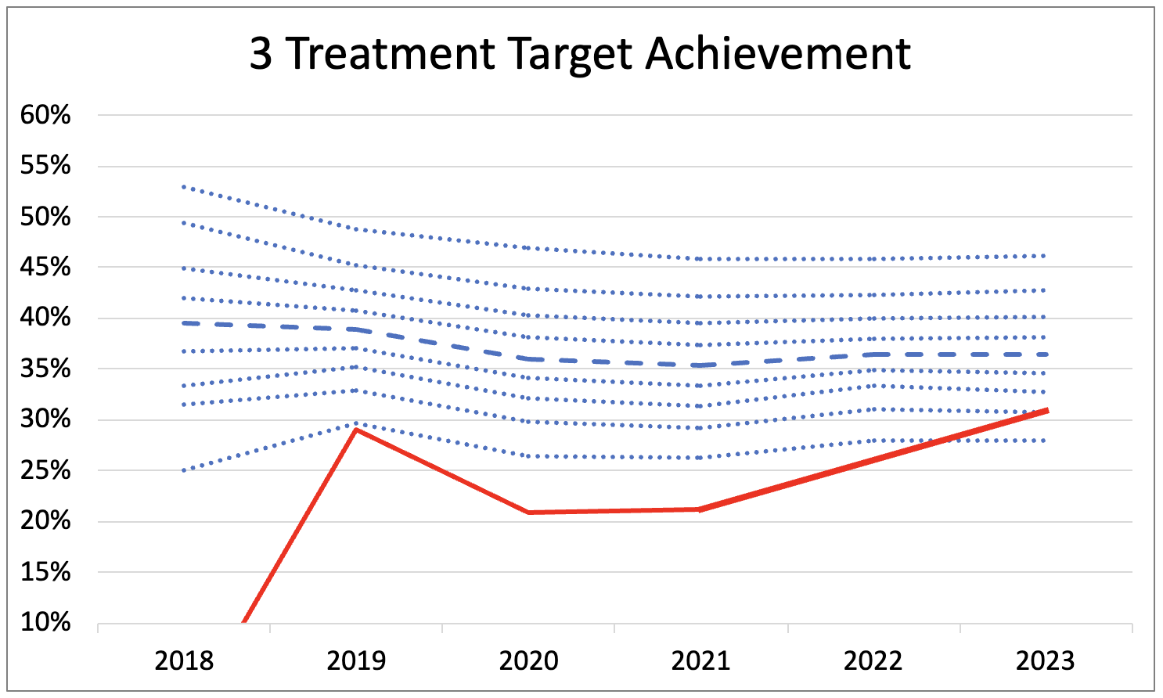
An example of variation within a practice
Each blue line on this chart represents a performance decile
Heavy blue line = national median
Red line = practice performance
(2018 data is not available)
Notes:
This chart shows the performance for this practice (red line)
plotted against the national average performance (heavy blue line) with each performance decile shown by the other blue lines
This surgery has performed in the worst 10% nationally between 2019 and 2022 although performance has improved to the 80th decile in 2023
The reason this practice is interesting is the variation internally within this practice….

Slide 14
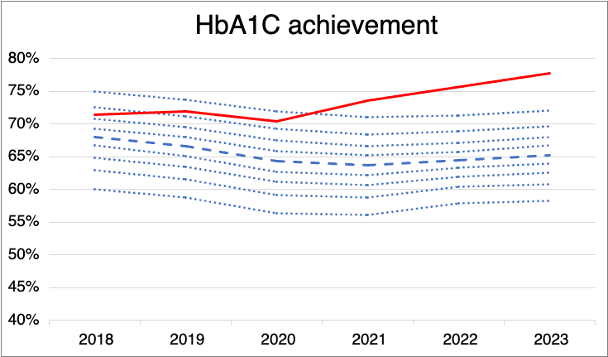
Notes:
Their HbA1C control is truly spectacular
Way above the 10th decile - 13% more patients achieve HbA1C targets at this practice than the national average
HbA1C control is also by far the most challenging performance metric to achieve
This practice must have a superb diabetes nurse or a very motivated clinician
So the next question is - how are they performing so badly in the 3 treatment target metric?

Slide 15
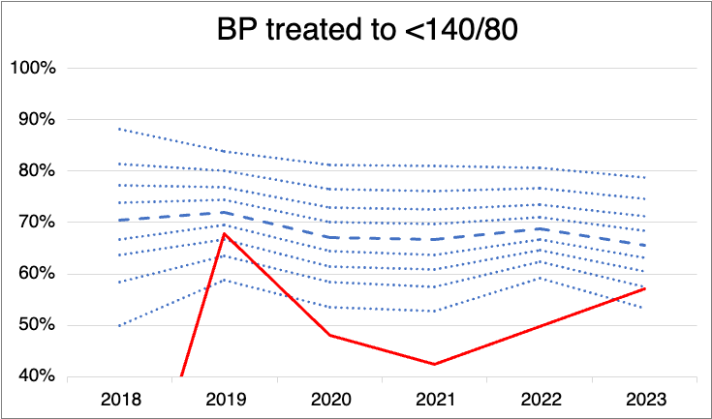
Notes:
Their blood pressure control is really poor
9 % below the national average
And…

Slide 16
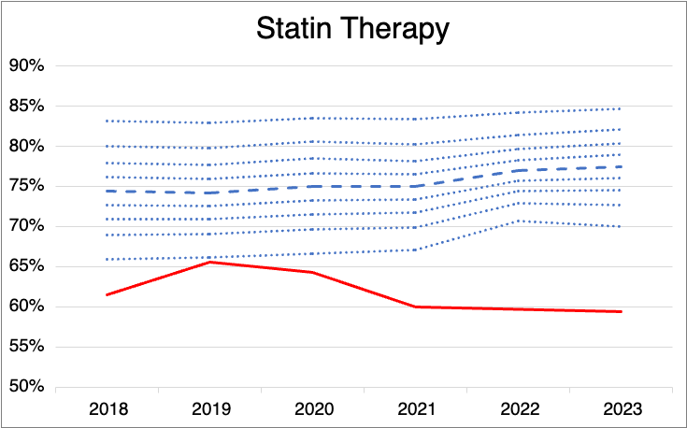
Notes:
Their performance with regard to statin therapy is even worse, 18% worse than the national average in fact
So we are left in this bizarre position where this practice does some truly spectacular and complex work in terms of optimising blood sugar control but are letting their patients down through poor BP control and statin uptake.
Not only are their patients not receiving optimal care but the practice is also loosing out on significant sums of QOF income

Slide 17
So what causes this huge variation?
Can we justify any of this variation?
Can we do anything about it?
Notes:
So we must ask ourselves 3 key questions about this variation
Firstly - what causes this variation?
I think the most important thing to acknowledge is that it is us.
It is our processes and mechanisms of practicing medicine that result in either good or poor care
[click]
The next things we must acknowledge is that very little of the variation in performance is justified.
It is us, our processes and our systems that have caused the variation and this level of variation is totally unacceptable.
[click]
And finally, the most important question of all - can we do anything about it.
And I’m here to say HELL YES!
We can change our performance. We don’t just want to be aiming for average either - we all need to be targeting performance at the very top of this chart
So the next question is how….

Slide 18

Notes:
We’re going to cheat!
We’ll not cheat exactly, but we are going to copy and learn from others - if something is working well somewhere else the chances are it will work well for us too.
Some practices might have one or two amazing clinicians that make the magic happen, but in most cases I suspect the key distinction between high and low performing practices is all about processes and effectively deployed IT solutions.
And we are here today to learn from each other about what works well and how the best performing practices deliver such good results. We have a host of software suppliers, many of whom have developed solutions to this problem. Many are presenting on subjects today or are running break out sessions so that you can learn more. Go and talk to them.
To help you make the most out of exploring the opportunities available I wanted to summarise why I think so many of us are currently failing in long term conditions care

Slide 19
Why we fail
We fail to recall people aggressively
We fail to act on abnormal results
We fail to follow up abnormal results
Notes:
First and foremost we fail to recall people aggressively –
Many practices adopt a month of birth recall system meaning we send people 2 invites to attend, satisfy QOF by offering appointments and then binning them off for a year when they don’t respond – you might satisfy QOF exclusion criteria but this won’t satisfy CQC (more on this later!) The month of birth approach also fails to take into account conditions or medicines that need more frequent monitoring – for example diabetes. When people have additional recalls outside of the annual recall it can then get very messy requiring clinicians to update recalls and all clinicians are rubbish at this!!
Our second opportunity for failure occurs when we do the monitoring – we may record abnormal results but fail to act on them appropriately.
I’ve looked into the notes of our diabetic and hypertensive patients who were not at target and often came across the phrase “patient will try diet and exercise, repeat in 6 months” – and the same thing was said year after year and guess what? The patient never achieved target.
Another are where we fail to act on results is ones that are only slightly out of range “well your BP of 145/95 is only slightly above target and you don’t want more medication so just try a bit more diet and exercise”
Argh! This does my nut in! A normal BP is 120/80! 140/90 is the upper limit of acceptable after which we should generally be thinking about more medication or aggressive diet and exercise regimens with follow up in a few weeks to months.

Slide 20
So what processes do we need for excellence?
Recall
Act on result
Follow up / Recall
Notes:
So if you are looking for software and processes to solve your population health challenges you firstly need a robust recall system that responds to the needs and circumstances of your patient – recalling people when recommended by NICE – this may be based on previous test results as well – so for example diabetes patients require 6 monthly HbA1C recall when treated to target and 3 monthly recall when not.
You then need your medical teams to act on abnormal results
Some of this can be trained into people, but often they need prompts and reminders to take action – maybe this could be a pop-up prompting them to take action or guidelines embedded within a template to help guide them when interpreting results.
Finally you need to follow up on the action taken to ensure the patient has achieved treatment to target after an intervention (this follow up can be integrated into a high functioning recall system)

Slide 21
Funding
QOF does remunerate good care – the funding is not always great on an individual level
Hypertension:
  £6.97 per patient
  (£15.49 between QOF thresholds)
But at scale this money is significant
  if all practices in Devon achieved 85% hypertension treatment to target this would equate to an additional £2.8M into primary care every year

Slide 22
Summary
Accept that there are no excuses for the wide variation in care
1
Let’s collectively rise to the challenge of delivering high quality population health
2
Let’s maximise our QOF income
3
Let’s be life saving heroes
4

Slide 23
Devon
Hypertension size of the prize, if we achieved 80% TTT
134 Deaths Prevented
249 Strokes Prevented
167 Heart Attacks Prevented
Data: UCL partners: Size of the Prize

