Slide 1
QOF optimisation and practical PHM
Dr James Boorer

Slide 2
Who am I?
Dr James Boorer
CD Pathfields Medical Group
CD Sentinel CiC
Part time pain doc
Part time private skin surgeon
Amateur vasectomist
Full time geek
MSc in IT
Software Company (Target Health Solutions)
One day I’ll be diabetic & hypertensive

Slide 3

What is population health management
“Population Health Management (PHM) is a systematic approach to improving the health outcomes of a group or population by monitoring and identifying individual patients within that group. It combines clinical care, data analytics, and preventive strategies to manage and improve health outcomes across a defined population, while also aiming to reduce healthcare costs.”

Slide 4
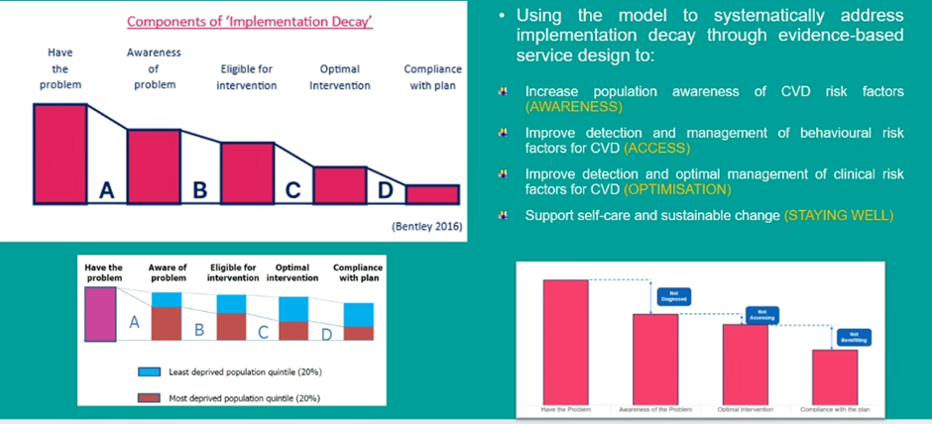
Implementation decay Prof Chris Bentley

Slide 5

Do we have useful data?

Slide 6
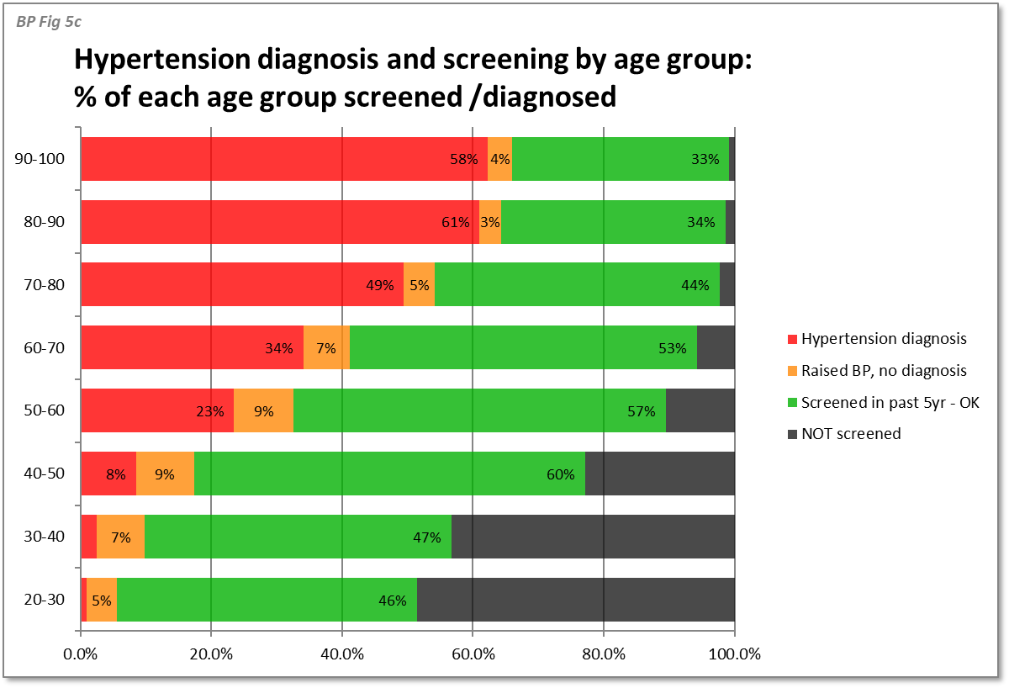
We have a wealth of data! But we don’t usually have the skills to extract analyse and use it

Slide 7
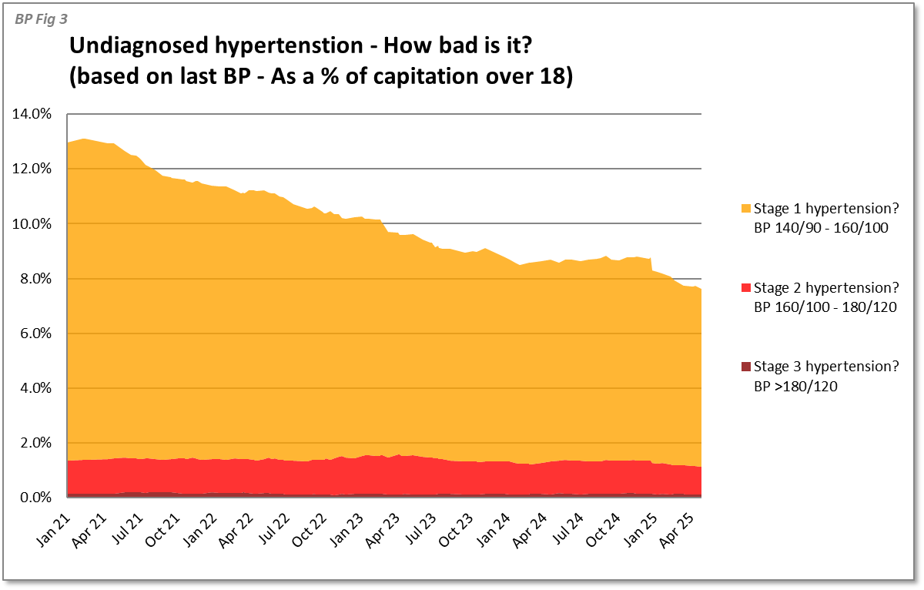
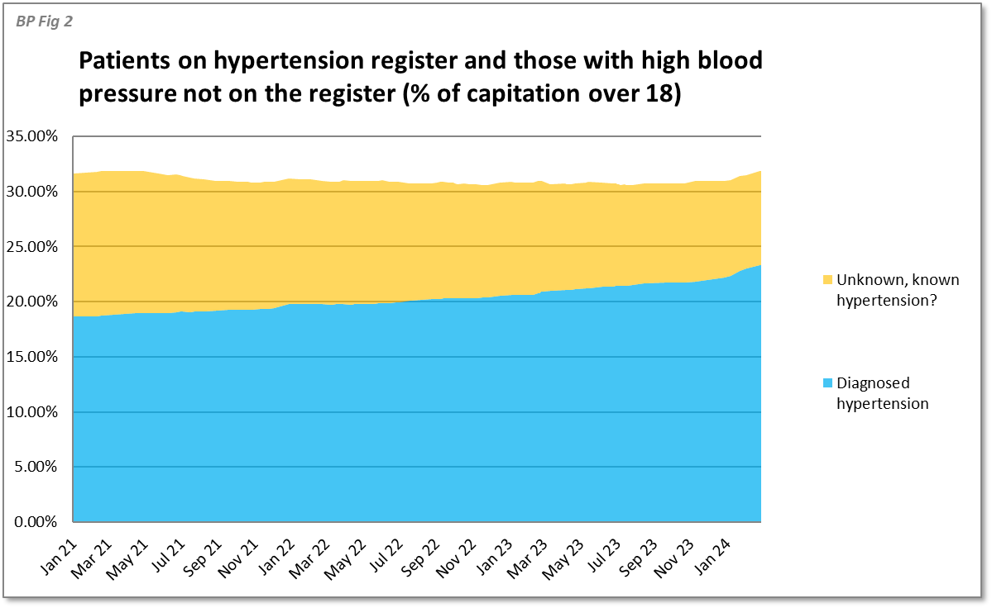
We can use that data to drive change

Slide 8
How do we use this data?
Mindfully!
Each patient we diagnose hypertension in is worth about £7
NICE model the costs of treatment of hypertension in year 1 at £125!

Slide 9
We have to be ruthlessly cost focused
Use community pharmacy to make the diagnosis (boosts their income too ☺)
Use the automated BP machine in reception
Signpost people to these services via comms campaigns to those with high BP without a diagnosis
Leverage ARRS workforce (pharmacy techs, led by pharmacists) to make the diagnosis and initiate treatment

Slide 10
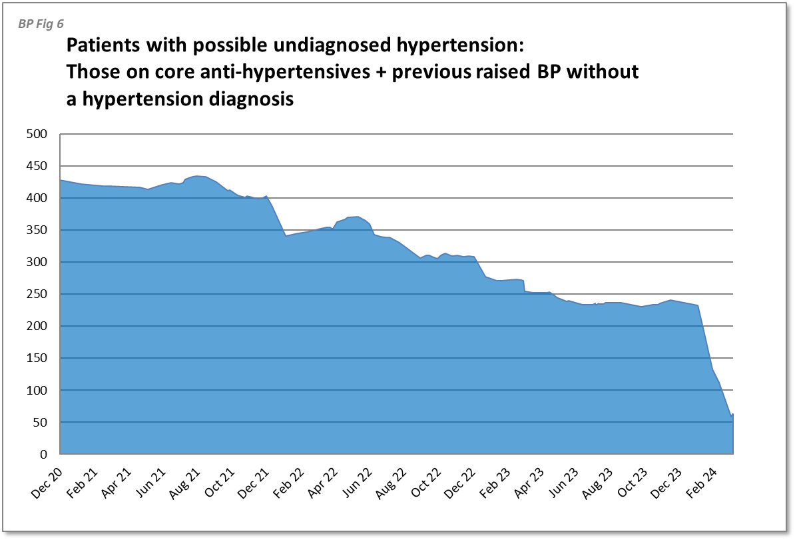
Maximise your QOF income: if you are already doing the work make sure you’ve coded them!

Slide 11
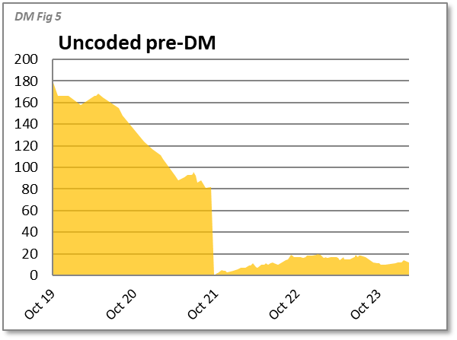
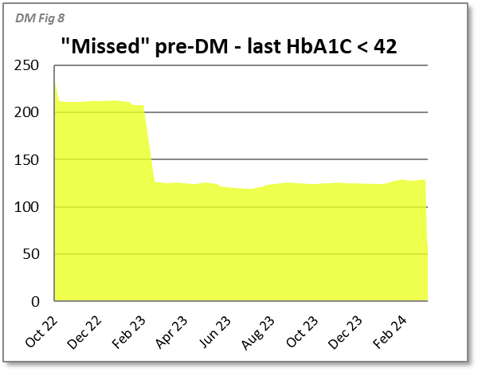
Focus on profitable and easy QOF domains

Slide 12
Ensure your systems are slick
The money from QOF is limited: you can’t afford to have people coming back multiple times if this is not required
Rationalise recalls into one
Ensure you do you BP, NHD, drugs monitoring in a single appointment
Don’t book annual reviews with a nurse for people who are to target
Leverage your ARRS staff to do the work that was previously done by GPs (BP meds titration, HF meds titration, etc)

Slide 13
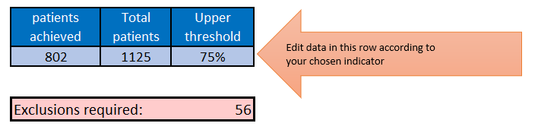
Don’t rely on exclusions to maximise income & don’t over-exclude!

Slide 14
PHM – is it about equity of outcome?

Slide 15
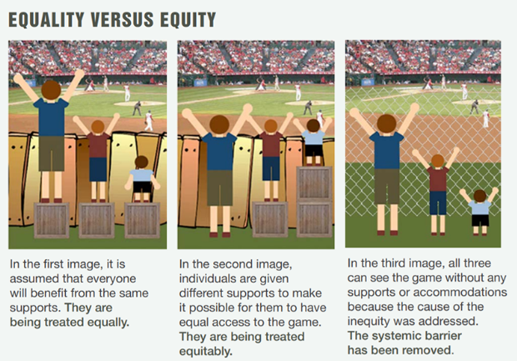
Can the NHS afford 3 boxes?

Slide 16

Reality of PHM
Most people respond to prompts if prodded enough and via mixed methodologies
Keep prodding and your performance will improve
Those that don’t respond are tricky! AND expensive

Slide 17

Group discussion
What have we achieved in our practices?
What challenges have we faced?
Do we want to plan something together?

