Slide 1

THS enables you to provide better & more efficient care
Dr James Boorer

Slide 2

Born out of frustration
Pathfields had a complex recall system involving a lot of high level management input
People would come in for bloods but not get their QOF checks done!
People might already have had their QOF checks but be recalled anyway!
People might miss recall and then run uncontrolled for a long period

Slide 3
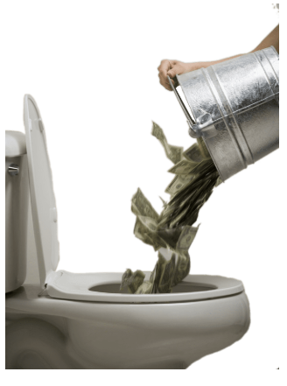
Expensive & wasteful
People attended more phlebotomy appointments than required
We processed bloods that were not needed
We were loosing senior management time to this work
Our QOF performance / income was very average

Slide 4

2018
Searches used to help our diabetologists review patients

Slide 5
2019
Searches used to drive diabetes recalls
We start to record outcome data in a dashboard

Slide 6
2020
Protocol to help ensure all bloods required for a QOF review are done when a patient comes in for a test

Slide 7
2021
Rise of the machines: The computer takes over all blood, BP and ACR recalls at Pathfields in April 21.
Computer prompts medical team to uptitrate BP meds in people with uncontrolled hypertension.
Development of templates to support clinicans processing pathology results

Slide 8
2022
Rise of the machines: The computer takes over all blood, BP and ACR recalls at Pathfields in April 21.
Computer prompts medical team to uptitrate BP meds in people with uncontrolled hypertension.
Nerve racking for managers and myself!
Positive results with improving QOF performance seen within 4-6 weeks!

Slide 9
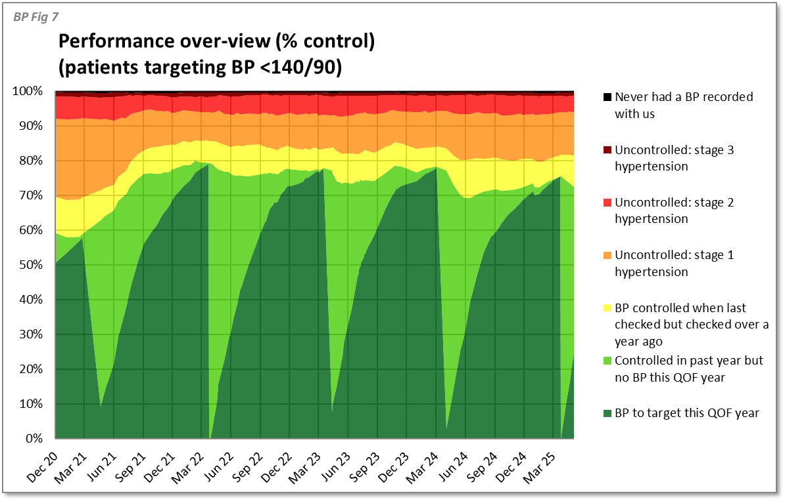

Slide 10
2023
Diabetes and hypertension performance much improved despite the COVID pandemic, leading regional hypertension league tables by some margin
NHSE Diabetes (covid) Recovery & Innovation Fund bid:
£194K awarded to support an expanded pilot in Devon
Ongoing expansion of capabilities, reports, dashboards

Slide 11
2024
Slow uptake in many parts of Devon
Those that did adopt and use excelled

Slide 12
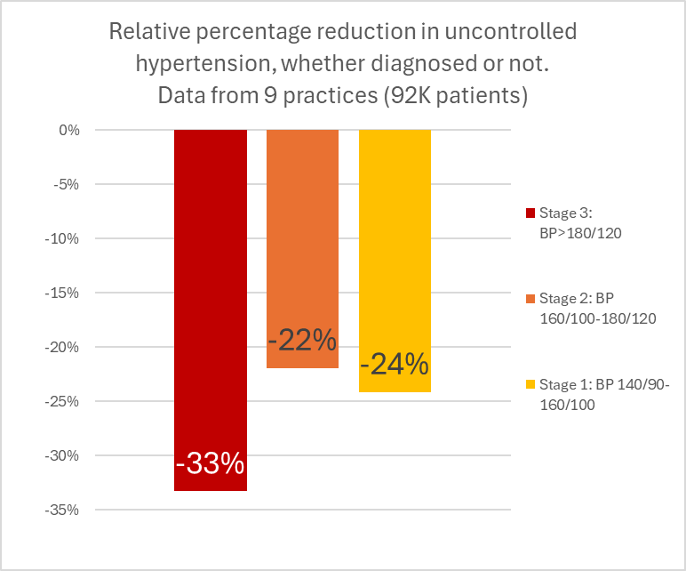
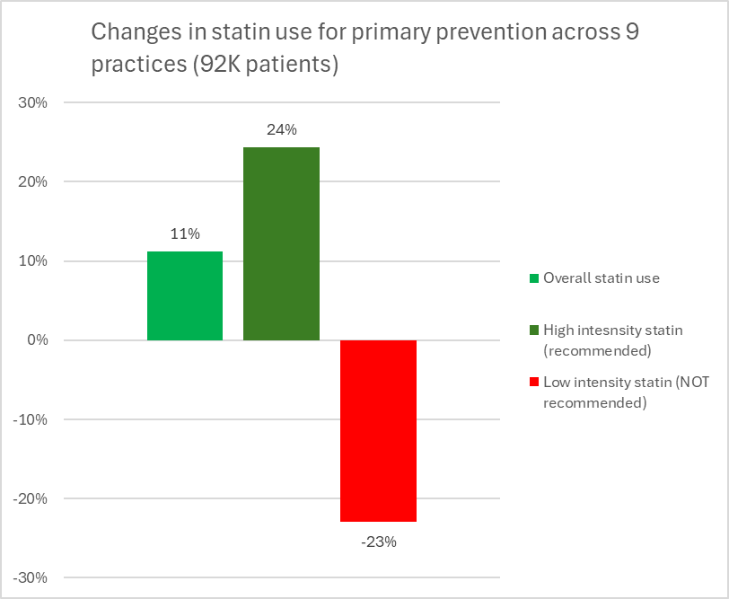

Slide 13
2025
We want more people to join us
We want to transform Devon into the best performing ICB for LTC care and CDV prevention
We want to help you stop people with hypertension and other conditions suffering strokes, heart attacks and dying
Free to use in Devon until 01/04/2028 and after this time price matched to Ardens / Competitors

Slide 14

So how does it work? Recall
The recall software is based of thousands of reports
Patient biometrics compared to guidelines and recall flexes to date and value of last test
eg: HbA1C recall is 6 monthly when controlled and 3 monthly when not
Admin users invite patients in bulk using the most cost effective recall method (SMS / email)
Takes minutes rather than hours
Simple and can be done by an apprentice

Slide 15
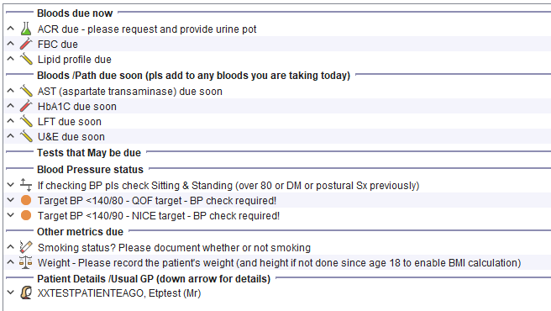
Nurse / HCAs get a pop up detailing what tests are due

Slide 16
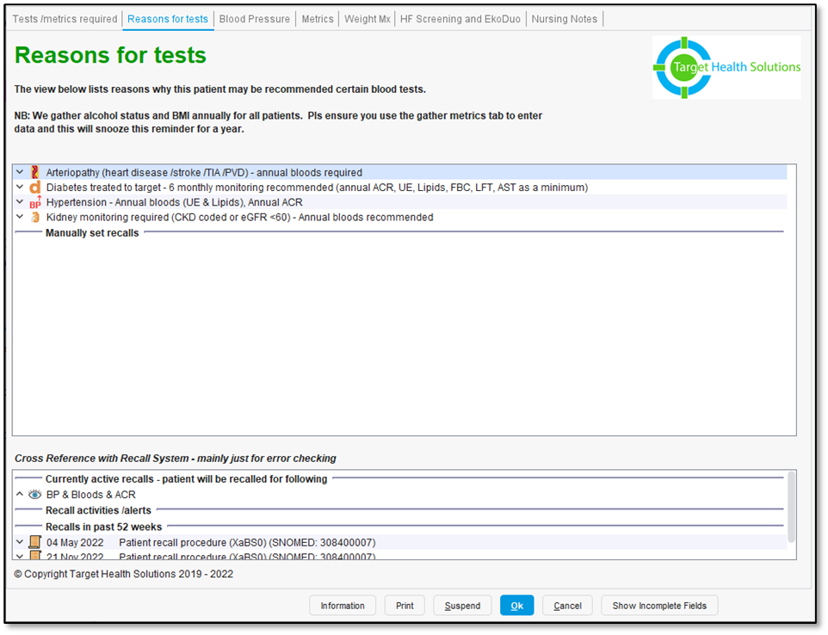
If you want to know why a patient is being recalled

Slide 17
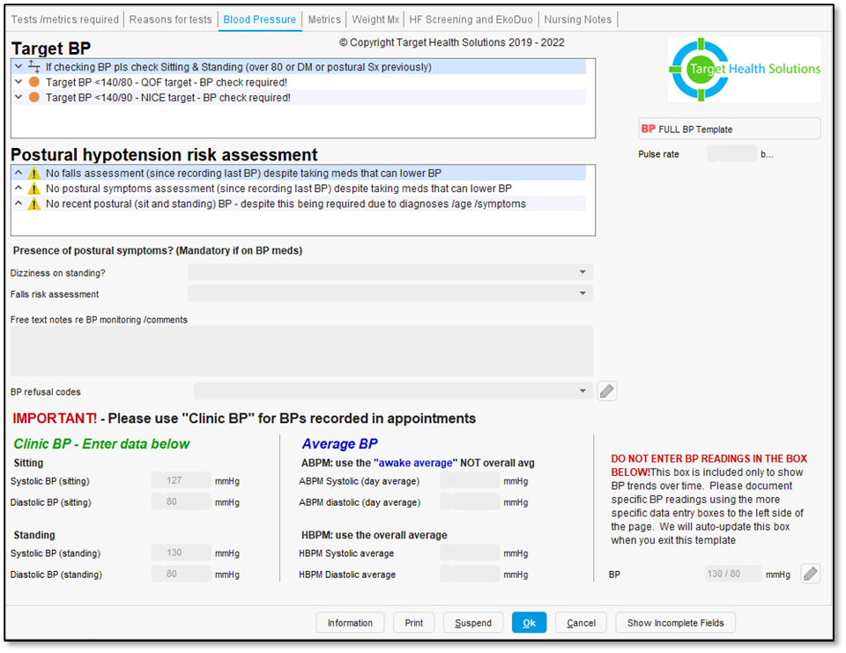
BP decision support prompts
If BP entered is above QOF target the system prompts the HCA / nurse to send a task to the hypertension team to consider increasing meds

Slide 18
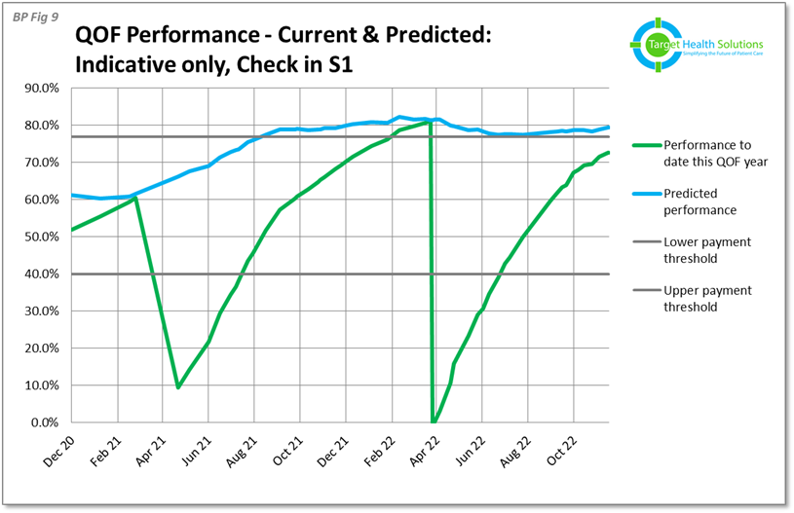
Results speak for themselves

Slide 19
Staff efficiency
Saves huge time for admin teams managing recalls
Potentially saves phlebotomy time
  You will significantly reduce wasted appointments but will be monitoring in line with NICE so some people will be called in more frequently
Saves nurse review time
  Patients do not need an annual hypertension / cardiovascular / diabetes review with a nurse
    if their BP and biometrics are to target they can carry on as normal
    If their BP is high a pharmacist or pharmacy tech can discuss with them remotely
    If their HbA1C is high they get a nurse review (but not required if to target)
  Pathfields have not re-recruited a full time nurse due to these efficiencies (30,000 patient practice)

Slide 20
Clinical templates

Slide 21
Clinical templates
Not tick boxy
If its not a mandatory QOF code you don’t get a tick box!
Collate all relevant information in one place
Helps clinicians make faster and safer decisions

Slide 22
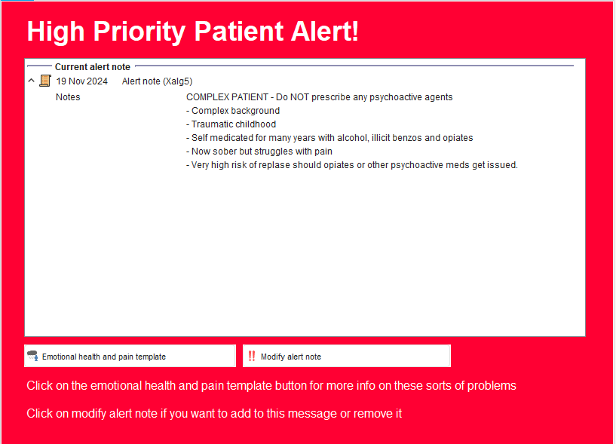

Slide 23

Anaemia – a thief of GP time!
High risk (could it be cancer?)
Have they seen a gastroenterologist?
Have they been scoped?
Had a qFIT?
Is there another condition causing in?

Slide 24
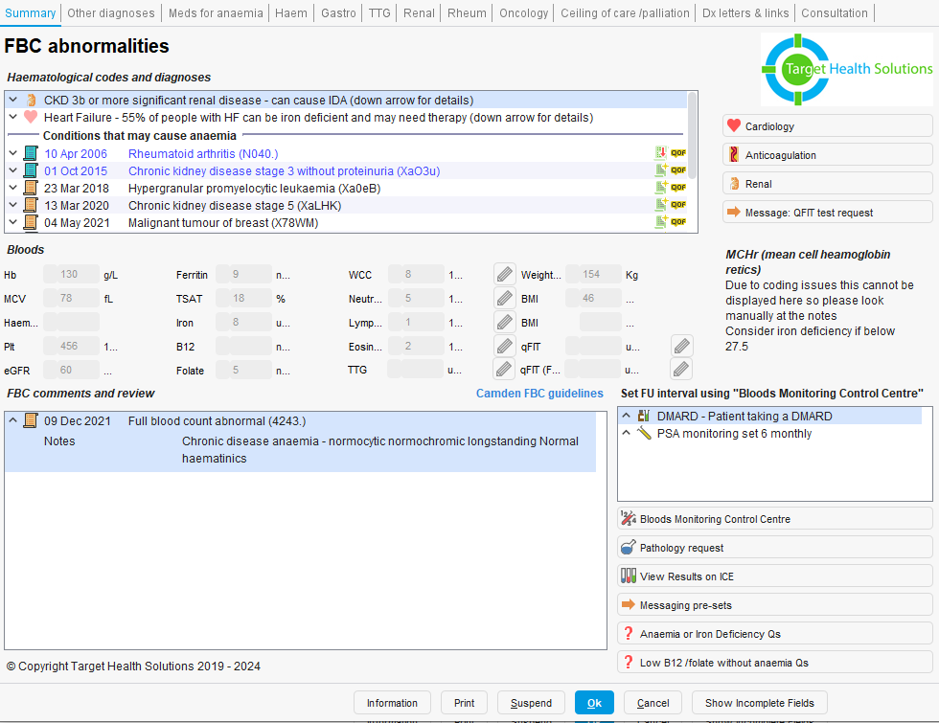
THS draws all relevant information into one place
Previous GP assessments of the blood count
Key FBC metrics
Haematinics
Relevant diagnoses
Letters from gastro and endoscopies
Provides GPs with an anaemia questionnaire they can send to a patient in a few clicks

Slide 25

Cardiology and heart failure

Slide 26
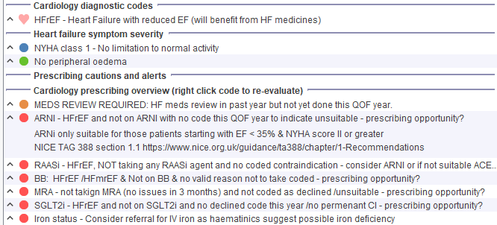
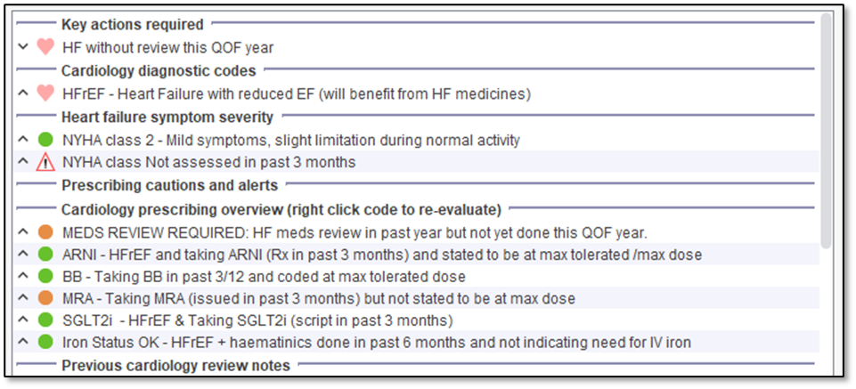

Slide 27
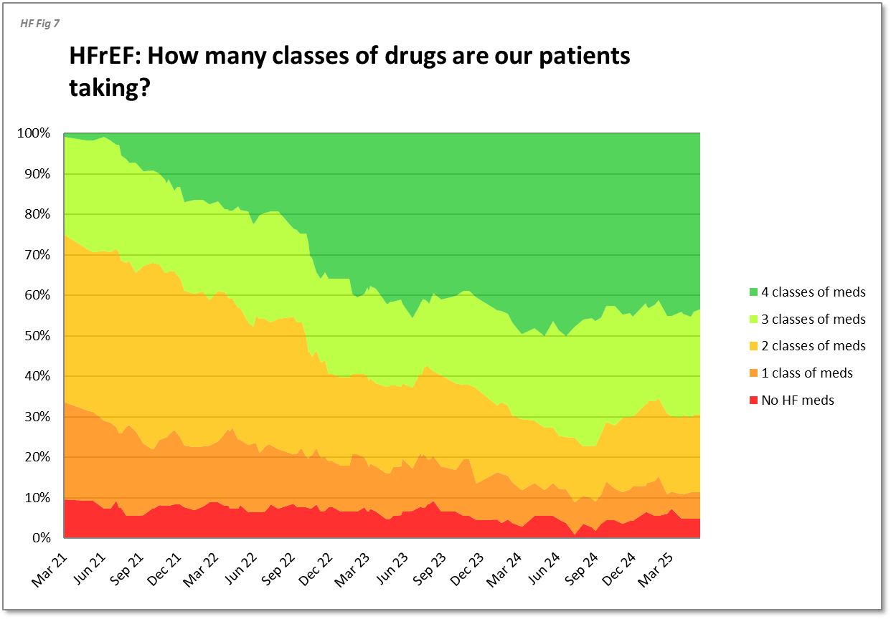
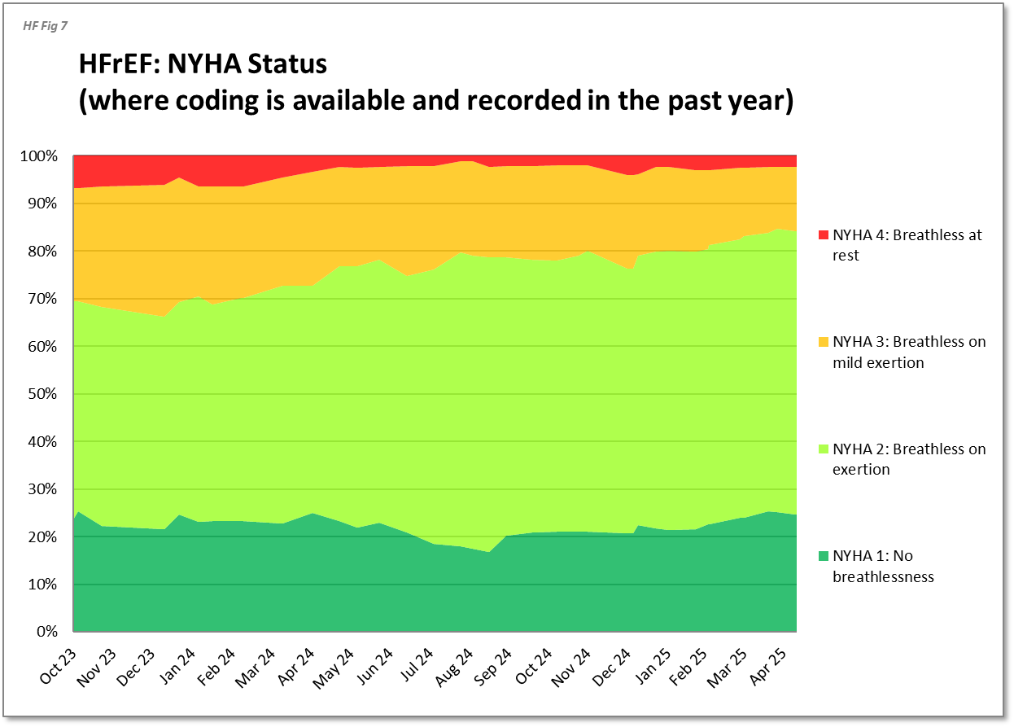
Heart failure:
As prescribing improves patient symptoms reduce

Slide 28
Lipid optimisation

Slide 29
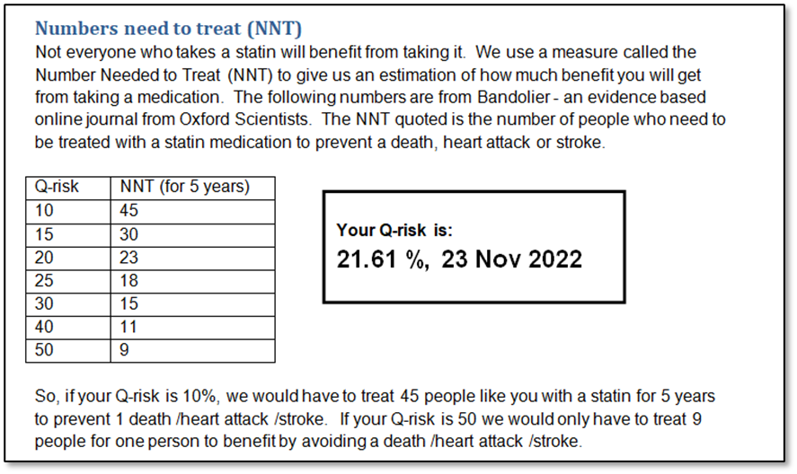
“Force” clinicians to Q-Risk and if > 10% send an automated, personalized letter to the patient offering statin therapy

Slide 30
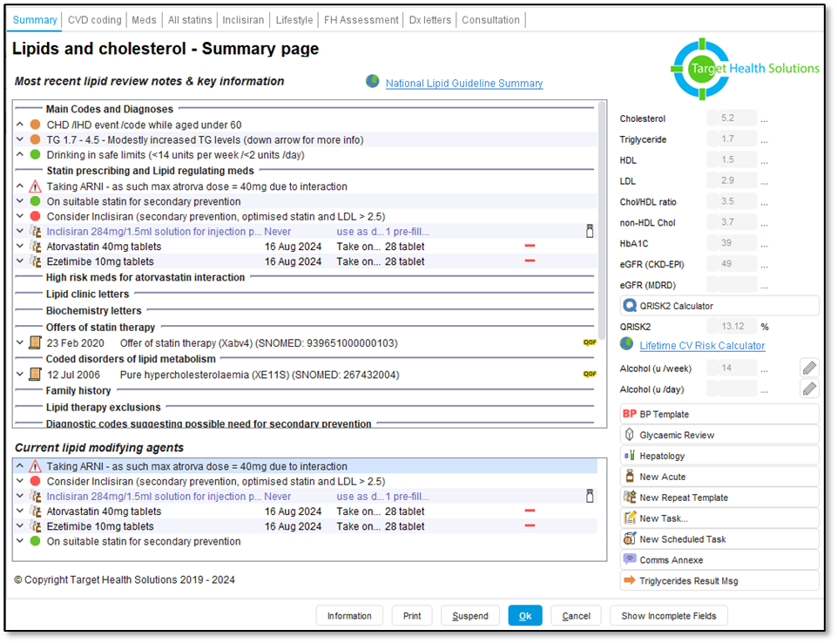
Statin template:
Prompts to uptitrate therapy if indicated
Manages Inclisiran recalls

Slide 31
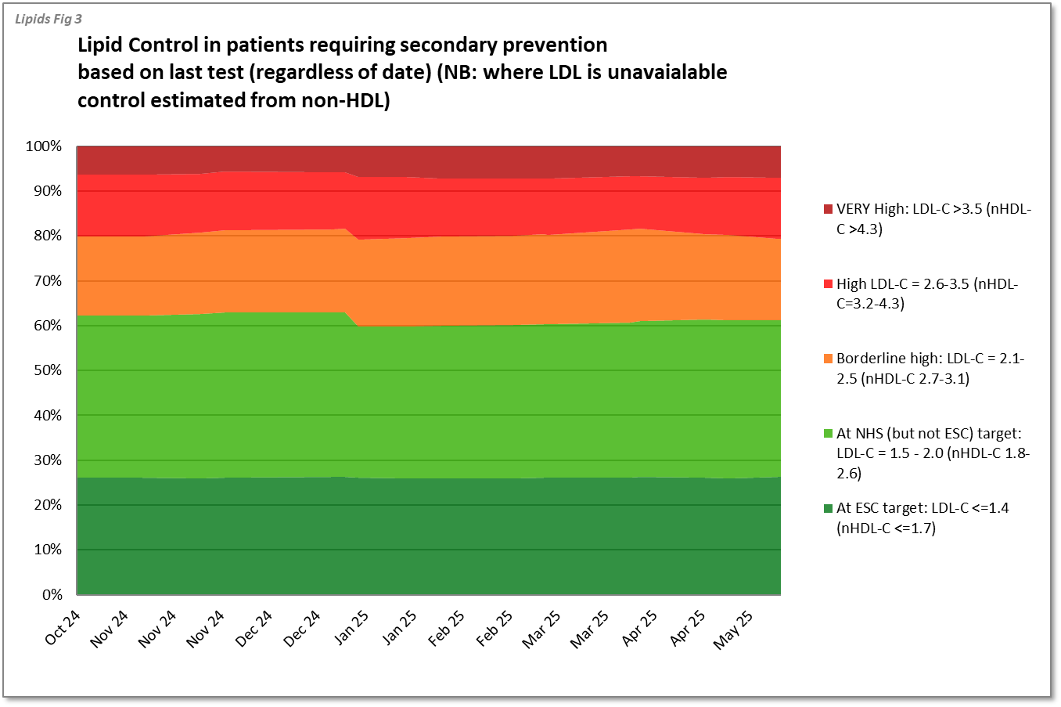
Results:
Pathfields have already smashed next year’s LDL target achievement by 10%

Slide 32
Free until 2028
We want to help you save lives AND maximise your QOF income
We have clinicians and managers who can help you deploy
Questions? Recall video? Test patient? Dashboard?

