Slide 1


Effectively Plan, Deliver, and Monitor National & Local Contracts
with Ardens
Wednesday 4th June 2025
Nathan Cavin – Training Specialist Lead

Slide 2



Agenda
Plan, Deliver and Monitor GP Contracts
National Contracts
Local Contracts
Ardens Clinical
Ardens SystmOne & Ardens EMIS
Templates, Protocols & Reports
Ardens Manager
Dashboards

Slide 3




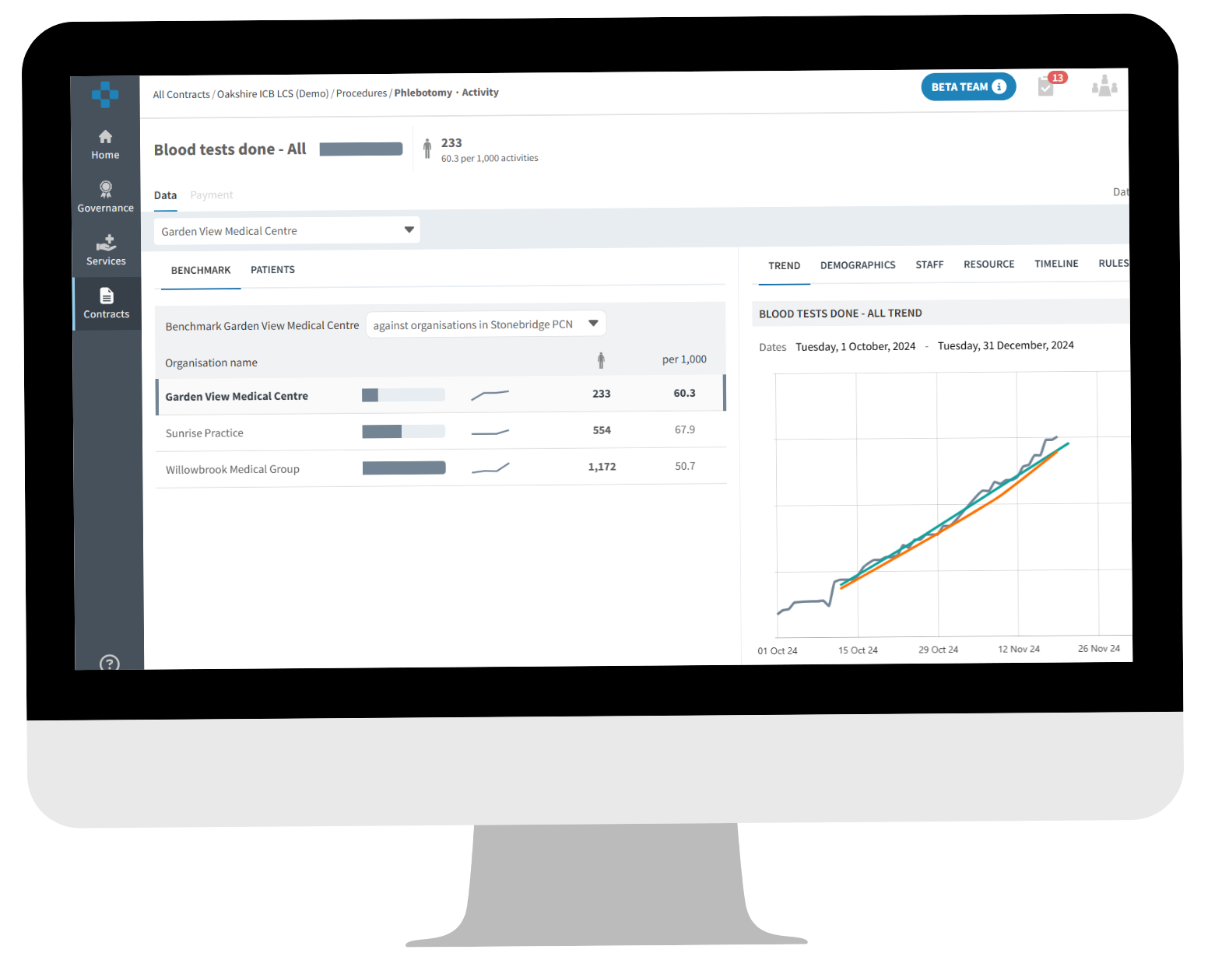
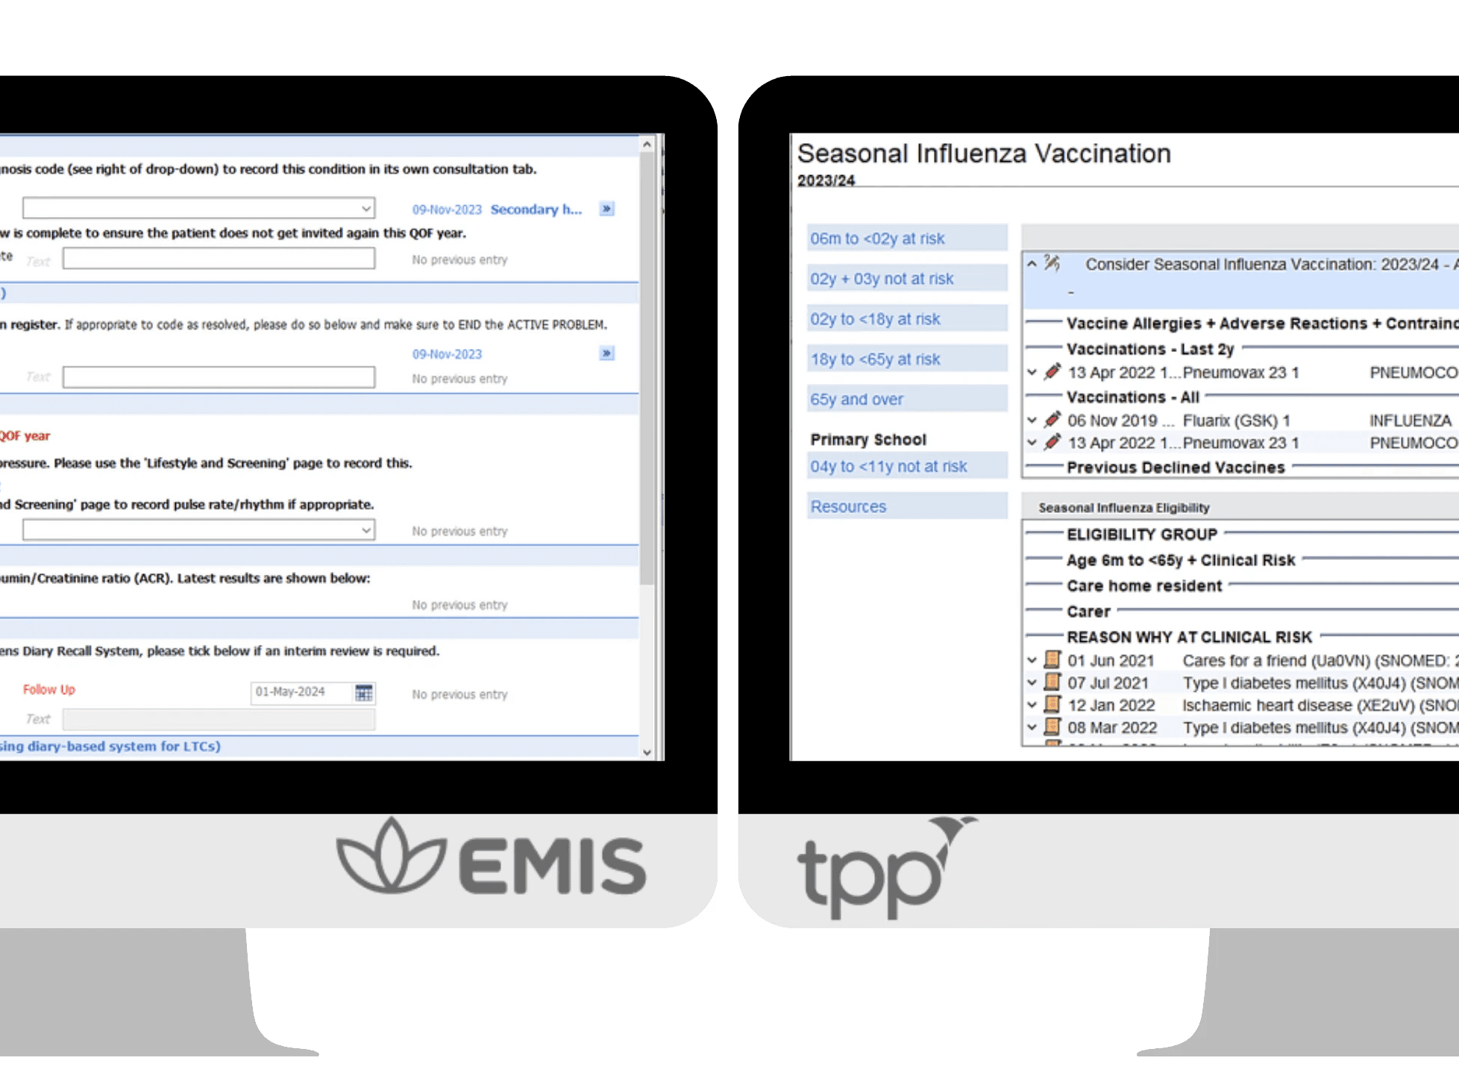





About Ardens - Our Products
BEST PRACTICE
ACCESS
CONTRACT
OUTCOMES
PATIENT DATA
Our clinical decision support tool for
EMIS Web & SystmOne users.
Our population health management tool for GP Practices, PCNs, ICBs & councils.
EFFICIENCIES

Slide 4







Clinical templates
Safety alerts
Clinical decision support tools
for EMIS Web and SystmOne users
Recall systems
Data quality reports
Referral forms
Local contracts

Slide 5



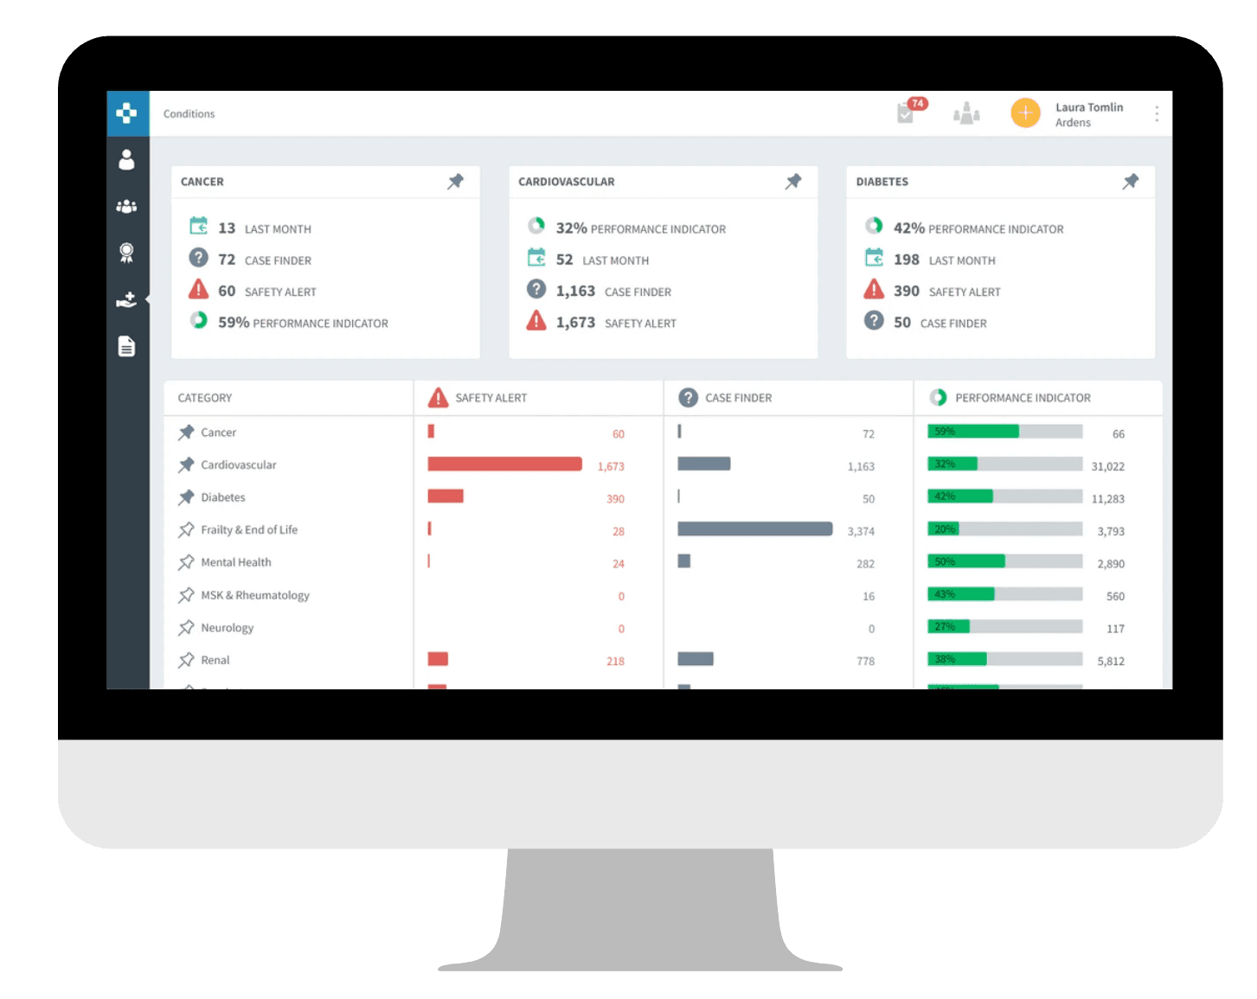




Automatic data uploads
Rules &
code sets
Population health management tools
for GP practices, PCNs, ICBs, Councils & Groups
Benchmark & breakdown
Trends & targets
Assign & comment
Patient data
NEW

Slide 6

About Ardens - Our Coverage
5,400+
GP Practices
1,300+
Primary Care Networks
140
Dedicated staff
42
Integrated Care Boards
12+
Years experience

Slide 7







What can Ardens be used for?
Contract
Delivery
Demand &
Capacity
Disease
Prevention
Medicines
Optimisation
Referral
Management
Vaccination
Delivery

Slide 8
Devon Priorities
Devon LCS Essentials Dashboard In Development for 25/26
Public Health Dashboards for Devon Council
  NHS Health Checks
  Smoking Cessation
Super Users

Slide 9
National Contracts
National Contracts
QOF
NHS Health Checks
Weight Management
SMI Health Checks
Network Contract DES
Notes:
Ardens covers all National Contracts
In our example we will focus on QOF but applies to all of these as well

Slide 10
National Contracts
Plan, Deliver and Monitor GP Contracts
Local Contracts
Ardens Clinical
Ardens SystmOne & Ardens EMIS
Templates & Reports
Ardens Manager
Dashboards

Slide 11




LCS Essentials
Simplify claims & enhance care for your local population
Improved accuracy & efficiency with automatic extraction & reporting, removing the need for manual claims.
Better transparency with embedded business rules and code-lists in a clear format that are easy to understand.
Enhanced outcomes through using resources designed to address the unique challenges of your local population.
National Contracts
Local Contracts
Notes:
LCS Essentials Overview

Slide 12





LCS Essentials
Key functionality on Ardens Manager now included in Ardens Plus or Pro
Automatic daily reporting
Practice, PCN & ICB benchmarking
Trends &
targets
Rules &
code-sets
Patient data
NEW
National Contracts
Local Contracts

Slide 13
Local Contracts
Local Contracts
Plan
Notes:
Ardens Manager - planning

Slide 14
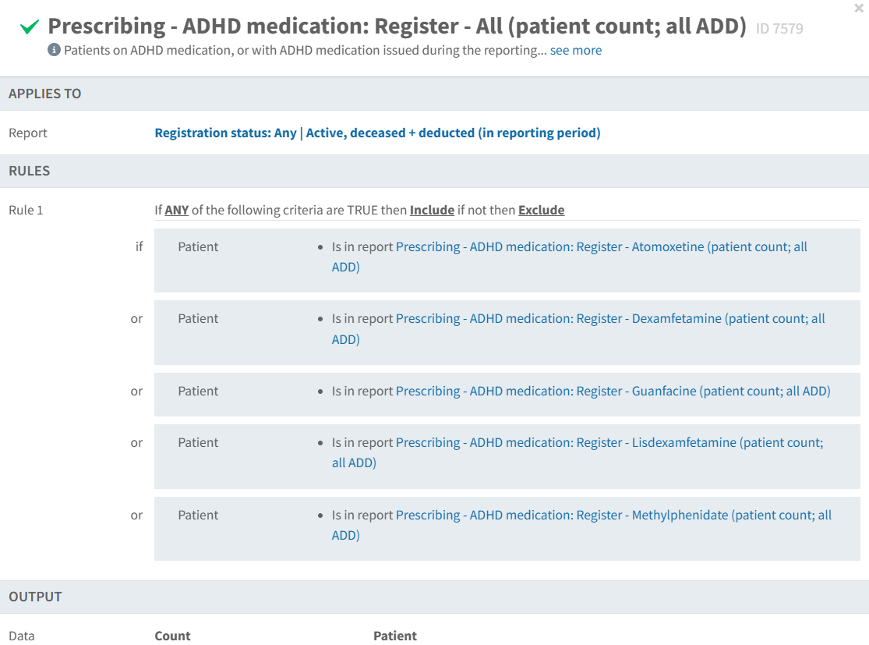
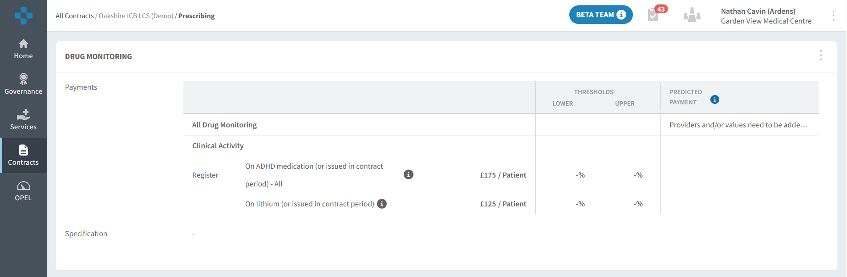
Plan – Dashboard
National Contracts
Local Contracts
Notes:
Contract page to view specific specifications and business rules, and what the reports are looking for

Slide 15
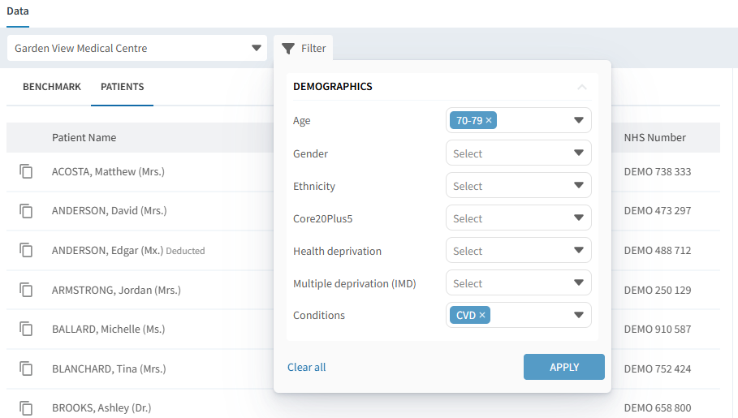
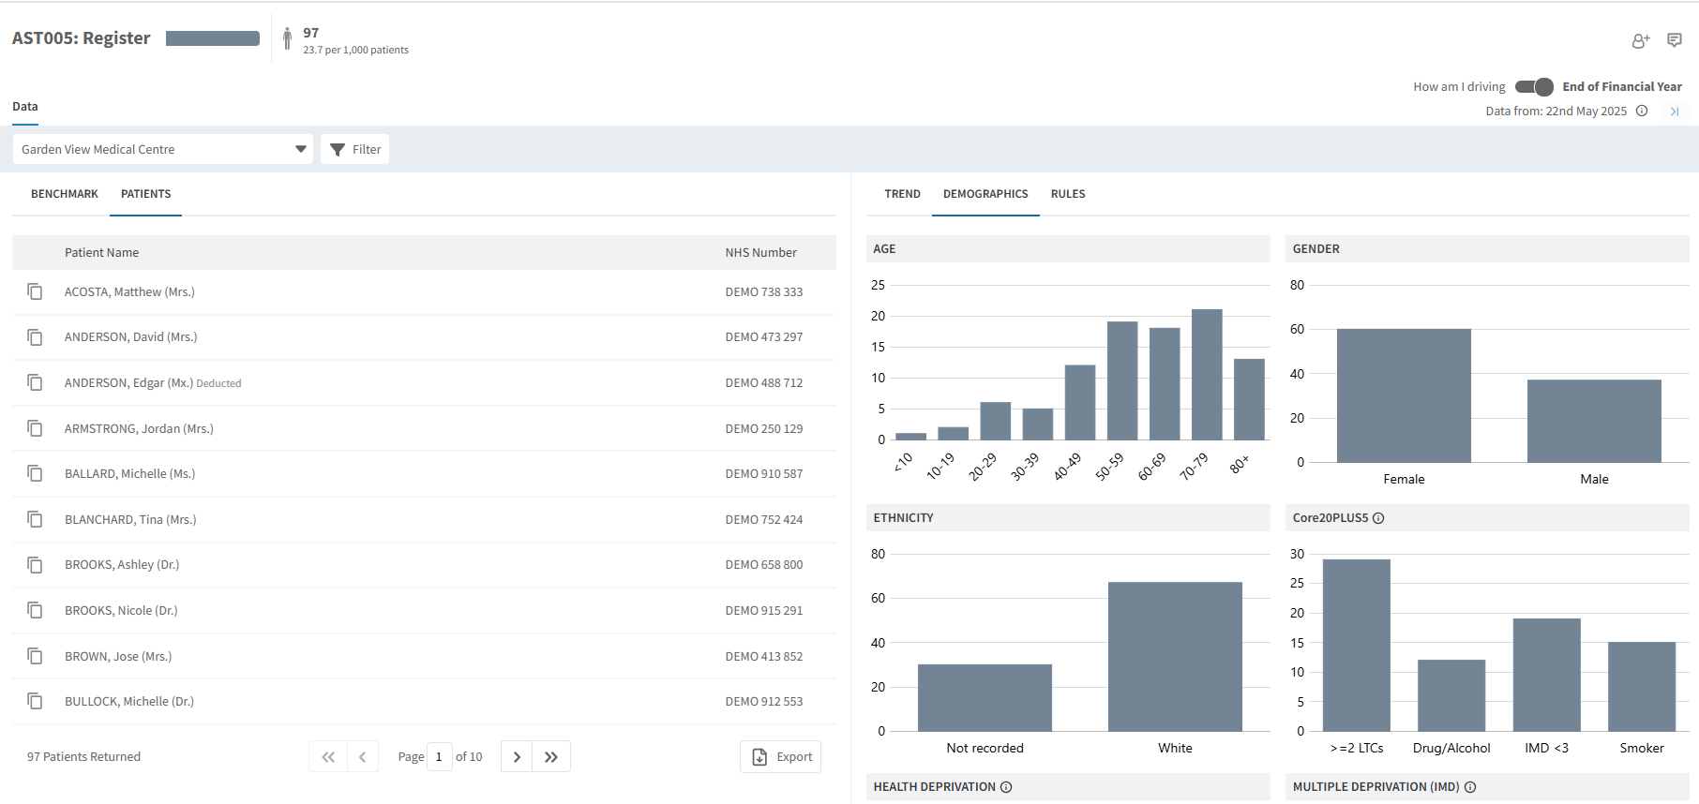
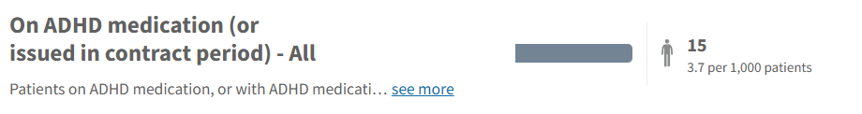
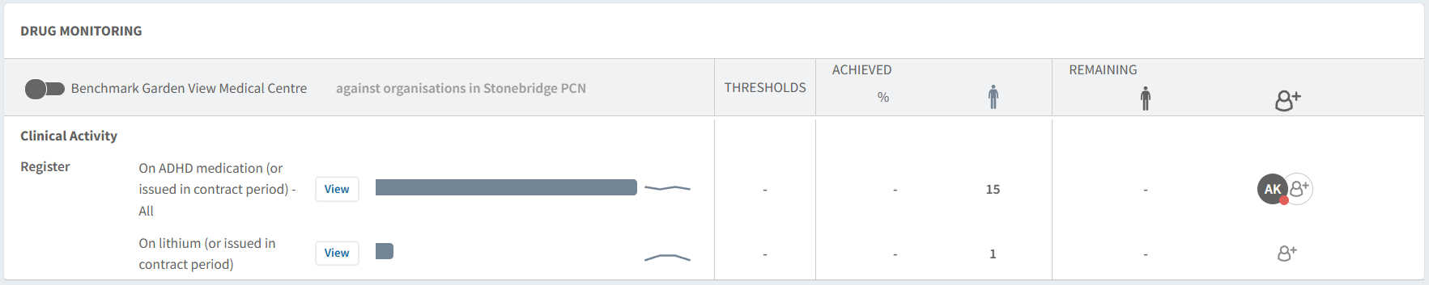
Plan – Dashboard
National Contracts
Local Contracts
Notes:
Can view Registers to plan work
Can view patient data with smart card
Can view demographics
Can filter patients on various data

Slide 16
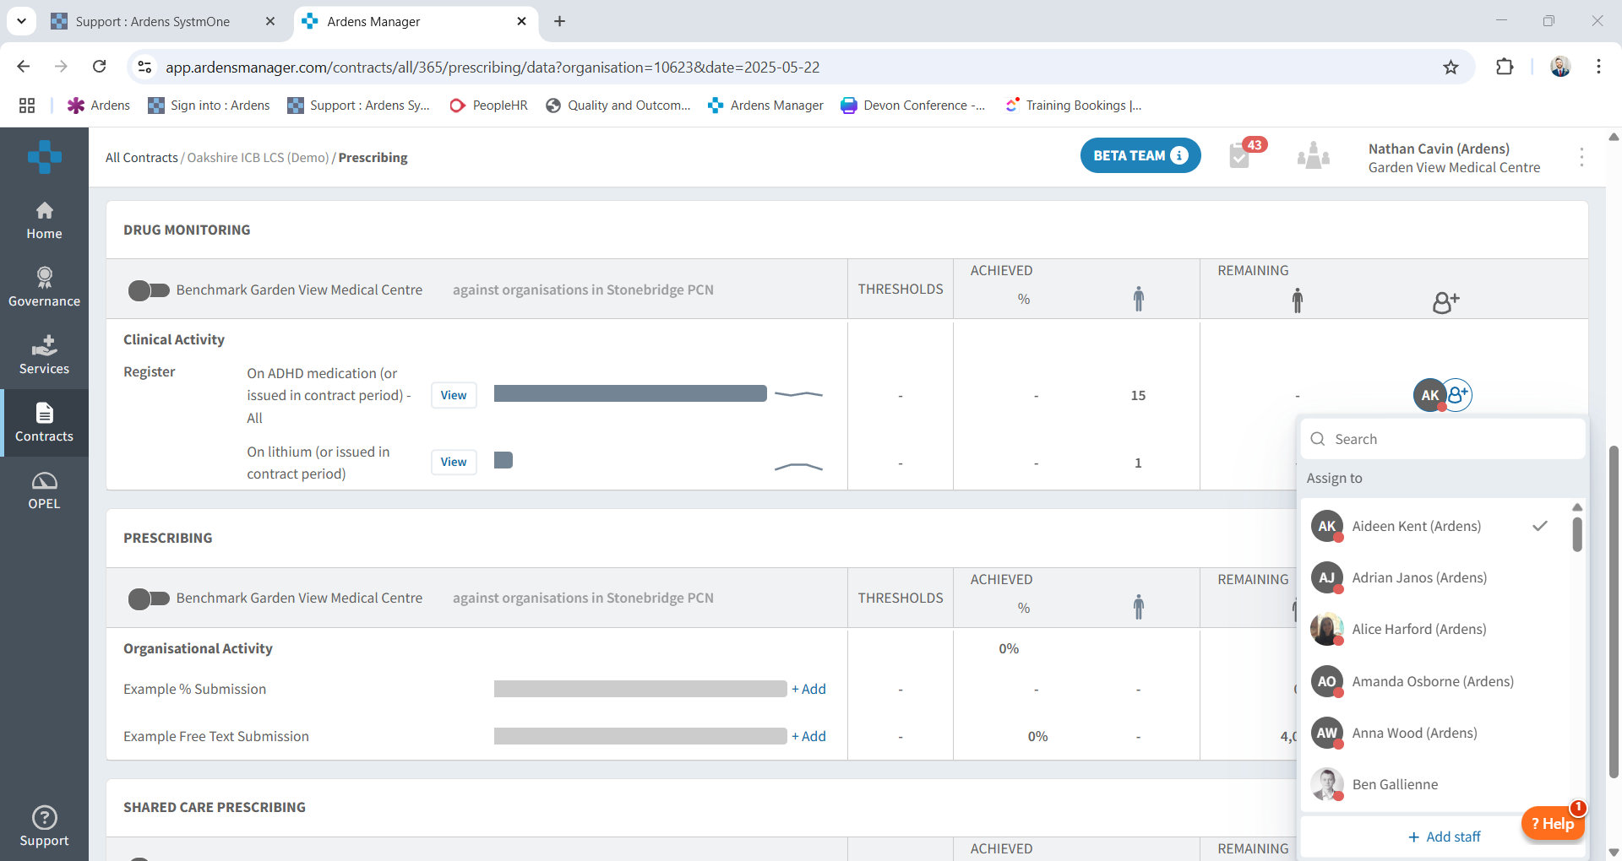
Plan – Assign & Comment
National Contracts
Local Contracts
Notes:
Can assign work to other staff members easily

Slide 17
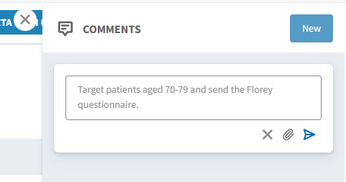
Plan – Assign & Comment
National Contracts
Local Contracts
Notes:
Can leave comments to plan work load and focus on specific areas

Slide 18
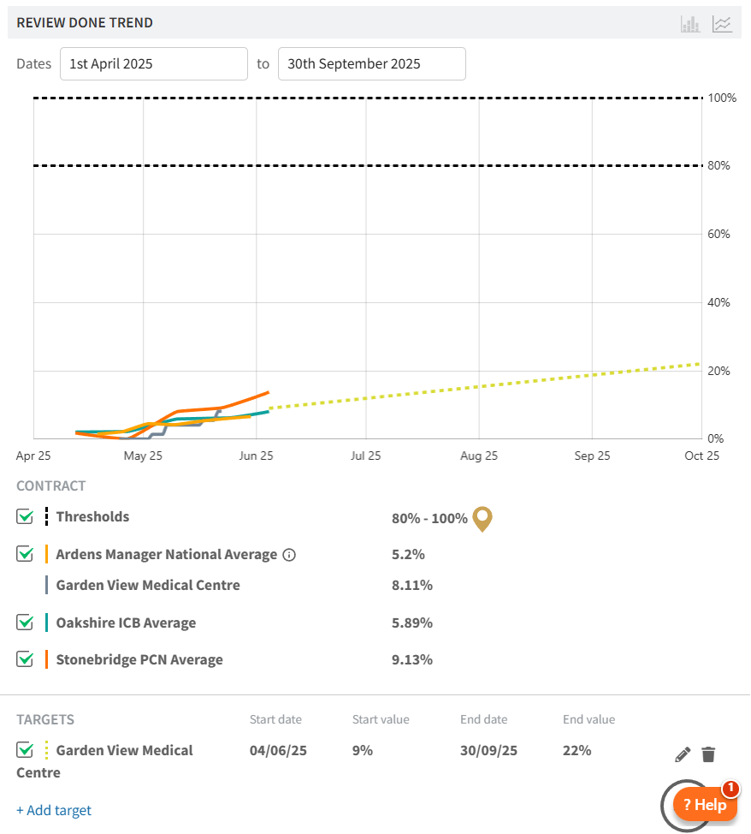
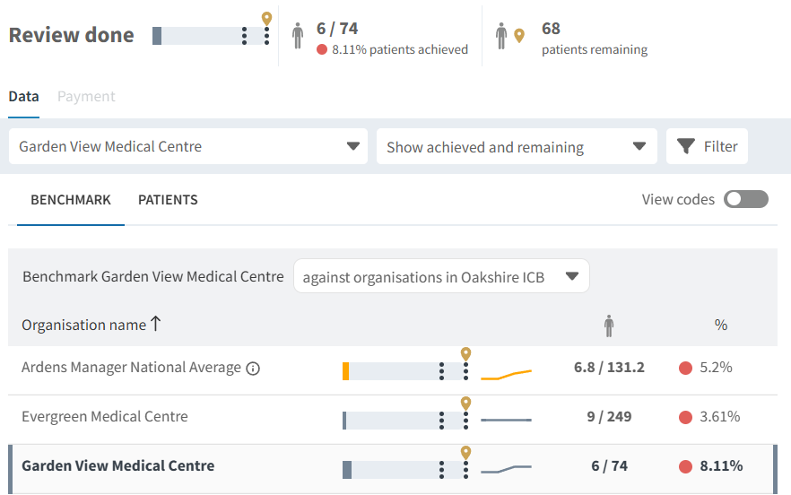
Plan – Trends & Targets
National Contracts
Local Contracts
Notes:
Can view trend data – across ICB/PCN if working at that level
Can set targets for Practice for ICB/PCN etc – achieve certain work by a certain time

Slide 19

Local Contracts
Local Contracts
Deliver

Slide 20
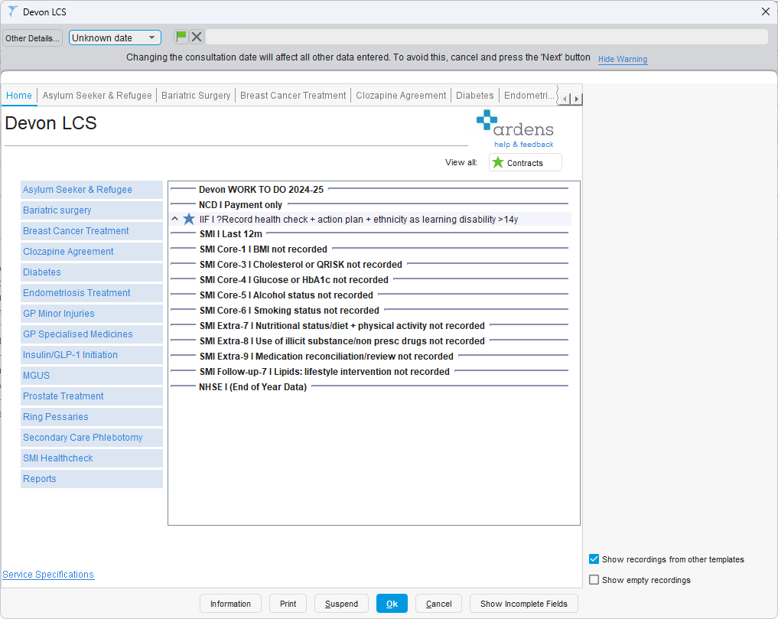
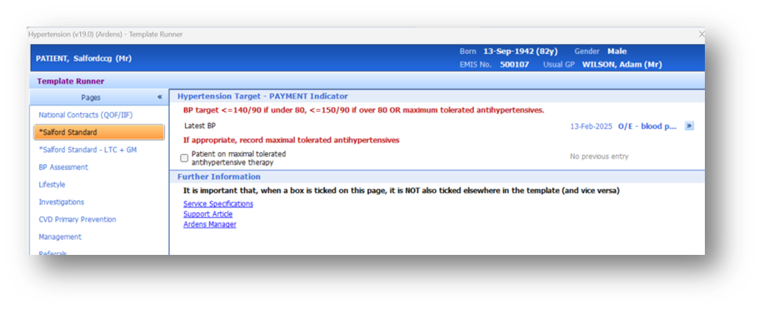
Deliver – Record Data
* ICB Name
National Contracts
Local Contracts
Notes:
For Local Contract data entry:
Practices who use SystmOne will find a contract specific template which is separate from the standard templates.
The template will be named accordingly and will outline the criteria of the specification and the necessary data fields to ensure accurate completion.
Practices who use EMIS Web will continue to use the standard Ardens Clinical Templates and where appropriate they will include localised content. The local content is usually represented by an additional page, which is named with an * followed by the name of the ICB or Place.

Slide 21
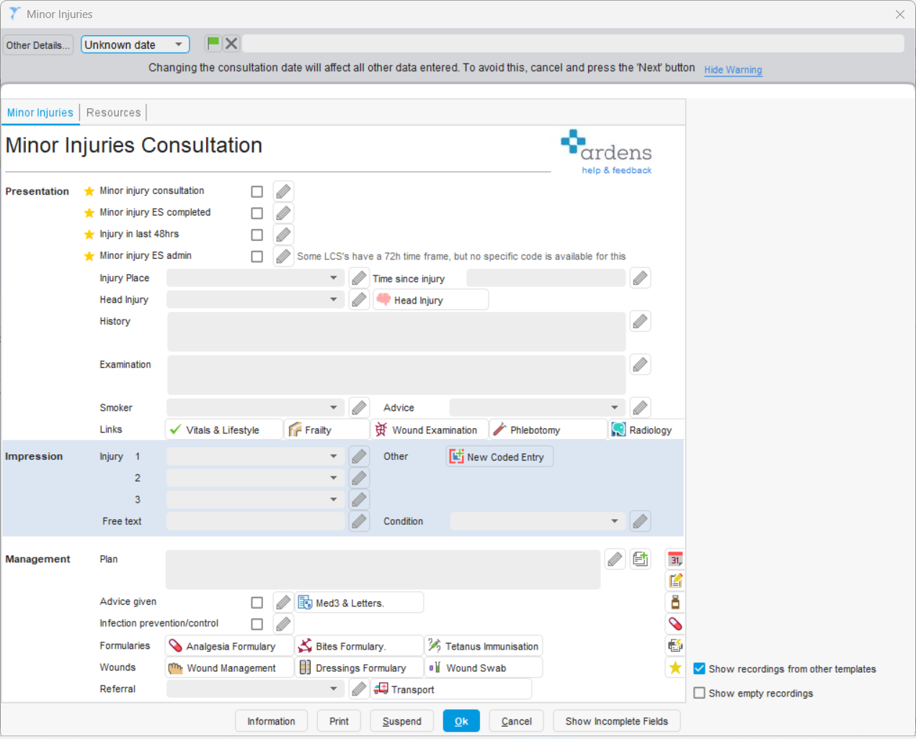
Deliver – Record Data
* ICB Name
National Contracts
Local Contracts
Notes:
For Local Contract data entry:
Practices who use SystmOne will find a contract specific template which is separate from the standard templates.
The template will be named accordingly and will outline the criteria of the specification and the necessary data fields to ensure accurate completion.
Practices who use EMIS Web will continue to use the standard Ardens Clinical Templates and where appropriate they will include localised content. The local content is usually represented by an additional page, which is named with an * followed by the name of the ICB or Place.

Slide 22
Deliver – Record Data
National Contracts
Local Contracts
Notes:
For Local Contract data entry:
Practices who use SystmOne will find a contract specific template which is separate from the standard templates.
The template will be named accordingly and will outline the criteria of the specification and the necessary data fields to ensure accurate completion.
Practices who use EMIS Web will continue to use the standard Ardens Clinical Templates and where appropriate they will include localised content. The local content is usually represented by an additional page, which is named with an * followed by the name of the ICB or Place.

Slide 23
Local Contracts
Local Contracts
Monitor
Notes:
Ardens Manager - planning

Slide 24
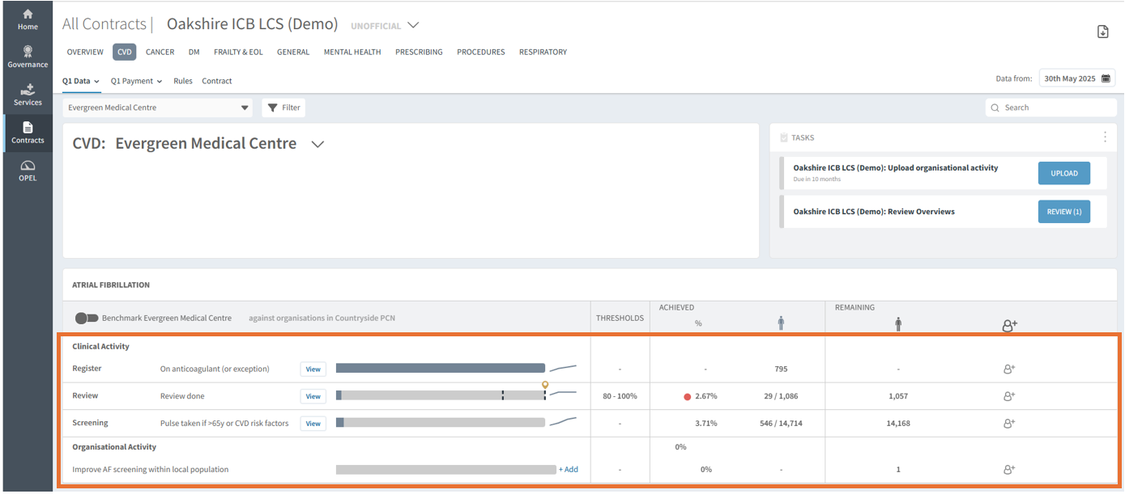
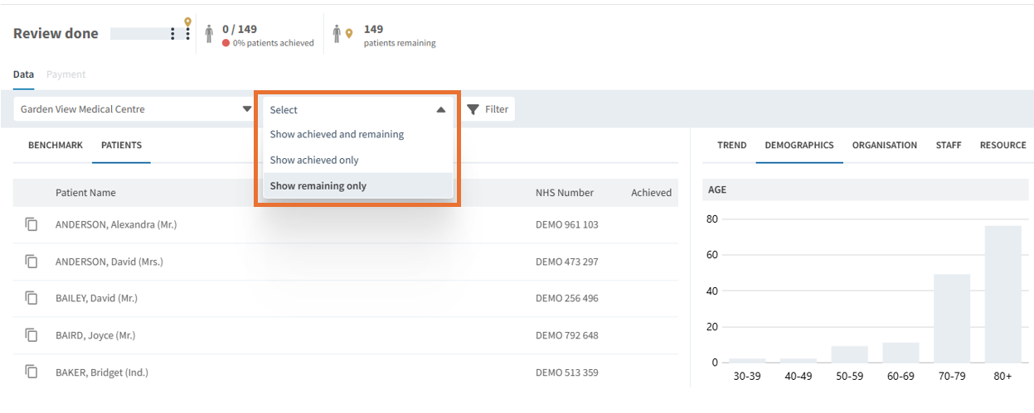
Monitor – Dashboard
National Contracts
Local Contracts
Notes:
Can then clearly see the progress of the specific local specifications, and how a practice is doing
Click
Can then see remaining patients who still need work done, just like before with QOF but now linked to their local services

Slide 25
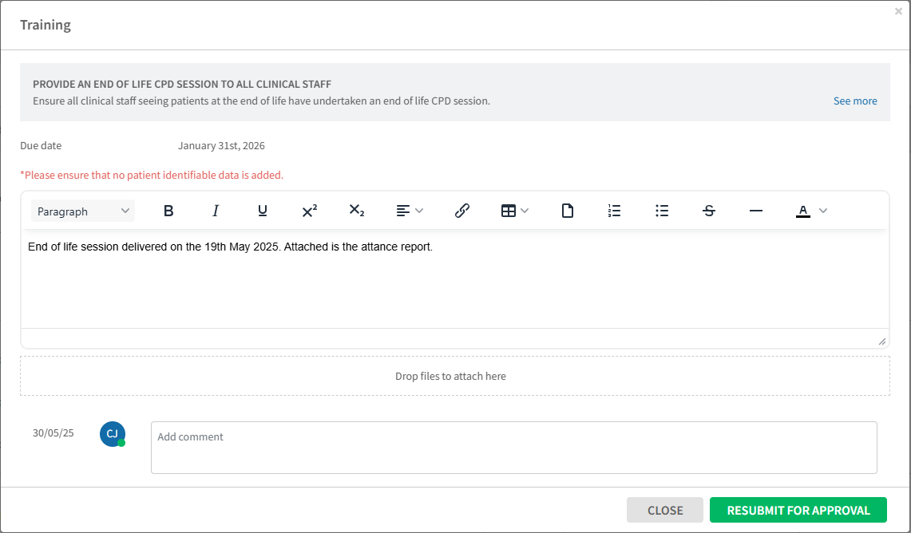
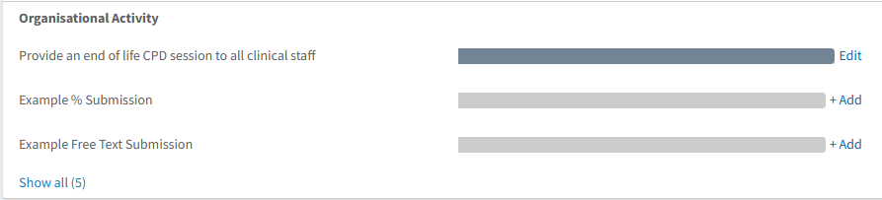
Monitor – Dashboard
National Contracts
Local Contracts
Notes:
Organisational Activity that can’t be recorded in the clinical systems can be recorded on Ardens Manager
Click
E.g. Record specific training for staff with deadlines, and attachments and comments from staff

Slide 26
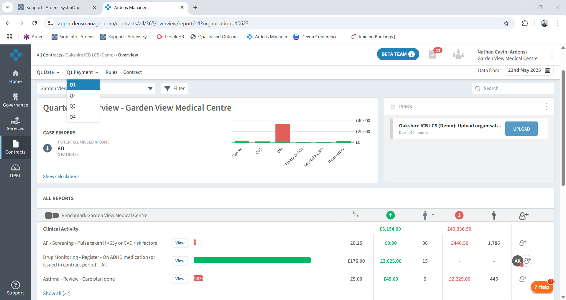
Monitor – Dashboard
National Contracts
Local Contracts
Notes:
Can then easily report on the areas that have been achieved on the local contracts for easy submission for payment
Breakdown by Quarter
Quicker and Clearer than finding and running the reports within SystmOne has extracted automatically and ready to be checked

Slide 27
Monitor – Dashboard
National Contracts
Local Contracts
Notes:
Can then easily report on the areas that have been achieved on the local contracts for easy submission for payment
Breakdown by Quarter
Quicker and Clearer than finding and running the reports within SystmOne has extracted automatically and ready to be checked

Slide 28
Monitor – Dashboard
National Contracts
Local Contracts
Notes:
Can then easily report on the areas that have been achieved on the local contracts for easy submission for payment
Breakdown by Quarter
Quicker and Clearer than finding and running the reports within SystmOne has extracted automatically and ready to be checked

Slide 29
Monitor – Dashboard
National Contracts
Local Contracts
Notes:
Can then easily report on the areas that have been achieved on the local contracts for easy submission for payment
Breakdown by Quarter
Quicker and Clearer than finding and running the reports within SystmOne has extracted automatically and ready to be checked

Slide 30
Agenda
Plan, Deliver and Monitor GP Contracts
National Contracts
Local Contracts
Ardens Clinical
Ardens SystmOne & Ardens EMIS
Templates, Protocols & Reports
Ardens Manager
Dashboards

Slide 31






In-person
training
Regular
webinars
Ardens
Academy
Online
support articles
Dedicated
support team
Facebook
community

Slide 32
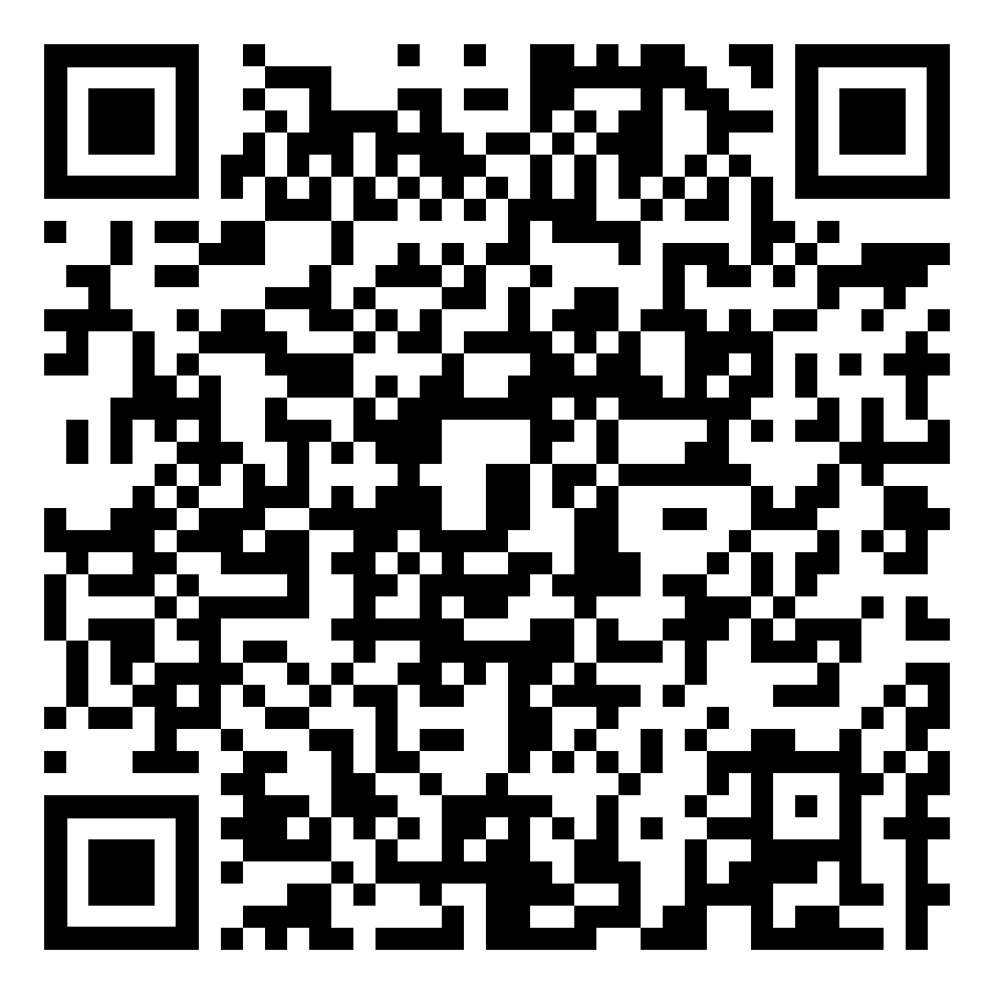
Register for webinars→
Thursday 12th June – 1pm
Planning & Monitoring the 2025/26 GP Contract with Ardens Manager
Thursday 26th June – 1pm
Managing Demand & Capacity with Ardens Manager
Trial Ardens Manager for 3 Months
Take advantage of a 3-month free trial of Ardens Manager National Content dashboards for Devon practices.
www.ardens.org.uk/trial

Slide 33
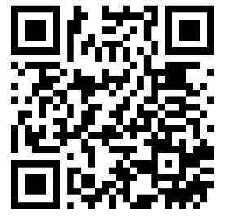
Scan to get in touch →
support-systmone@ardens.org.uk
support-emis@ardens.org.uk
support-manager@ardens.org.uk
training@ardens.org.uk

