Slide 1

RESTORE2 and RESTORE2 Mini
Training for Clinical Staff in Primary Care

Slide 2

What is

Slide 3
RESTORE2 is a physical deterioration and escalation tool for care/nursing homes
It is designed to support homes to:
Recognise when a resident may be deteriorating or at risk of physical deterioration
Act appropriately according to the residents care plan
Obtain a complete set of physical observations to inform escalation and conversations with health professionals
Speak with the most appropriate health professional in a timely way
Provide a concise escalation history to health professionals to support their professional decision making
Get staff and residents the right support in the right timescale

Slide 4
RESTORE2 – Training of Carers
Many carers (care homes, domiciliary carers and informal carers) have been involved in RESTORE2 training over the last 12 months which has been either virtually delivered or face-to-face by their in-house trainers and competencies have been assessed where appropriate.
We have sent you this training package as some care staff in your area have now signed up for/completed the training and therefore you may start noticing a difference in the calls you receive, the information you are given and the way this is communicated to you.

Slide 5
RESTORE2
What are the main features of the RESTORE2
  Recognising soft signs that may indicate a patient is deteriorating
  NEWS2 score: Using a NEWS score when they are well and comparing this to a NEWS score when there has been any change
  Communication and handover: Using the SBARD tool care staff will handover the clinically relevant information about the patient including a recommendation of what they feel this patient needs.

Slide 6
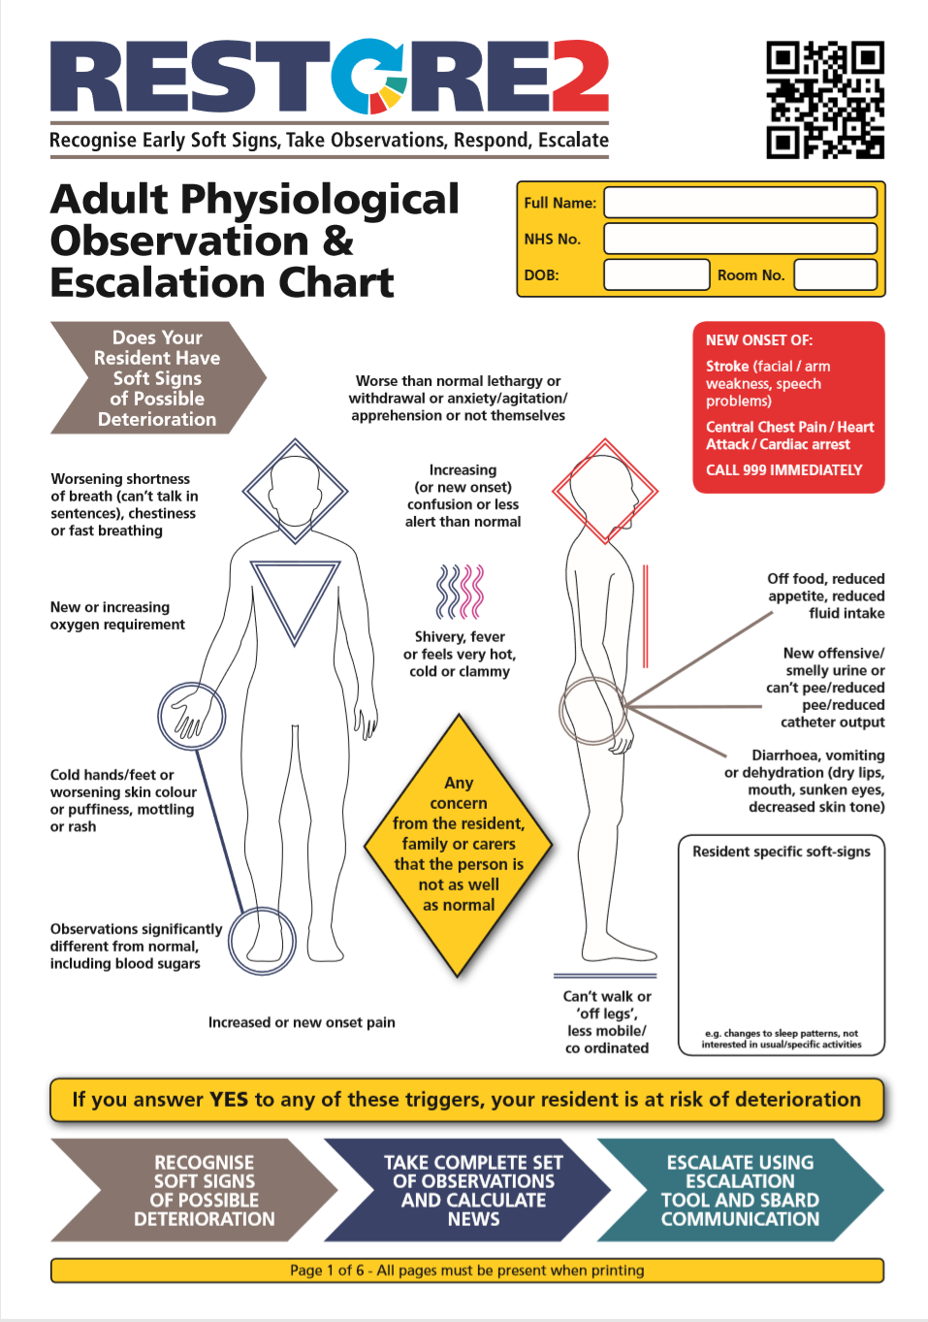
RESTORE2 Document
When care staff within a care setting have completed training they will receive or be able to print off a copy of the RESTORE2 documentation. Each resident will have their own personalised RESTORE2 documentation.
Soft Signs
Care staff are initially asked to review their patient on a regular basis and look for any possible soft signs of a deteriorating patient.
Car

Slide 7
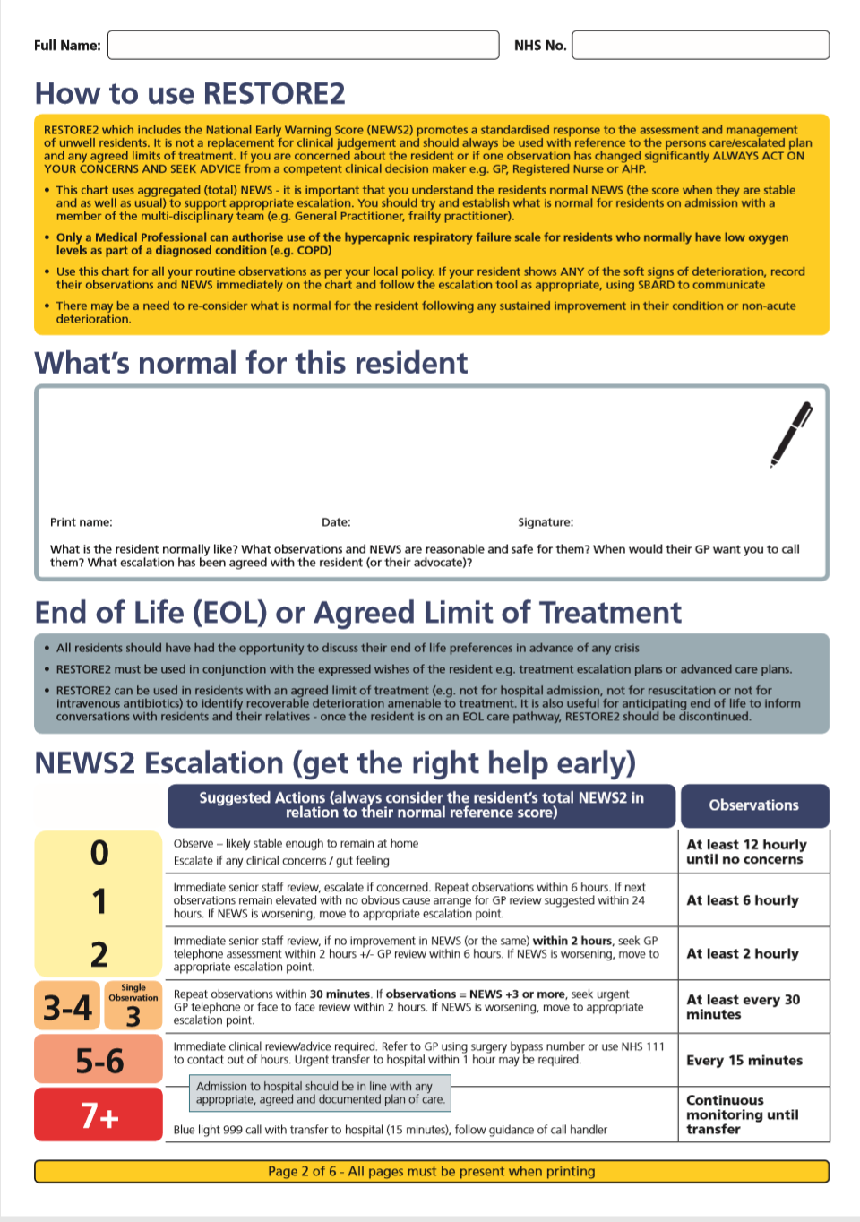
What is normal & NEWS2 Score
If any soft signs are noticed the care staff are then asked to compare these to what is normal for that patient. Things to consider include;
What is the resident normally like?
What is the residents observations normally?
What escalation has been agreed by the GP?
When the care staff has assessed the above and feel that the patient is showing differing signs to normal a full set of observations are taking and a NEWS2 score calculated.

Slide 8
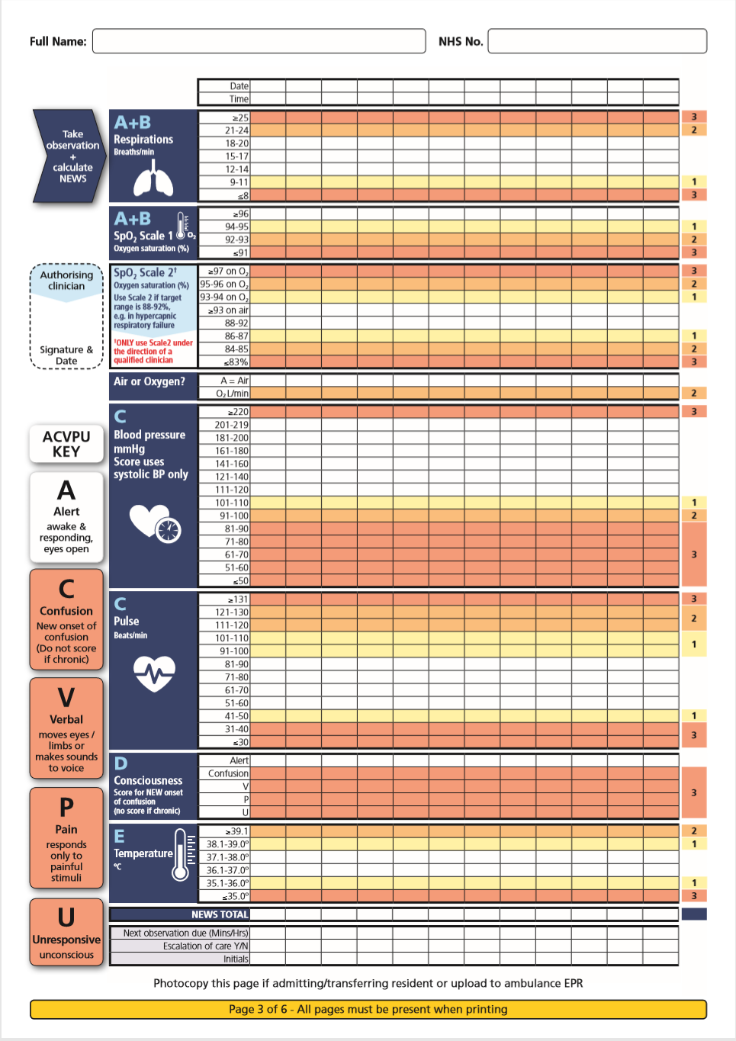
NEWS2 Score
A NEWS2 will be calculated as a method of assessing a patient with any signs of possible deterioration. This will then be assessed against a score from when the patient was deemed well.
The NEWS2 Score can then be used to monitor a patient who there are concerns about.
The care staff will not be taking observations nor calculating a NEWS2 score when the patient is well.

Slide 9
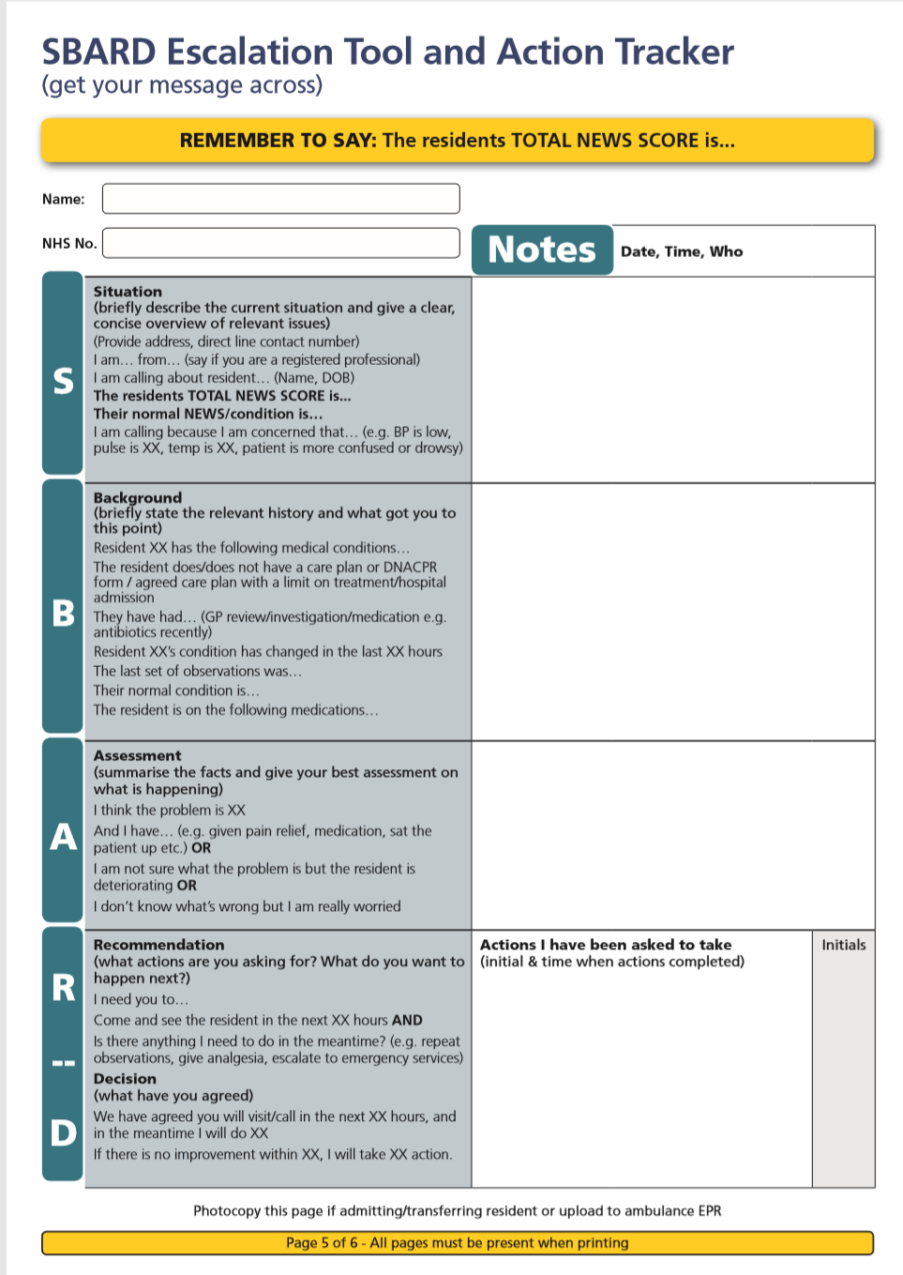
Communication Tool
Care staff are being trained to use the SBARD escalation tool and action tracker to help with communication. Evidence shows that use of the SBARD tool helps with communication, confidence and patient safety.
Once care staff have attended the RESTORE2 training please expect them to discuss their concerns with you in the following format:
Situation
Background
Assessment
Recommendation
Care staff will then document
Decision that has been agreed

Slide 10
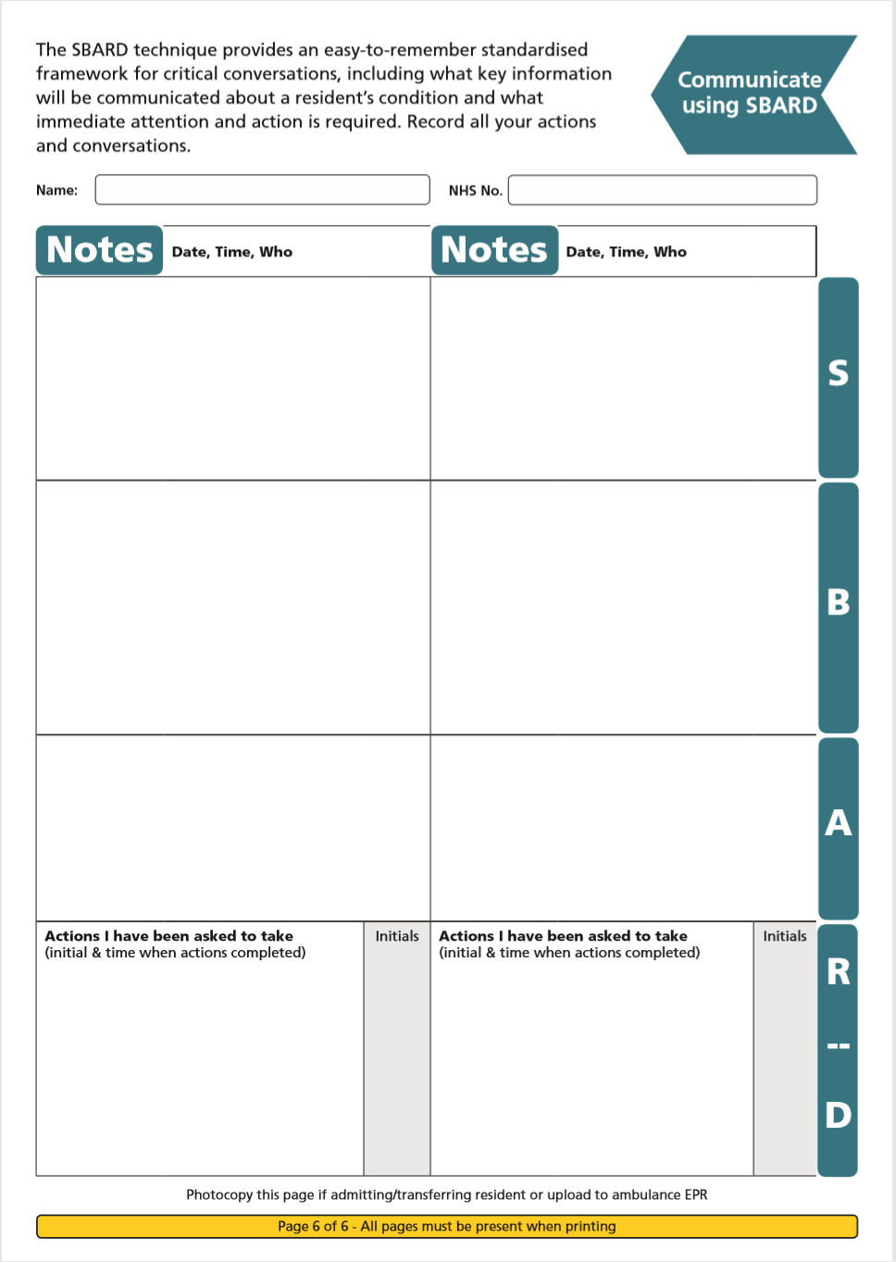
Communication Tool
It may take time for care staff to feel comfortable with using this tool. Please support them in doing so.
The RESTORE2 documentation has a page for notes to help them use this tool.

Slide 11

In settings where it isn’t possible to take clinical observations, the RESTORE2™ Mini is used.
The RESTORE2™ Mini is a ‘soft signs’ only version of the RESTORE2™ tool. It is targeted towards;
  Domiciliary Carers
  Informal Carers

Slide 12
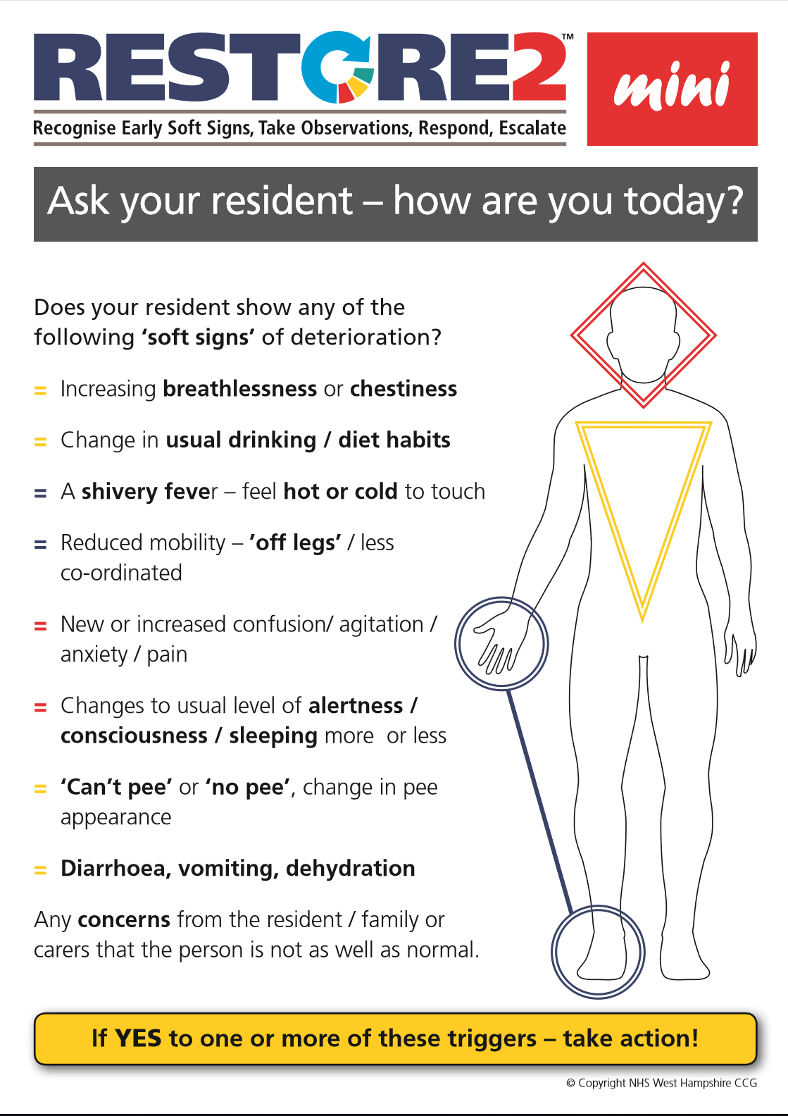
Soft Signs
Care staff are initially asked to review their patient on a regular basis and look for any possible soft signs of a deteriorating patient.

Slide 13
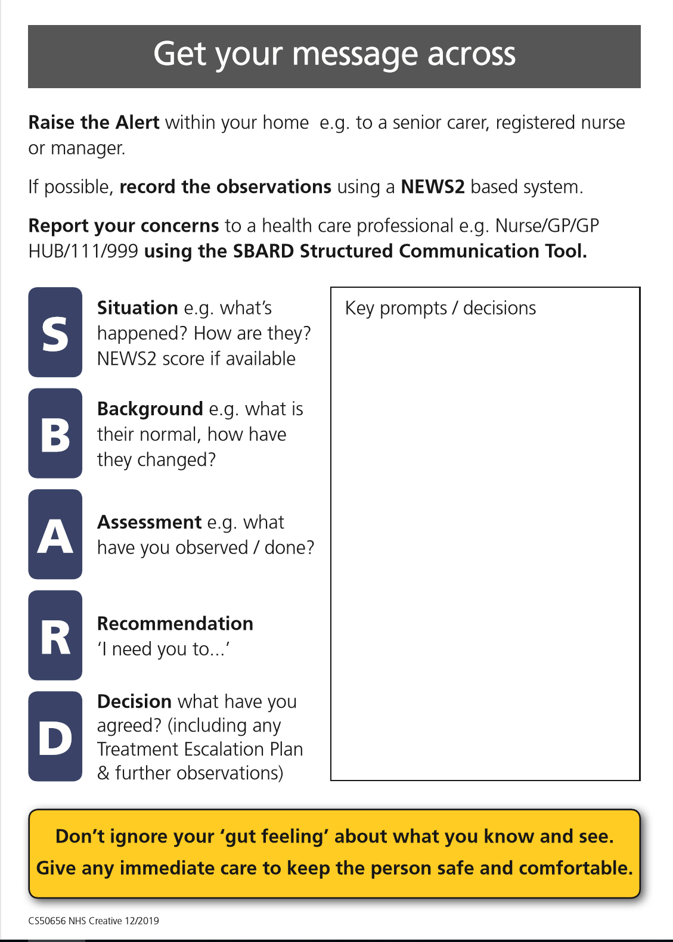
Communication Tool
Care staff are being trained to use the SBARD escalation tool and action tracker to help with communication. Evidence shows that use of the SBARD tool helps with communication, confidence and patient safety.
Once care staff have attended the RESTORE2 training please expect them to discuss their concerns with you in the following format:
Situation
Background
Assessment
Recommendation
Care staff will then document
Decision that has been agreed

Slide 14
General Practice protocol
Your practice can or may have developed a protocol for you to use in order to help you react appropriately to messages coming in using the RESTORE2 escalation tool
It is important to remember that this tool is to help clinical staff decide how to respond to deteriorating patients including doing remote consultations, home visits or even admission of the patient to hospital if appropriate
Therefore if you receive a SBARD message about RESTORE 2 from a carer you will need to take some action promptly.
Note: 2 Covid 19 symptoms: temperature and respiratory rate may not trigger a NEWS2 Score, however silent hypoxia has been seen in patients, so many homes are now measuring Oxygen Saturation. It is important to note that an unwell resident may have a normal NEWS score.

Slide 15
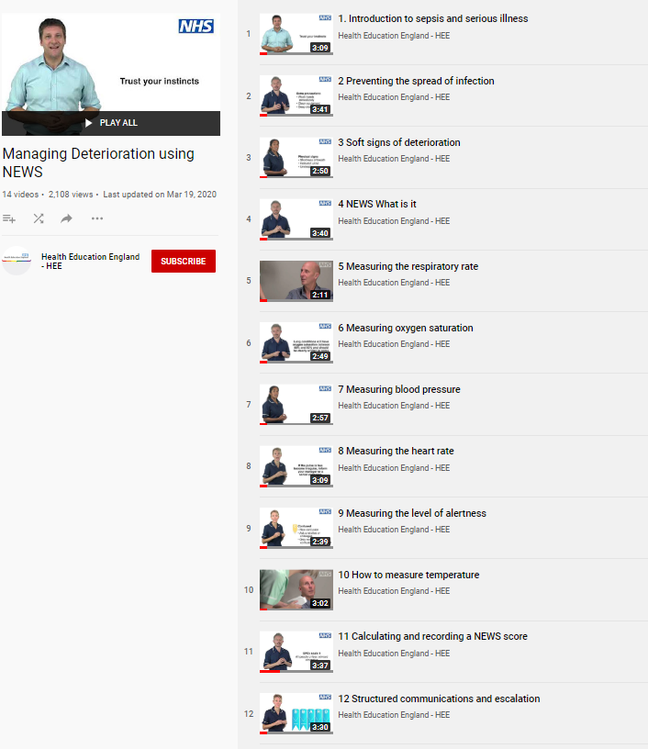
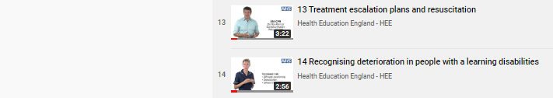
REFERENCES AND RESOURCES
Wessex AHSN and West of England AHSN have collaborated with West Hampshire CCG (RESTORE2) and Health Education England to produce a series of free videos and e-learning materials to support staff working in care homes to care for residents who are at risk of deterioration.
The full set of 14 Managing Deterioration Videos can be accessed via: https://wessexahsn.org.uk/projects/358/care-home-training-resources and individual videos applicable to the use of RESTORE2mini are flagged below with a green tick ( ) and indicated on the relevant slides.
✓
Linking the Managing Deterioration Videos and RESTORE2
Spotting serious illness and sepsis
Some people are more at risk than others of becoming unwell very quickly and developing a serious illness such as sepsis. This is known as ‘deterioration’ and it is important that anyone who cares for individuals who are at risk of deterioration knows how to spot the signs, especially during the current COVID-19 outbreak.
Watch this film
  Introduction to sepsis and serious illness
Soft Signs and What’s Normal
What to look out for when it is not appropriate to take measurements of a person’s vital signs.
The RESTORE2 mini tool is helpful in these situations.
A white paper from Geoff Cooper at Wessex AHSN looks at using soft signs to identify deterioration.
Watch these films
  Preventing the spread of infection
  Soft signs of deterioration
  Recognising deterioration with a learning disability
Take Observations
The National Early Warning Score is used by GPs, ambulance services and acute hospital trusts.
RESTORE2 makes NEWS2 more accessible to care and nursing homes.
Watch these films
  NEWS: What is it?
  Measuring the respiratory rate
  Measuring oxygen saturation
  Measuring blood pressure
  Measuring the heart rate
  Measuring level of alertness
  How to measure temperature
  Calculating and recording a NEWS score
Escalate and Communicate
Effective communication is vital for safety critical messages between different healthcare staff
Watch these Films
  Structured communication and escalation
  Treatment escalation plans and resuscitation
✓
✓
✓
✓

Slide 16
RESOURCES contd…
What? | For who? | Where? | Who runs/delivers? | When?
RESTORE2 Primary Care and Care Home case studies, resources, videos | Primary care, care homes, carers | https://westhampshireccg.nhs.uk/restore2/restore2-training-and-resources/ | West Hampshire CCG | NA
RESTORE2Mini on-line Training | All care providers and carers | TBC | Bluestream & SW AHSN | 24/7
RESTORE2 Familiarization powerpoint 1 | GP and Clinical Staff | On the Devon Training Hub (see below) | Individual GP practice | TBC
RESTORE2 Training Package powerpoint 2 | Non-Clinical GP staff | On the Devon Training Hub (See below) | Devon CCG/trainer | TBC
Please note these are accessible on the Devon Training Hub https://www.devontraininghub.co.uk/

Slide 17
Training for Carers in your county
DEVON
RESTORE2 and RESTORE2Mini training in the Southern region of Devon is being delivered by Torbay and South Devon Trust Department of Education. To find out more information please contact sarah.couth@nhs.net, Centre Co-ordinator & Administrator
For RESTORE2 training in the rest of Devon please contact the Devon Clinical Commissioning Group (CCG) at D-CCG.PersonalHealthBudgets@nhs.net

Slide 18
Conclusion
We hope this training has enabled you to understand more about RESTORE2 and RESTORE2 Mini
With training taking place in your area please expect to notice some changes to the information you receive from care staff
Please support your local care staff with this change
If you have any questions please contact patientsafety@swahsn.com

