Slide 1

RESTORE2 and RESTORE2 Mini
Training for non -clinical Staff in Primary Care

Slide 2

What is

Slide 3
RESTORE2 is a physical deterioration and escalation tool for care/nursing homes
It is designed to support homes to:
Recognise when a resident may be deteriorating or at risk of physical deterioration
Act appropriately according to the residents care plan
Obtain a complete set of physical observations to inform escalation and conversations with health professionals
Speak with the most appropriate health professional in a timely way
Provide a concise escalation history to health professionals to support their professional decision making
Get staff and residents the right support in the right timescale

Slide 4
RESTORE2
As a non clinical staff member you may receive phone calls from carers either working in care homes or in patients’ own homes regarding deterioration of their clients medical condition.
These care workers may have received training in how to use RESTORE 2 or RESTORE2 mini to assess their clients’ condition

Slide 5
RESTORE2 – Training of Carers
Since last year RESTORE2 training has been delivered to carers in some parts of the county
Carers who look after patients registered at your practice may have been trained how to use the tool
It is important you understand what the tool is so that you can communicate the information you are given about your patients to your GPs and clinical staff appropriately

Slide 6
RESTORE2
What are the main features of the RESTORE2
  Recognising soft signs that may indicate a patient is deteriorating
  NEWS score: This is a score that includes measurements taken that will indicate to clinical staff the condition of the patient.
  The care staff will only contact the GP practice if the patient is deteriorating and they need further help or advice

Slide 7
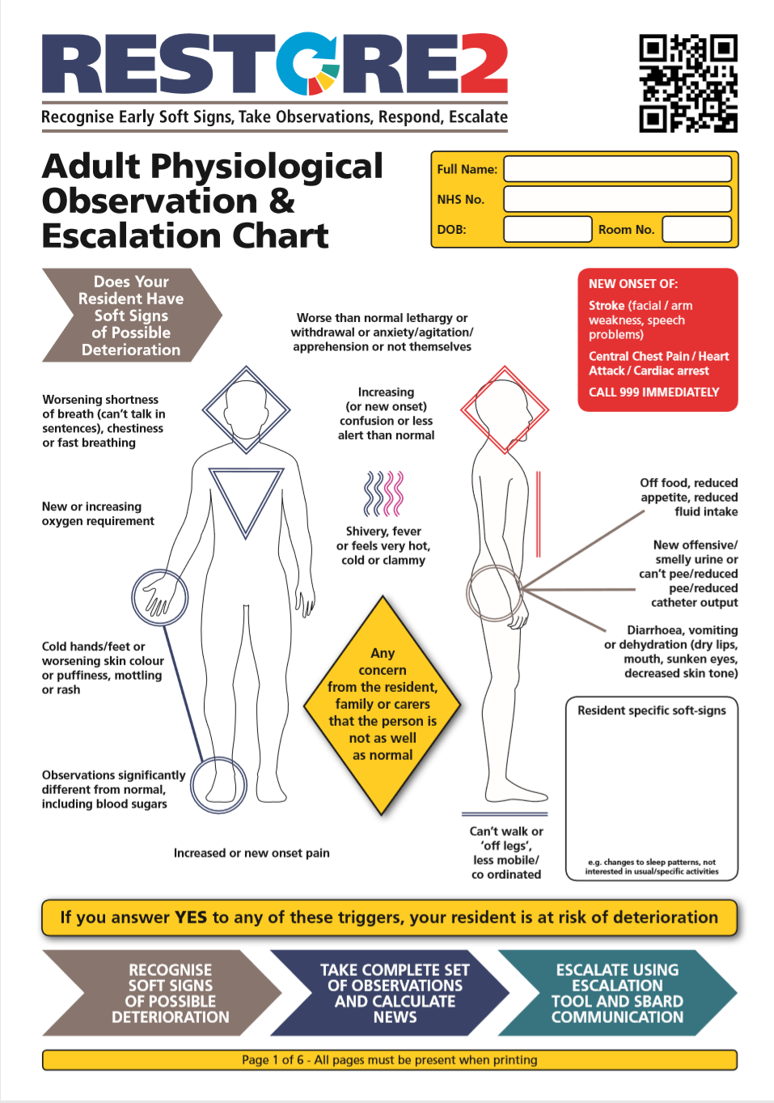
RESTORE2 Document
When carers within a care setting have completed training they will receive or be able to print off a copy of the RESTORE2 documentation. Each resident or person cared for at home will have their own personalised RESTORE2 documentation.
Soft Signs
Carers are initially asked to review their patient on a regular basis and look for any possible soft signs of a deteriorating patient.
Car

Slide 8
Communication tool
When the care staff member has completed their assessment and completed the RESTORE2 or RESTORE2 mini paperwork, if it is appropriate they will complete an escalation tool that they can email to the practice for attention of the GP or other clinician.
An example of this tool is on the following two slides

Slide 9
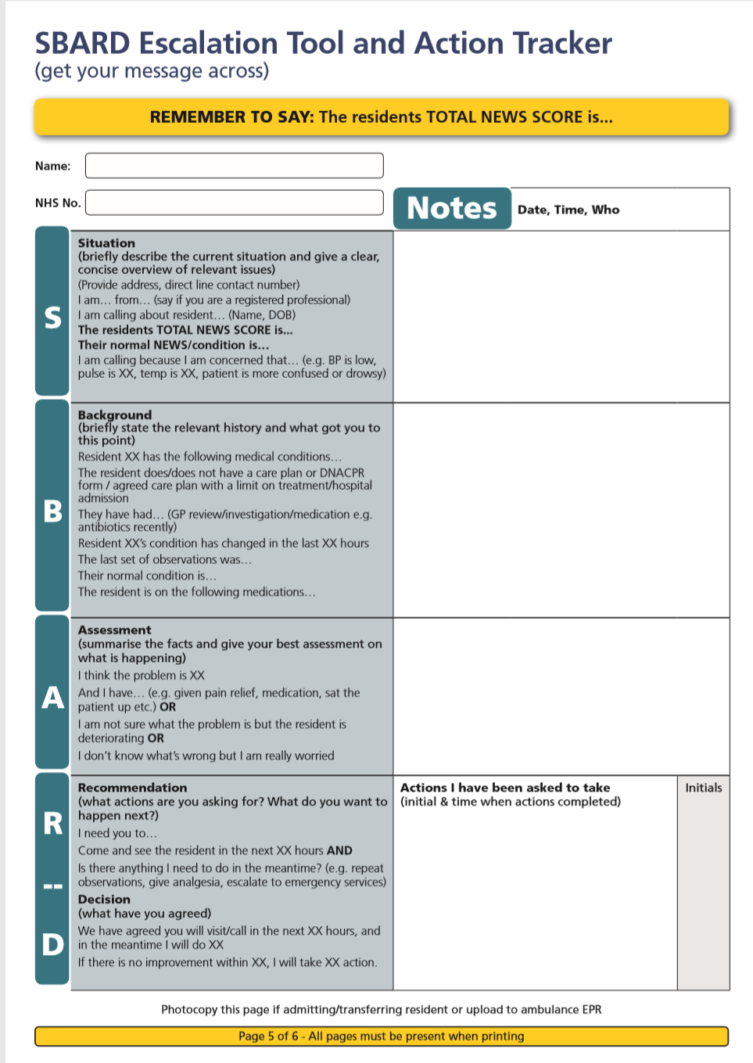
Communication Tool
Carers are being trained to use the SBARD escalation tool and action tracker to help with communication. Evidence shows that use of the SBARD tool helps with communication, confidence and patient safety.
Once carers have attended the RESTORE2 to training please expect them to discuss their concerns with you in the following format:
Situation
Background
Assessment
Recommendation
Carers will then document
Decision that has been agreed

Slide 10
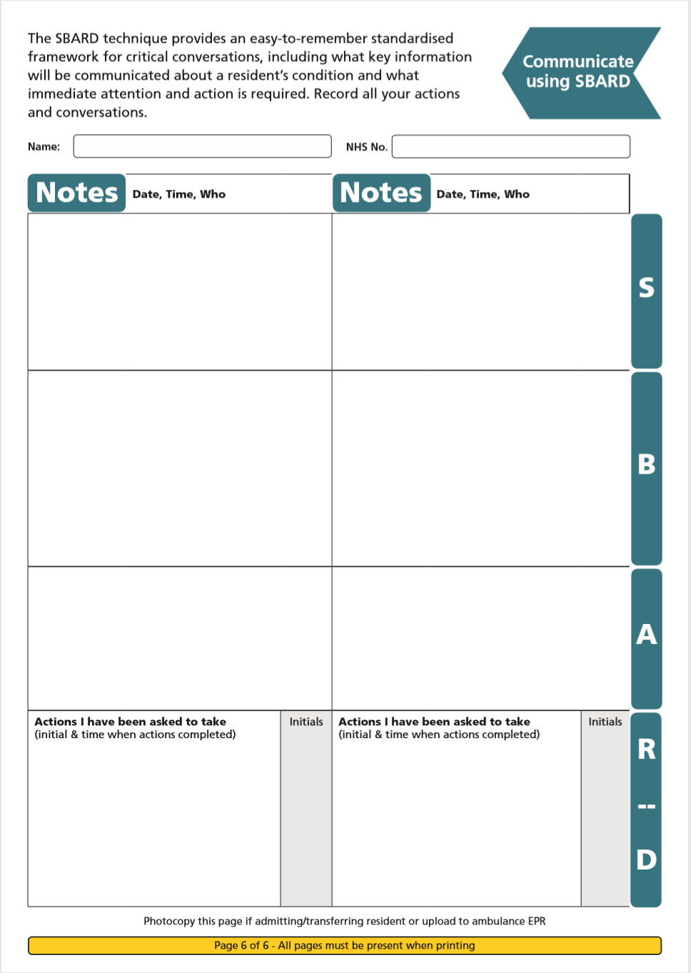
Communication Tool
It may take time for carers to feel comfortable with using this tool. Please support them in doing so.
The RESTORE2 documentation has a page for notes to help them use this tool.

Slide 11
Practice protocol
Your practice will have developed a protocol for you to use in order to help you react appropriately to messages coming in using the RESTORE2 escalation tool.
It is important to remember that this tool is to help clinical staff decide how to respond to deteriorating patients including doing remote consultations, home visits or even admission of the patient to hospital if appropriate
Therefore if you receive a message about RESTORE 2 from a carer you will need to take some action promptly.

Slide 12

In settings where it isn’t possible to take clinical observations, the RESTORE2™ Mini is used.
The RESTORE2™ Mini is a ‘soft signs’ only version of the RESTORE2™ tool. It is targeted towards;
  Residential home carers
  Domiciliary Carers
  Informal Carer

Slide 13
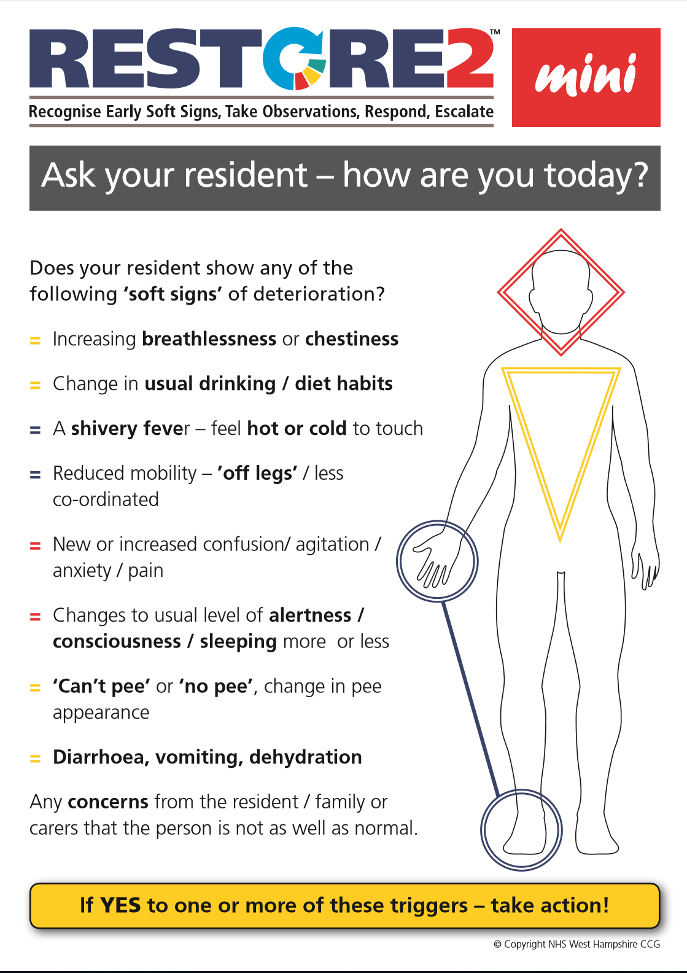
Soft Signs
Carers are initially asked to review their patient on a regular basis and look for any possible soft signs of a deteriorating patient.

Slide 14
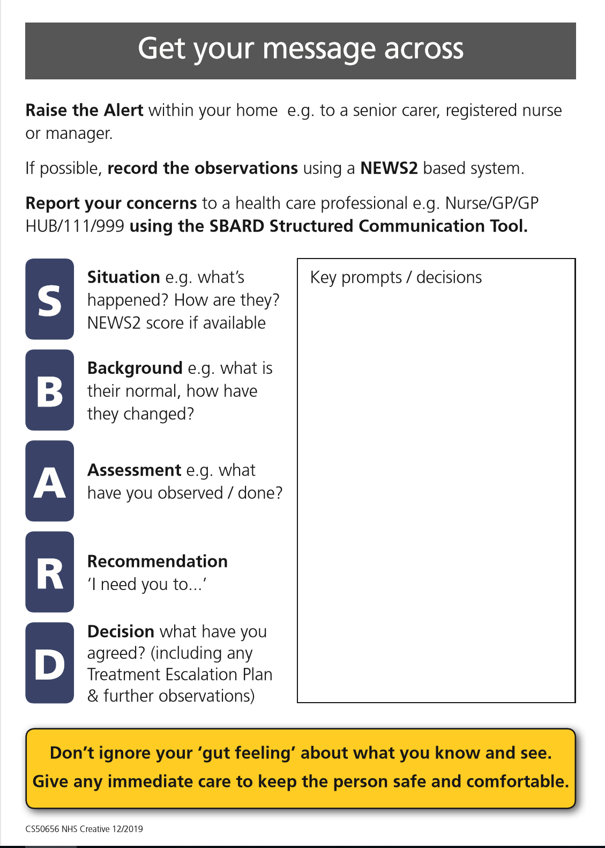
Communication Tool
Carers are being trained to use the SBARD escalation tool and action tracker to help with communication. Evidence shows that use of the SBARD tool helps with communication, confidence and patient safety.
Once carers have attended the RESTORE2 to training please expect them to discuss their concerns with you in the following format:
Situation
Background
Assessment
Recommendation
Carers will then document
Decision that has been agreed

Slide 15
SELF-CHECK QUIZ
What does RESTORE2 stand for?
What is RESTORE2 ? (in one sentence)
Why is early detection of deterioration important?
Name 2 benefits of RESTORE2
What does NEWS2 stand for?
What observations have different escalation trigger points during this Covid 19 pandemic?
Please attempt these questions – before moving onto the next slide.

Slide 16
SELF-CHECK QUIZ ANSWERS
1. What does RESTORE2 stand for?
See above.
2. What is RESTORE2 ?
RESTORE2TM is a physical deterioration and escalation package designed specifically for residential and nursing homes. It can also be used in the domiciliary care sector.
3. Why is early detection of deterioration important?
Gets the Right Help at the Right Time.
4. Name 2 benefits of RESTORE2
Keeps Residents SAFE, Avoids 999 Calls, Reduced Admissions
5. What does NEWS2 stand for?
National Early Warning Score
6. What observations have different escalation trigger points during this Covid 19 pandemic?
Temperature, Respiratory Rate. Silent Hypoxia (Low Oxygen Saturations) noted with Covid 19

Slide 17
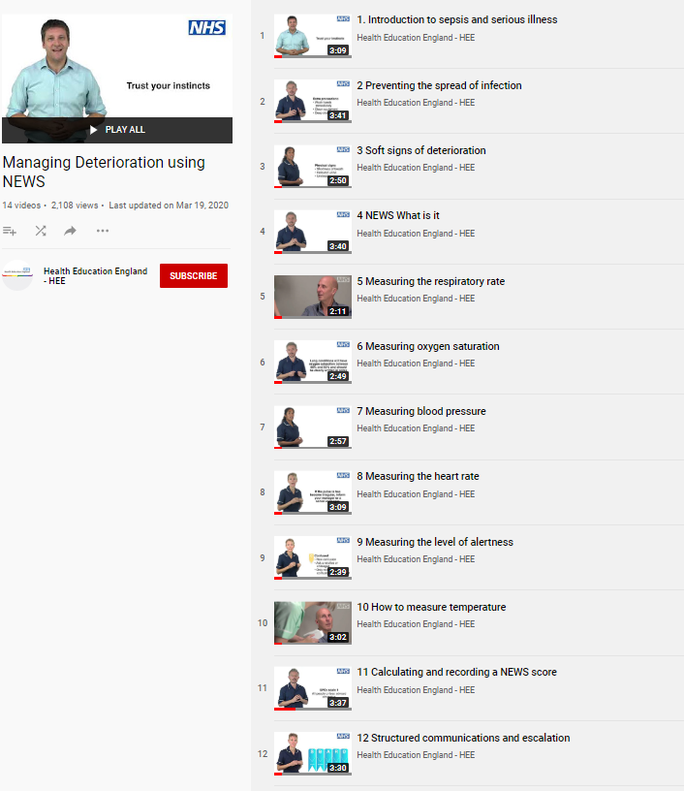

REFERENCES AND RESOURCES
Wessex AHSN and West of England AHSN have collaborated with West Hampshire CCG (RESTORE2) and Health Education England to produce a series of free videos and e-learning materials to support staff working in care homes to care for residents who are at risk of deterioration.
The full set of 14 Managing Deterioration Videos can be accessed via: https://wessexahsn.org.uk/projects/358/care-home-training-resources and individual videos applicable to the use of RESTORE2mini are flagged below with a green tick ( ) and indicated on the relevant slides.
✓
Linking the Managing Deterioration Videos and RESTORE2
Spotting serious illness and sepsis
Some people are more at risk than others of becoming unwell very quickly and developing a serious illness such as sepsis. This is known as ‘deterioration’ and it is important that anyone who cares for individuals who are at risk of deterioration knows how to spot the signs, especially during the current COVID-19 outbreak.
Watch this film
  Introduction to sepsis and serious illness
Soft Signs and What’s Normal
What to look out for when it is not appropriate to take measurements of a person’s vital signs.
The RESTORE2 mini tool is helpful in these situations.
A white paper from Geoff Cooper at Wessex AHSN looks at using soft signs to identify deterioration.
Watch these films
  Preventing the spread of infection
  Soft signs of deterioration
  Recognising deterioration with a learning disability
Take Observations
The National Early Warning Score is used by GPs, ambulance services and acute hospital trusts.
RESTORE2 makes NEWS2 more accessible to care and nursing homes.
Watch these films
  NEWS: What is it?
  Measuring the respiratory rate
  Measuring oxygen saturation
  Measuring blood pressure
  Measuring the heart rate
  Measuring level of alertness
  How to measure temperature
  Calculating and recording a NEWS score
Escalate and Communicate
Effective communication is vital for safety critical messages between different healthcare staff
Watch these Films
  Structured communication and escalation
  Treatment escalation plans and resuscitation
✓
✓
✓
✓

Slide 18
RESOURCES contd…
What? | For who? | Where? | Who runs/delivers? | When?
RESTORE2 Primary Care and Care Home case studies, resources, videos | Primary care, care homes, carers | https://westhampshireccg.nhs.uk/restore2/restore2-training-and-resources/ | West Hampshire CCG | NA
RESTORE2Mini on-line Training | All care providers and carers | TBC | Bluestream & SW AHSN | 24/7
RESTORE2 Familiarization powerpoint 1 | GP and Clinical Staff | On the Devon Training Hub (see below) | Individual GP practice | TBC
RESTORE2 Training Package powerpoint 2 | Non-Clinical GP staff | On the Devon Training Hub (See below) | Devon CCG/trainer | TBC
Please note these are accessible on the Devon Training Hub https://www.devontraininghub.co.uk/

Slide 19
Training for Carers in your county
DEVON
RESTORE2 and RESTORE2Mini training in the Southern region of Devon is being delivered by Torbay and South Devon Trust Department of Education. To find out more information please contact sarah.couth@nhs.net, Centre Co-ordinator & Administrator
For RESTORE2 training in the rest of Devon please contact the Devon Clinical Commissioning Group (CCG) at D-CCG.PersonalHealthBudgets@nhs.net

Slide 20
Conclusion
We hope this training has enabled you to understand more about RESTORE2 and RESTORE2 Mini
With training taking place in your area please expect to notice some changes to the information you receive from care staff
Please support your local care staff with this change
If you have any questions please contact patientsafety@swahsn.com

