Slide 1

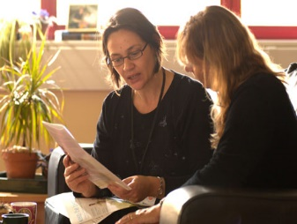
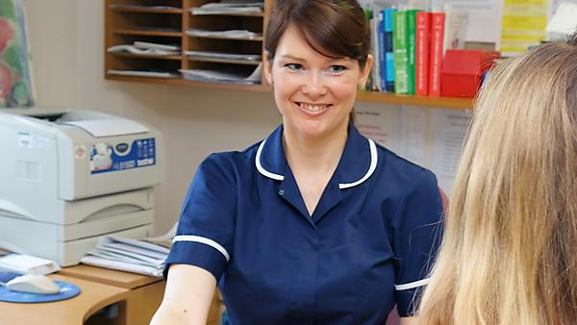
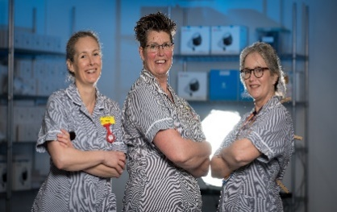
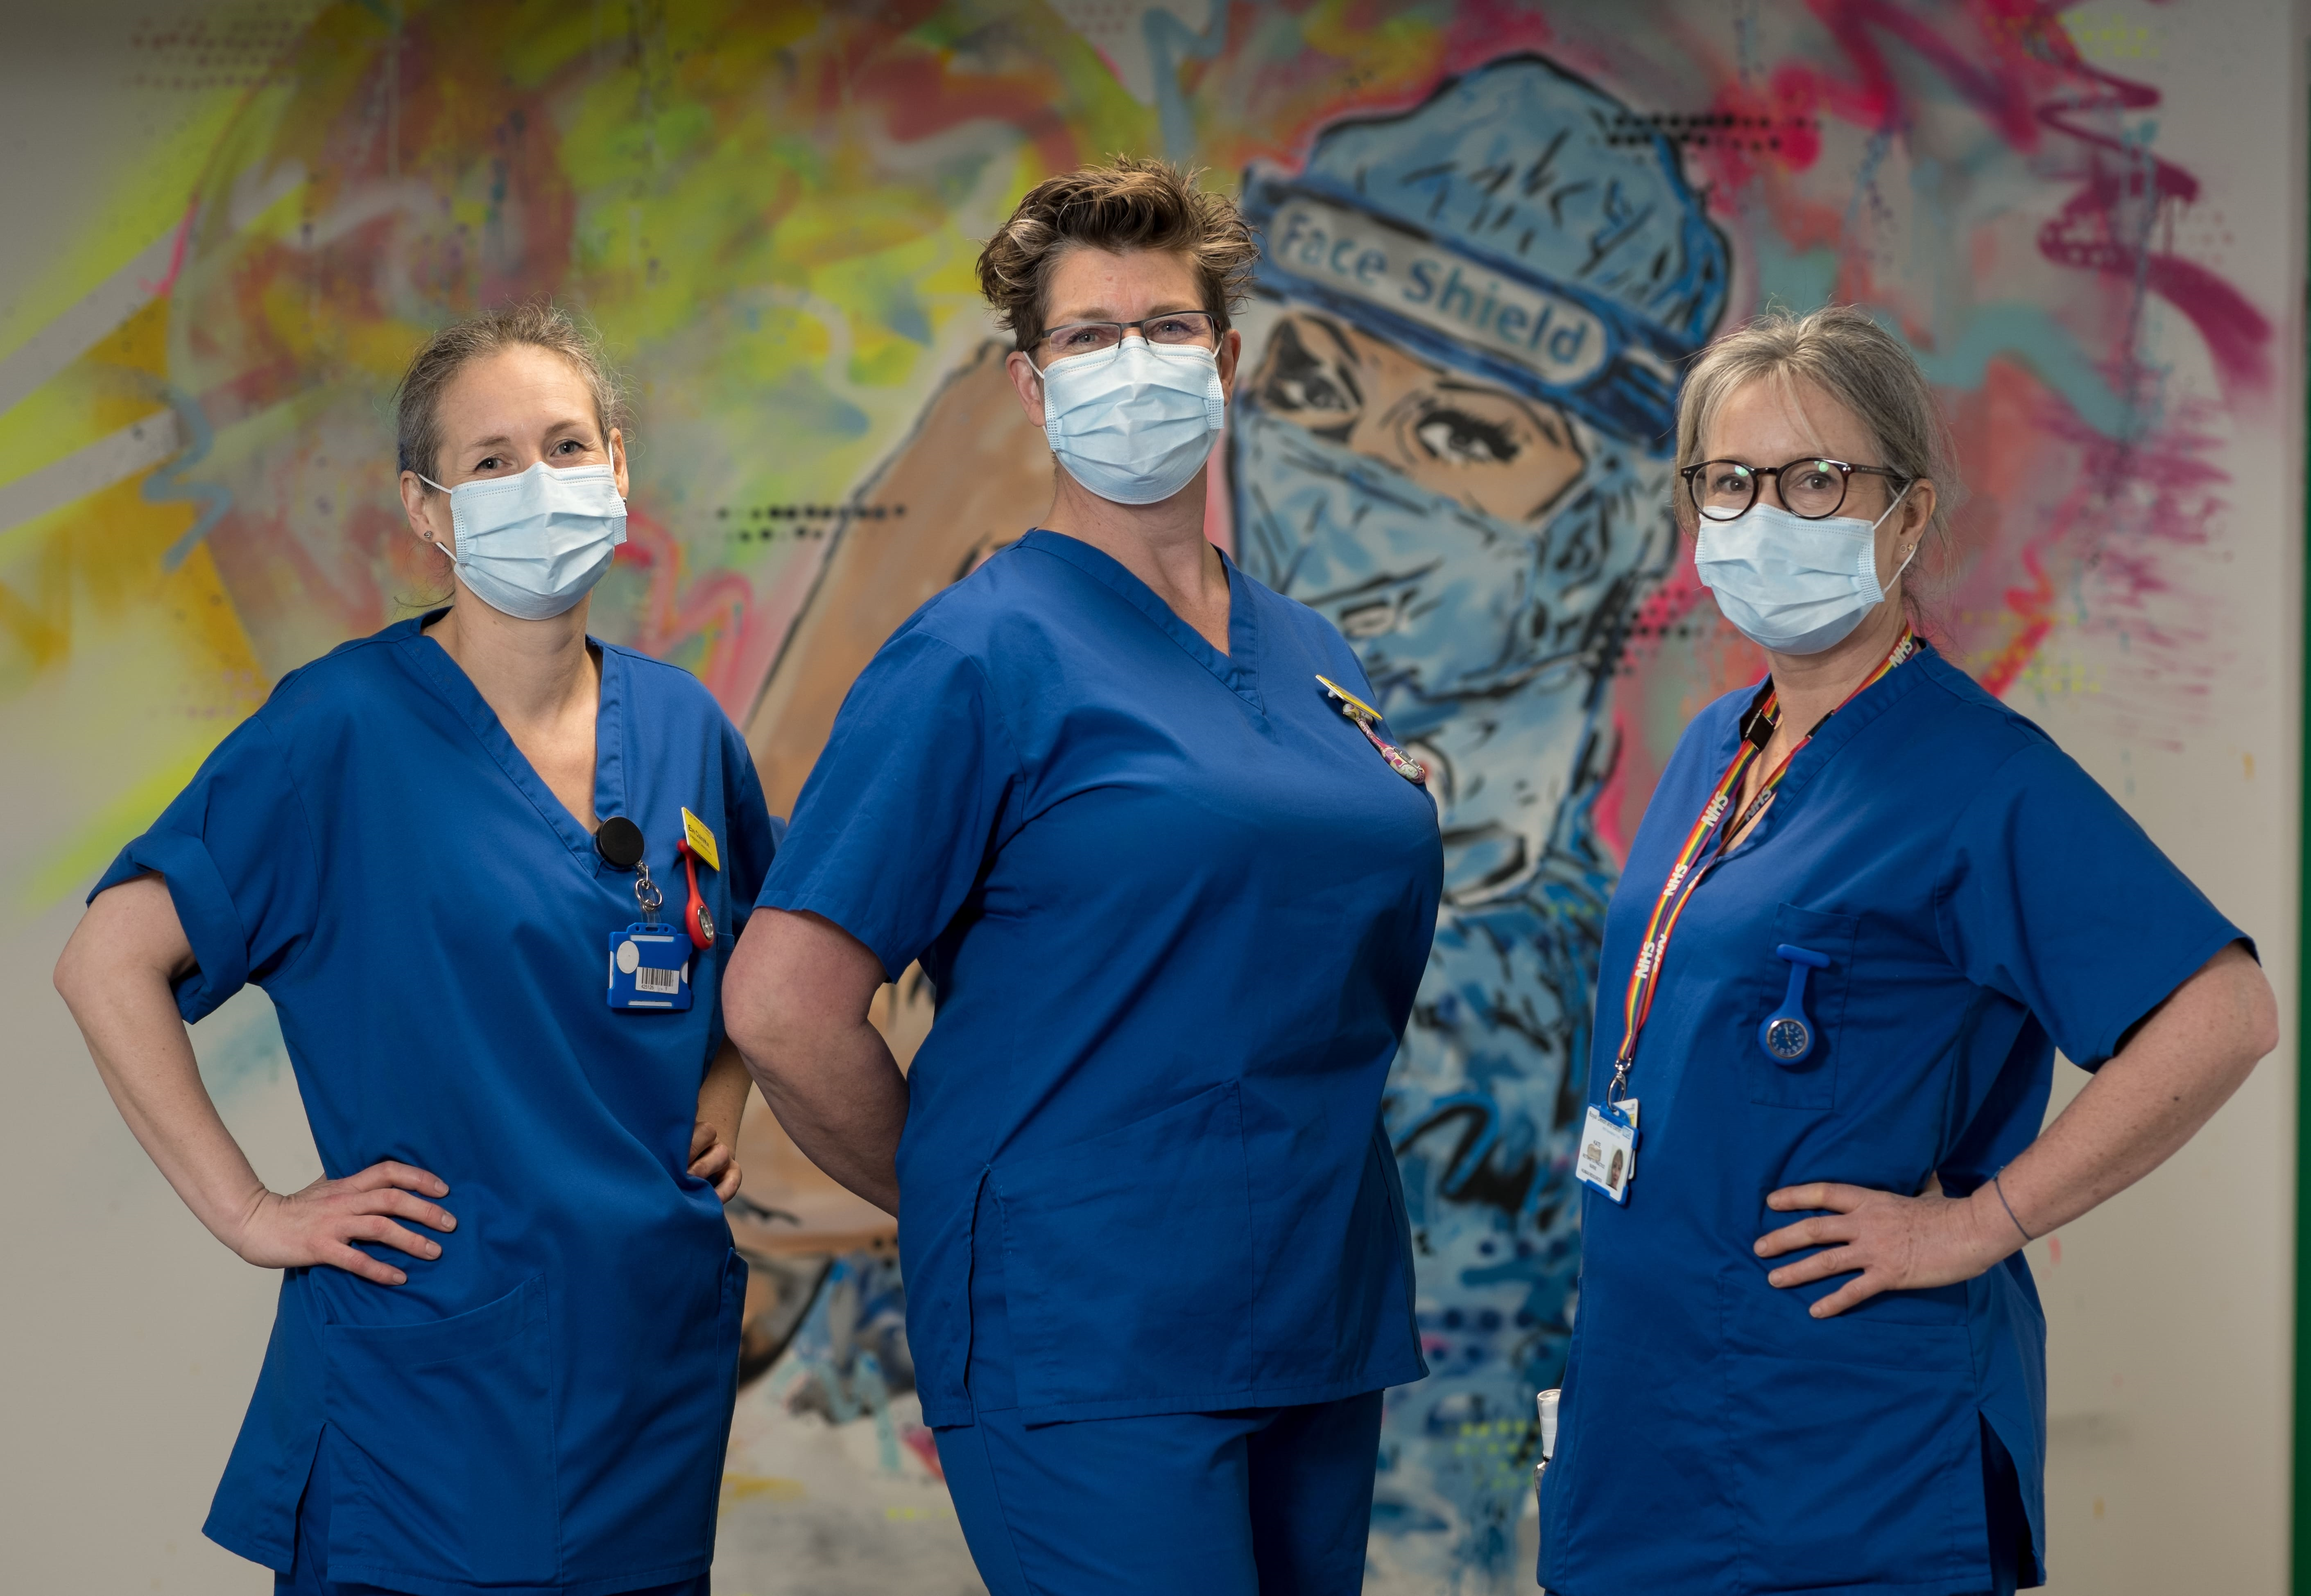

Advancing knowledge, transforming lives
Return to GP Practice Nursing
The University of Plymouth provide a highly successful Return to Practice Courses for the Southwest and invite you to consider “re-growing your own” registered nurses.
All Return to Practice students are required to undertake 450 hours of supervised clinical practice, which can be part time or full time, they could be in paid HCa Roles with protected Learning or Supernumerary
Course fees are paid for by Health Education England, Placements receive £500 and £1000 for the student to support learning.
*Those who have been working as Health Care assistants or joined the NMC Emergency Register can have up to 100 hours accredited to accelerate to registration.
The theoretical aspect of the course will run alongside a practice placement over 16 weeks either from September or February and will include: A mixture of 5 virtual taught days, 3 field specific days and relevant E-learning.
For Further information please go to our website or contact the Programme Lead Adele.kane@plymouth.ac.uk
Student to Staff Nurse in 5 months
Notes:
The University of Plymouth has for over 15 years, provided Nursing and Midwifery Council Approved, Health Education England contracted, Return to Practice programmes for Nurses, Midwives, and Specialist Community Public Health Nurses (SCPHN). Enabling them to return to the Nursing and Midwifery (NMC) register, in support of local workforce development.

